Slide 1
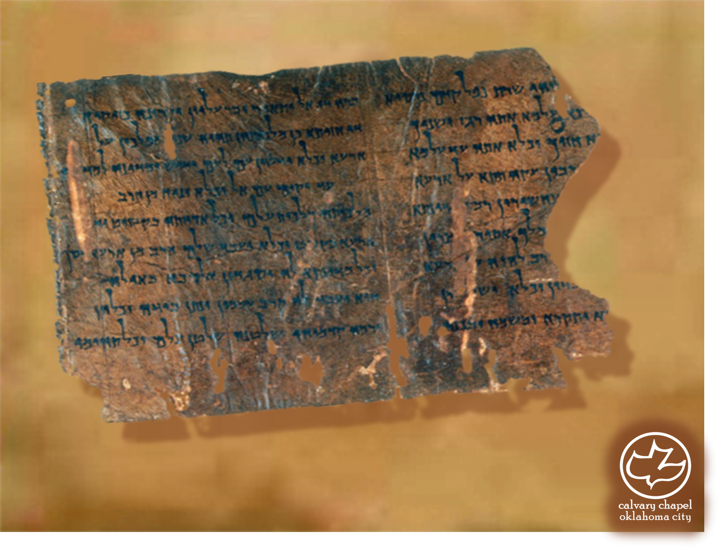

Minor Prophets … Major Message:
Zephaniah 1:1-3:20
A CD of this message will be available (free of charge) immediately following today's message
This message will be available via podcast later this week at calvaryokc.com

Slide 2
Zephaniah 1:1-3:20
Josiah
640BC
630BC
620BC
610BC
600BC
590BC
Zephaniah
Habakkuk
Jeremiah

Slide 3
Zephaniah 1:1-3:20
His name means Jehovah hides or treasures

Slide 4
Zephaniah 1:1-3:20
Idolatrous priests ~ KJV, chemarims
Milcom ~ another name for Molech

Slide 5
Zephaniah 1:1-3:20
1st of 19 references to the Day of the Lord in Zephaniah

Slide 6
Zephaniah 1:1-3:20
Maktesh ~ NIV, market district
From word meaning hollowed out
Cut down ~ NIV, wiped out – literally Undone (same as Is. 6:5)

Slide 7
Zephaniah 1:1-3:20
Settled ~ qaphaw – to thicken or curdle (usually translated congeal)
KJV ~ and punish the men that are settled on their lees: that say in their heart, The LORD will not do good, neither will he do evil.
NIV ~ and punish those who are complacent, who are like wine left on its dregs, who think, “The LORD will
do nothing, either good or bad.”

Slide 8
Zephaniah 1:1-3:20
Rev. 3:16 ~ So then, because you are lukewarm, and neither cold nor hot, I will vomit you out of My mouth.

Slide 9
Zephaniah 1:1-3:20
Undesirable ~ better, NASB - shameless ~ NIV - shameful
Nation ~ goy

Slide 10
Zephaniah 1:1-3:20
One accord ~ literally one shoulder

Slide 11
Zephaniah 1:1-3:20
KJV ~ The LORD thy God in the midst of thee is mighty; He will save, He will rejoice over thee with joy; He will rest in his love, He will joy over thee with singing.

Slide 12
Zephaniah 1:1-3:20
C. H. Spurgeon ~ “If God sings, shall not we sing? He did not sing when he made the world. No; he looked upon it, and simply said that it was good. The angels sang, the sons of God shouted for joy: creation was very wonderful to them, but it was not much to God, who could have made thousands of worlds by his mere
will. Creation could not make him sing . . . When all was done, and the Lord saw what became of it in the salvation of his redeemed, then he rejoiced after a divine manner.”

