Slide 1
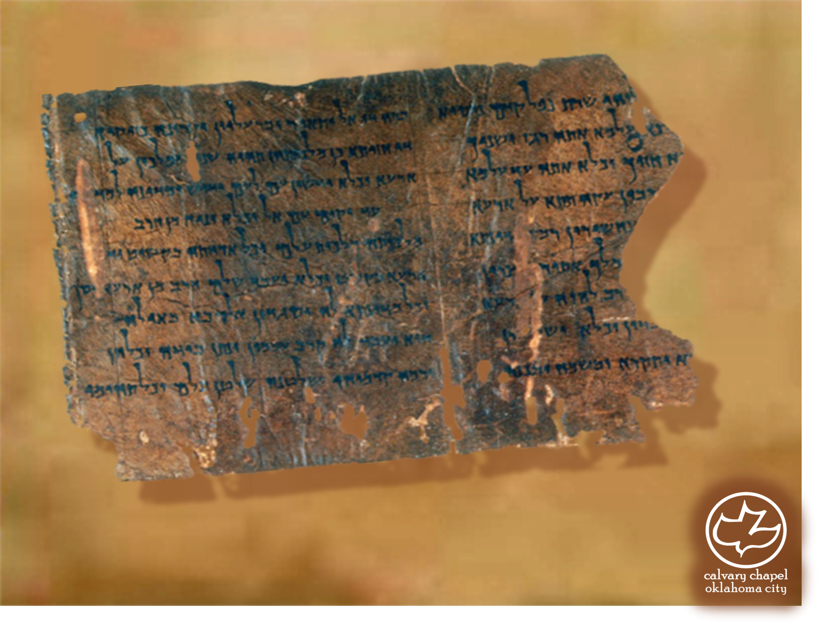

Minor Prophets … Major Message:
Zechariah 12:1-13:7
A CD of this message will be available (free of charge) immediately following today's message
This message will be available via podcast later this week at calvaryokc.com

Slide 2
Zechariah 12:1-13:7
1 Thess. 5:1 ~ But concerning the times and the seasons, brethren, you have no need that I should write to you.

Slide 3
Zechariah 12:1-13:7
Three types of Millennialism:
Amillennialism: Belief there will be a continuous parallel of good and evil in the world between the 1st and 2nd Coming of Christ. The Kingdom of God is now present in the world through the Word, His Spirit and His Church.

Slide 4
Zechariah 12:1-13:7
Three types of Millennialism:
Postmillennialism: Belief the Kingdom of God is now extended through teaching, preaching and evangelism. The world is to be Christianized resulting in a long period of peace and prosperity, followed by Christ’s return.

Slide 5
Zechariah 12:1-13:7
Three types of Millennialism:
Premillennialism: Belief in the concept of two-stages in the Coming of Christ. He will come for His Church (Rapture) and then with His Church (Revelation). There is a consistent distinction between Israel and the Church throughout history.

Slide 6
Zechariah 12:1-13:7
Preterism (from a Latin word, praeter, for past):
"A Christian belief system in which some or all of the end-time events specified in the New Testa-ment (including the Apocalypse) are believed to have already been fulfilled. They were accomplished in the past, particularly during the Roman-Jewish war of AD 66 to
AD73."

Slide 7
Zechariah 12:1-13:7
Ezekiel War?
Rapture
Abomination of Desolation
Return of Christ
Rise of Antichrist
Time of Jacob’s Troubles
Church Age
Millennium
7 year Tribulation

Slide 8
Zechariah 12:1-13:7
May 14, 1948
1967 6-Day War
1973 Yom Kippur War

Slide 9
Zechariah 12:1-13:7
Rom. 11:25-26a ~ ²⁵ For I do not desire, brethren, that you should be ignorant of this mystery, lest you should be wise in your own opinion, that blindness in part has happened to Israel until the fullness of the Gentiles has come in. ^{26a} And so all Israel will be saved …
Grieve ~ NASB, weep bitterly; NIV, grieve bitterly

Slide 10
Zechariah 12:1-13:7
C. H. Spurgeon ~ “It is a beautiful remark of an old divine, that eyes are made for two things at least; first, to look with, and next, to weep with. The eye which looks to the pierced One is the eye which weeps for him.”

Slide 11
Zechariah 12:1-13:7
John 4:13-14 ~ ¹³ Jesus answered and said to her, "Whoever drinks of this water will thirst again, ¹⁴ but whoever drinks of the water that I shall give him will never thirst. But the water that I shall give him will become in him a fountain of water springing up into everlasting life."
In that day ~ 10x in last two
chapters

Slide 12
Zechariah 12:1-13:7
Thrust through ~ NIV, stab

Slide 13
Zechariah 12:1-13:7
Lev. 19:28 ~ You shall not make any cuttings in your flesh for the dead, nor tattoo any marks on you: I am the LORD.
NIV ~ What are these wounds on your body?
KJV, What are these wounds in thine hands?

Slide 14
Zechariah 12:1-13:7
Companion – literally near relative or equal

Slide 15
Zechariah 12:1-13:7
C. H. Spurgeon (sermon dated June 19, 1864) “We know of a surety, because God has said it, that the Jews will be restored to their own land, and that they shall inherit the goodly country which the Lord has given unto their fathers by a covenant of salt forever; but, better still, they shall be converted to the faith of our Lord Jesus Christ, and shall see in him the house of David restored to the throne
of Israel.”

