Slide 1
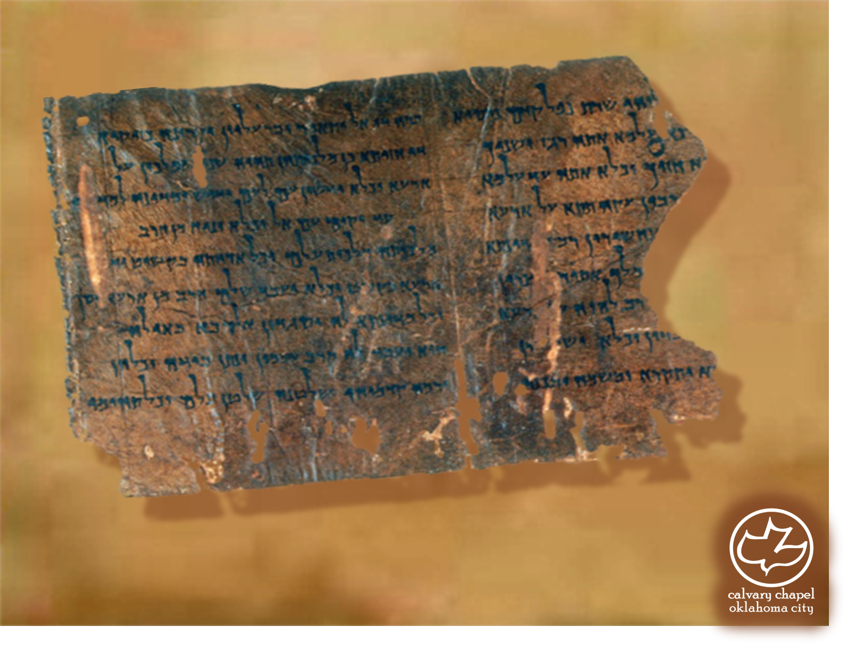

Minor Prophets … Major Message:
Zechariah 10-11
A CD of this message will be available (free of charge) immediately following today's message
This message will be available via podcast later this week at calvaryokc.com

Slide 2
Zephaniah 10-11
Idols ~ teraphim – plural of raphah (to heal)
Delusion ~ KJV, vanity
Message ~ Store-bought gods babble gibberish. Religious experts spout rubbish. They pontificate hot air. Their prescriptions are nothing but smoke.

Slide 3
Zephaniah 10-11
Goatherds ~ NASB, male goats; NIV, leaders

Slide 4
Zephaniah 10-11
Ruler ~ hagas – to drive or tyrannize

Slide 5
Zephaniah 10-11
Rom. 8:19-22 ~ ¹⁹ For the earnest expectation of the creation eagerly waits for the revealing of the sons of God. ²⁰ For the creation was subjected to futility, not willingly, but because of Him who subject-ed it in hope; ²¹ because the creation itself also will be delivered from the bondage of corruption into the glorious liberty of the children of God. ²² For we know that the whole creation groans and labors with birth pangs together until now.

Slide 6
Zephaniah 10-11
John 19:15 ~ But they cried out, "Away with Him, away with Him! Crucify Him!" Pilate said to them, "Shall I crucify your King?" The chief priests answered, "We have no king but Caesar!"

Slide 7
Zephaniah 10-11
Beauty ~ Grace
Bonds ~ Union

Slide 8
Zephaniah 10-11
Three shepards ~ Prophet, Priest and King?
Pharisees, Sadducees and Herodians?

Slide 9
Zephaniah 10-11
Poor ~ same word as 9:9 (lowly)
Matt. 5:3 ~ Blessed are the poor in spirit, For theirs is the kingdom of heaven.

Slide 10
Zephaniah 10-11
Ex. 21:32 ~ If the ox gores a male or female servant, he shall give to their master thirty shekels of silver, and the ox shall be stoned.

Slide 11
Zephaniah 10-11
Princely ~ from word for glorious
NASB ~ magnificent

Slide 12
Zephaniah 10-11
David Guzik ~ "A potter’s field was a piece of useless land where he threw his broken, damaged, and rejected pots. Jesus really did purchase the potter’s field - the place where broken, rejected, and useless people like us are scattered."

Slide 13
Zephaniah 10-11
Worthless ~ KJV, idol

