Slide 1
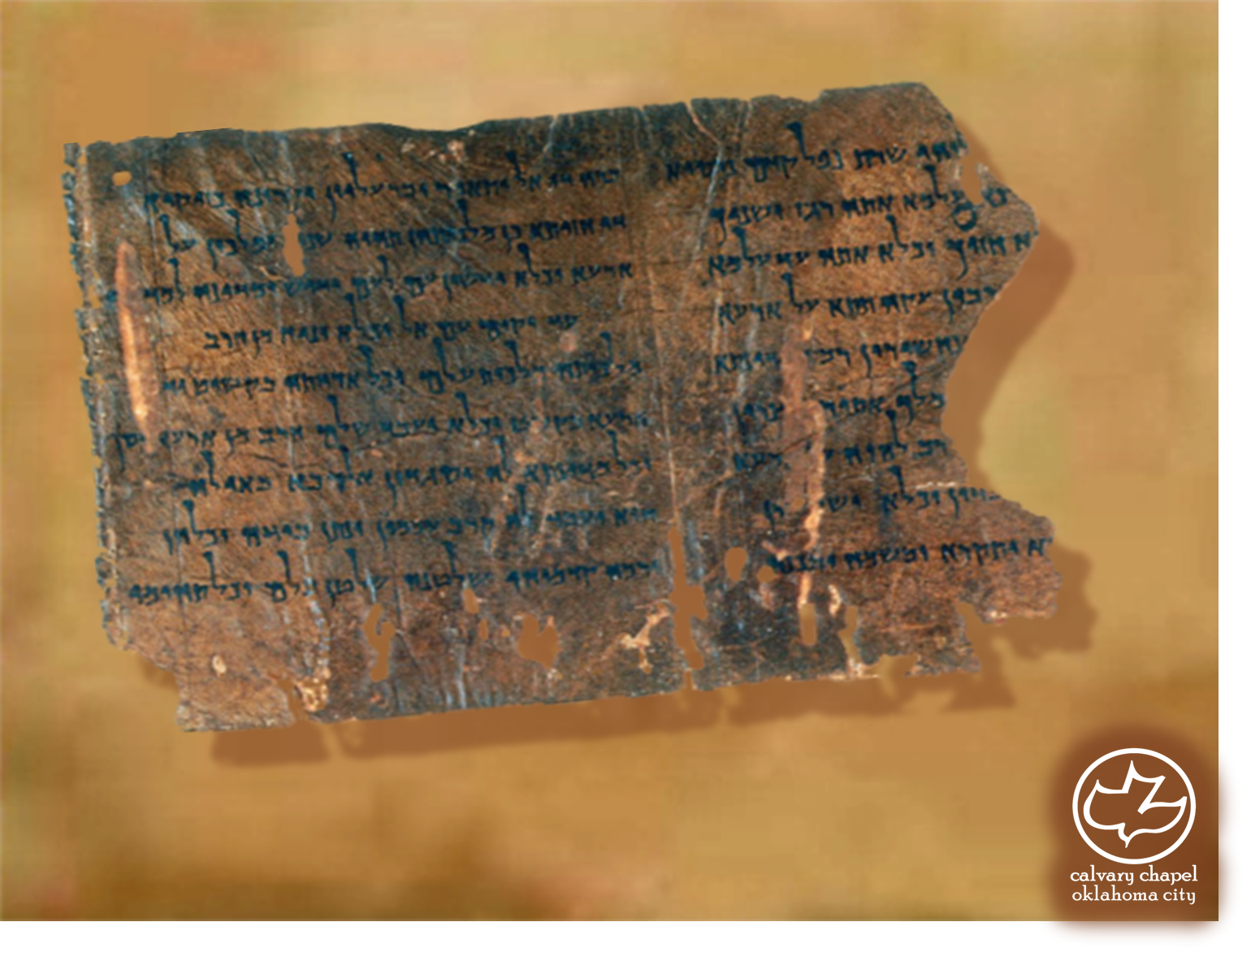

Minor Prophets … Major Message:
Zechariah 8-9
A CD of this message will be available (free of charge) immediately following today's message
This message will be available via podcast later this week at calvaryokc.com

Slide 2
Zechariah 8-9
Date
Event
Ref.
17 Tammuz
Mourning the capture of Jerusalem
Jer. 52:6-30
Burning of Jerusalem and the destruction of Solomon’s Temple
9 Av
2 Kg. 25:2-10
Assassination of Gedaliah and the massacre of 80 men
3 Tishri
Jer. 4:1-10
Beginning of Nebuchadnezzar’s siege against Jerusalem
10
Tevet
2 Kg. 25:1

Slide 3
Zechariah 8-9
Zechariah means "Jehovah remembers"

Slide 4
Zechariah 8-9
Shalmanezer laid siege for 5 years
Nebuchadnezzar laid siege for 13 years
Alexander the Great took 7 months

Slide 5
Zechariah 8-9
Zech. 9:9 ~ Rejoice greatly, O daughter of Zion!
Shout, O daughter of Jerusalem!
Behold, your King is coming to you;
He is just and having salvation,
Lowly and riding on a donkey,
A colt, the foal of a donkey.
Matt. 21:5 ~ Tell the daughter of Zion,
"Behold, your King is coming to you,
Lowly, and sitting on a donkey,
A colt, the foal of a donkey."

Slide 6
Zechariah 8-9
Lowly ~ `aniy ~ 80x in Scripture
58xs ~ poor
15x ~ afflicted
Gordon MacDonald ~ "I think we need to be constantly reminded that Jesus, by the standards of cultural success models, was a miserable failure."

Slide 7
Zechariah 8-9
Is. 61:1-2 ~ ¹ The Spirit of the Lord GOD is upon Me, Because the LORD has anointed Me To preach good tidings to the poor; He has sent Me to heal the brokenhearted, To proclaim liberty to the captives, And the opening of the prison to those who are bound; ² To proclaim the acceptable year of the LORD, And the day of vengeance of our God; To comfort all who mourn,
Lu. 4:18-19 ~ ¹⁸ The Spirit of the LORD is upon Me, Because He has anointed Me To preach the gospel to the poor; He has sent Me to heal the brokenhearted, To proclaim liberty to the captives And recovery of sight to the blind, To set at liberty those who are oppressed; ¹⁹ To proclaim the acceptable year of
the LORD.

Slide 8
Zechariah 8-9
Jesus’ life and ministry
7 year Tribulation
Church Age
Zech. 9:9
Zech. 9:10

Slide 9
Zechariah 8-9
Is. 9:6-7 ~ ⁶ For unto us a Child is born,
Unto us a Son is given;
And the government will be upon His shoulder.
And His name will be called
Wonderful, Counselor, Mighty God,
Everlasting Father, Prince of Peace.
⁷ Of the increase of His government and peace
There will be no end,
Upon the throne of David and over His kingdom,
To order it and establish it with judgment and justice
From that time forward, even forever.
The zeal of the Lord of hosts will perform this.

Slide 10
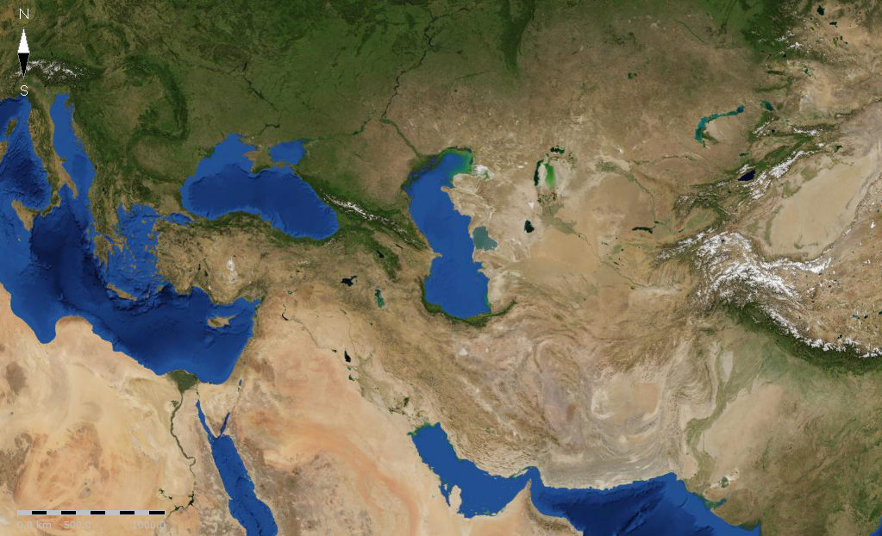
Zechariah 8-9
Cassander
Lysimachus
Seleucus
Ptolemy

