Slide 1
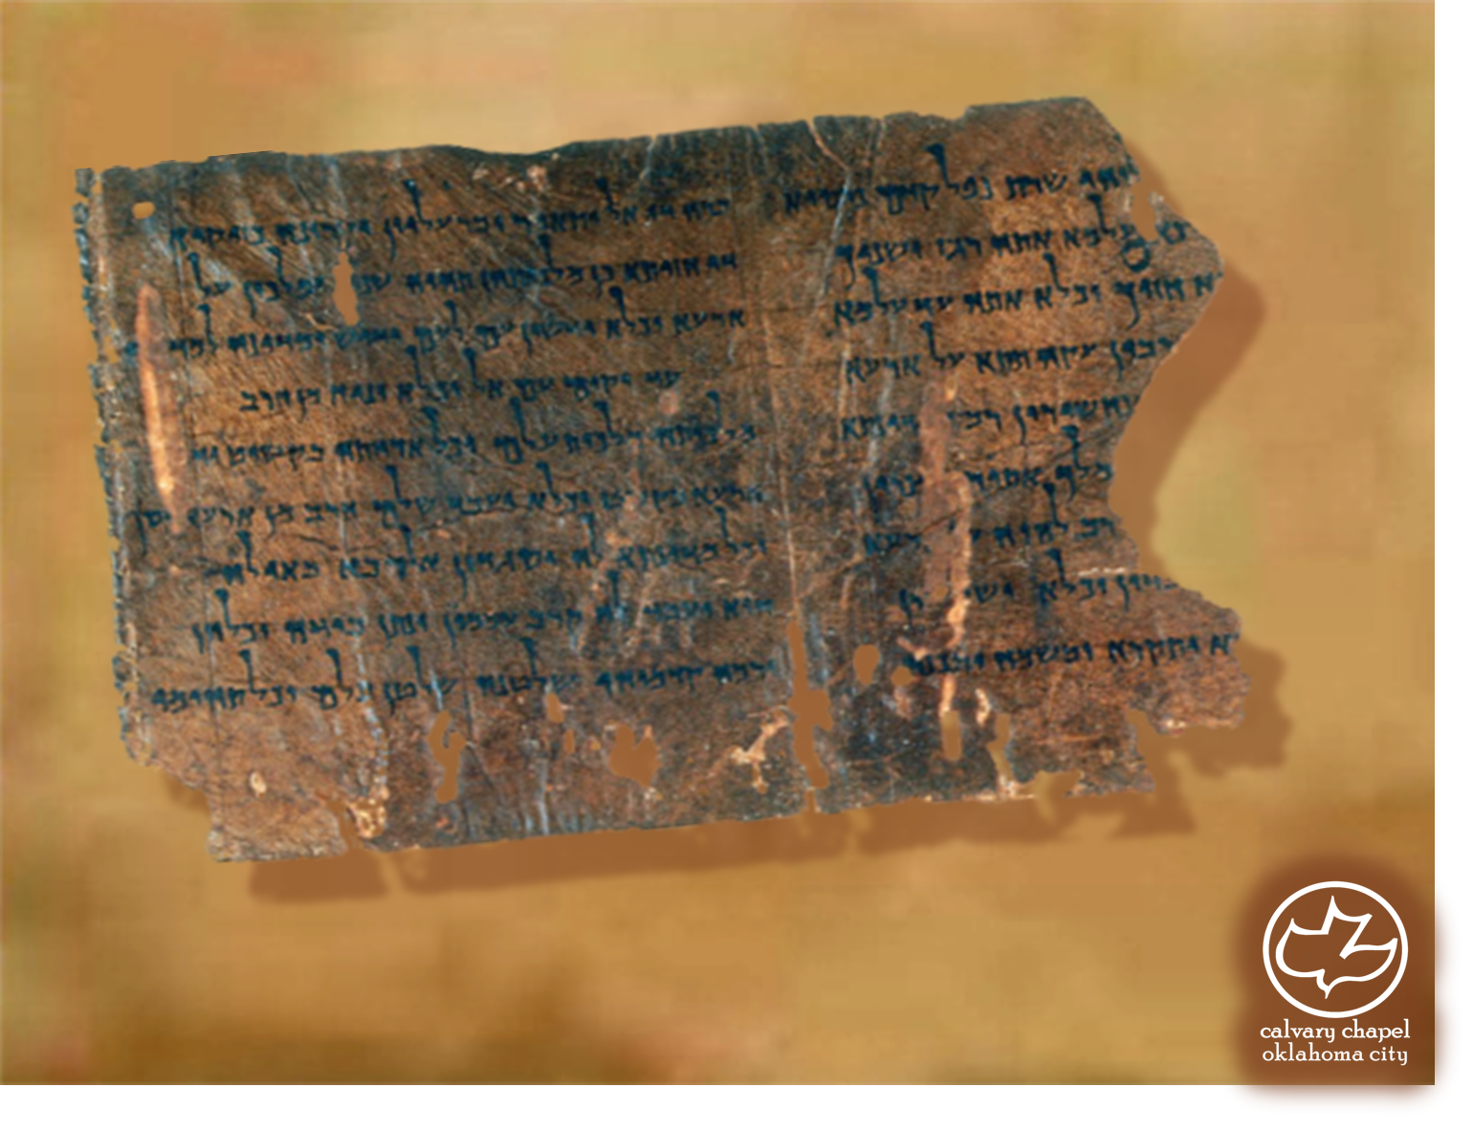

Minor Prophets … Major Message:
Zechariah 5-7
A CD of this message will be available (free of charge) immediately following today's message
This message will be available via podcast later this week at calvaryokc.com

Slide 2
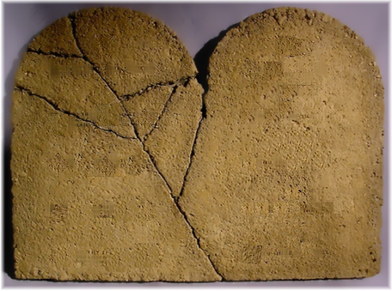
Zechariah 5-7
To Perjure: Sin against God
To Steal: Sin against man

Slide 3
Zechariah 5-7
Basket ~ KJV, NASB – ephah; NIV – measuring basket

Slide 4
Zechariah 5-7
4 angels of Rev. 9 at the Euphrates (6th trumpet)
4 horsemen of Rev. 6
4 Gentile nations – Babylon, Medo-Persia, Greek, Roman
Spirit ~ ruach – better, anger (Judges 8:3); KJV, spirit; NASB, wrath

Slide 5
Zechariah 5-7
Joshua ~
Yeshua ~
Jesus
James Boice ~ “In the Hebrew text the prophecy begins ‘Behold the Man,’ the very words Pilate used to present the beaten Christ to the people of Jerusalem: ‘Ecce homo!’”

Slide 6
Zechariah 5-7
Religion:
Dictionary definition: a belief in a supernatural being or power that controls the affairs of men
Christian definition: Man's attempt to make himself acceptable (to reach) God

Slide 7
Zechariah 5-7
Fourth year ~ 518 BC, 2 years later

Slide 8
Zechariah 5-7
NASB ~ town of Bethel sent [the men to the ask] the priests…
Date
Event
Ref.
4 Tammuz
Mourning the capture of Jerusalem
Jer. 52:6-30
Burning of Jerusalem and the destruction of Solomon’s Temple
9 Av
2 Kg. 25:2-10
Assassination of Gedaliah and the massacre of 80 men
3 Tishri
Jer. 4:1-10
Beginning of Nebuchadnezzar’s siege against Jerusalem
10
Tevet
2 Kg. 25:1

Slide 9
Zechariah 5-7
1 Cor. 10:31 ~ Therefore, whether you eat or drink, or whatever you do, do all to the glory of God.

Slide 10
Zechariah 5-7
F. B. Meyer ~ “There is no need to observe the sad anniversaries of our sins and their accompanying punishment, if once we are assured of God’s free forgiveness. When He forgives and restores, the need for dwelling on the bitter past is over . . . Too many of us are always dwelling beside the graves of the dead
past.”

