Slide 1
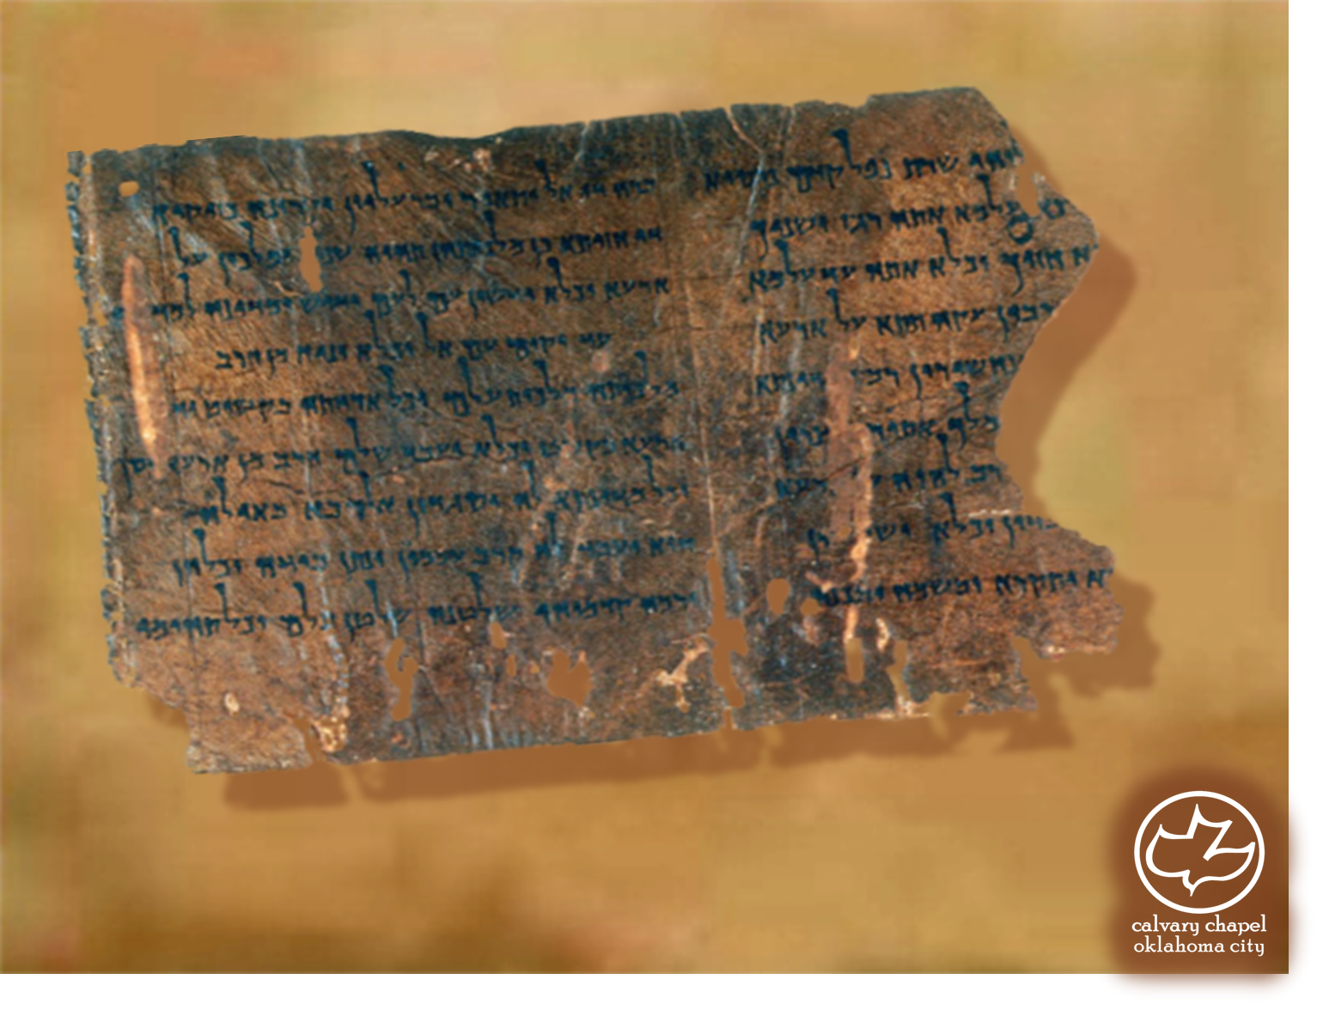

Minor Prophets … Major Message:
Zechariah 3-4
A CD of this message will be available (free of charge) immediately following today's message
This message will be available via podcast later this week at calvaryokc.com

Slide 2
Zechariah 3-4
1st Vision: Horse and riders ~ 1:7-11
2nd Vision: 4 horns and 4 craftsmen ~ 1:18-21
3rd Vision: Man with the measuring rod ~ 2:1-5

Slide 3
Zechariah 3-4
Rev. 12:10 ~ Then I heard a loud voice saying in heaven, "Now salvation, and strength, and the kingdom of our God, and the power of His Christ have come, for the accuser of our brethren, who accused them before our God day and night, has been cast down.”
Satan ~ adversary, opponent

Slide 4
Zechariah 3-4
1 John 1:9 ~ If we confess our sins, He is faithful and just to forgive us our sins and to cleanse us from all unrighteousness.
1 John 2:1 ~ My little children, these things I write to you, so that you may not sin. And if anyone sins, we have an Advocate with the Father, Jesus Christ the righteous.

Slide 5
Zechariah 3-4
Jude 1:9 ~ Yet Michael the archangel, in contending with the devil, when he disputed about the body of Moses, dared not bring against him a reviling accusation, but said, "The Lord rebuke you!"

Slide 6
Zechariah 3-4
Is. 64:6 ~ But we are all like an unclean thing,
And all our righteousnesses are like filthy rags;
We all fade as a leaf,
And our iniquities, like the wind, Have taken us away.
Charles Feinberg ~ “the strongest expression in the Hebrew language for filth of the most vile and loathsome character.”

Slide 7
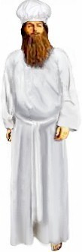
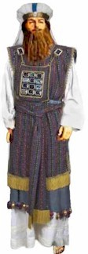
Zechariah 3-4

Slide 8
Zechariah 3-4
2 Cor. 5:21 ~ For He made Him who knew no sin to be sin for us, that we might become the righteousness of God in Him.

Slide 9
Zechariah 3-4
NIV, God bless it! God bless it!

Slide 10
Zechariah 3-4
C. H. Spurgeon – “There is an old ploughman in the country I sometimes talk with, and he often says, though in uncouth words, some precious things. He said to me one day, "The other day, sir, the Devil was tempting me and I tried to answer him; but I found he was an old lawyer and understood the law a great deal better than I did, so I gave over
and would not argue with him anymore; so I said to him, 'What do you trouble me for?'
'Why,' said he, 'about your soul.'
'Oh!' said I, 'that is no business of mine; I have given my soul over into the hand of Christ; I have transferred everything to him; if you want an answer to your doubts and queries, you must apply to my Advocate."'

Slide 11
Zechariah 3-4
Phil. 1:6 ~ being confident of this very thing, that He who has begun a good work in you will complete it until the day of Jesus Christ;

Slide 12
Zechariah 3-4
Anointed ones ~ literally sons of oil
Rev. 11:3-4 ~ ³ And I will give power to my two witnesses, and they will prophesy one thousand two hundred and sixty days, clothed in sackcloth. ⁴ These are the two olive trees and the two lampstands standing before the God of the earth.

