Slide 1
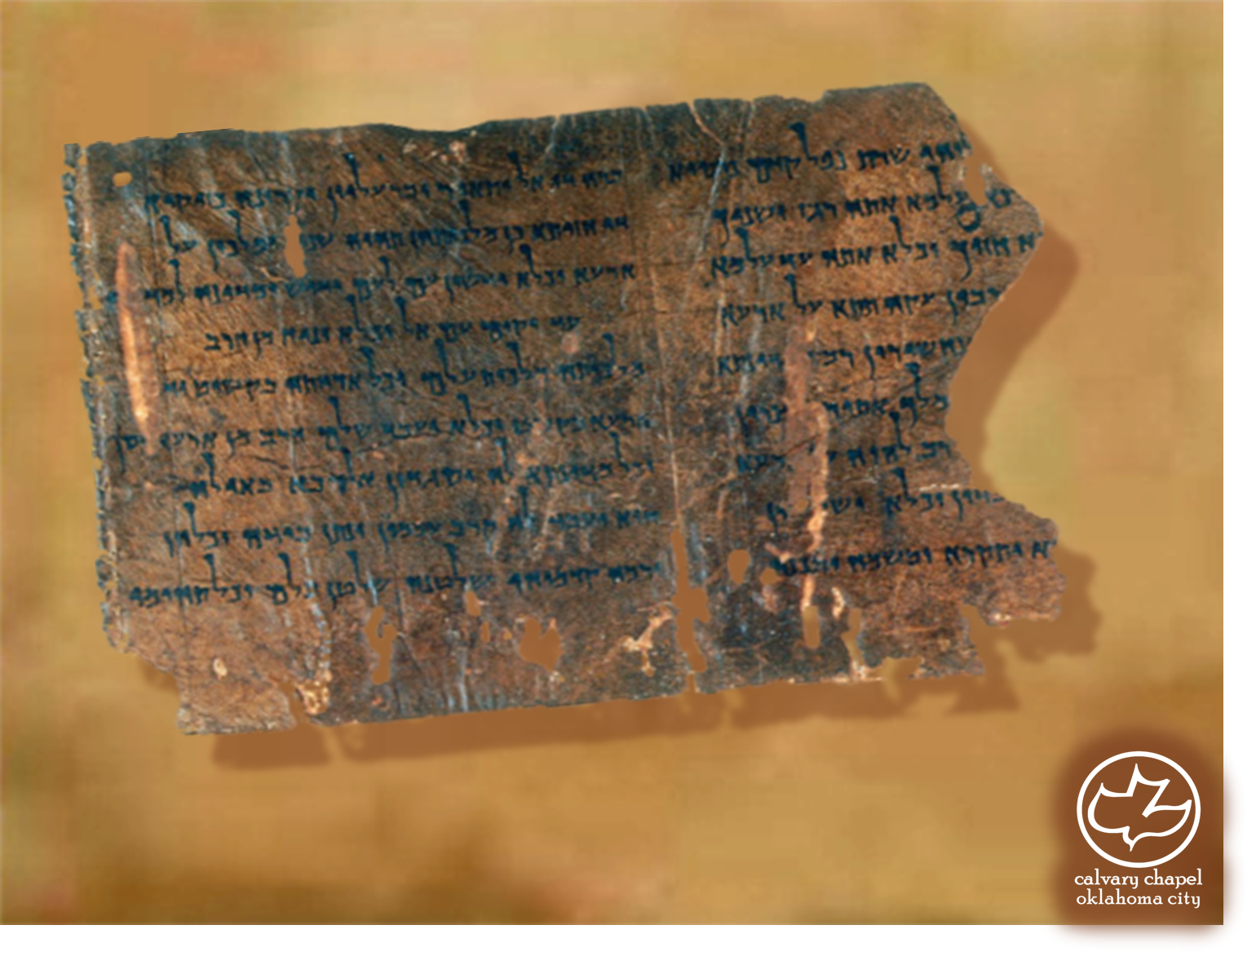

Minor Prophets … Major Message:
Zechariah 1-2
A CD of this message will be available (free of charge) immediately following today's message
This message will be available via podcast later this week at calvaryokc.com

Slide 2
Zechariah 1-2
Zechariah
… not Zachariah
Messianic prophecies: 2nd only to Isaiah
520 BC (two months after Haggai began)
Chapters 1-6 contain 8 visions

Slide 3
Zechariah 1-2
Zechariah means Yahweh remembers
Berechiah means Yahweh will bless
Iddo means At the appointed time

Slide 4
Zechariah 1-2
Literally, angry with anger with your fathers

Slide 5
Zechariah 1-2
Luke 10:42 ~ But one thing is needed, and Mary has chosen that good part, which will not be taken away from her.
Rev. 2:4 ~ Nevertheless I have this against you, that you have left (not lost) your first love.
James 4:8 ~ Draw near to God and He will draw near to you

Slide 6
Zechariah 1-2
LORD of Hosts ~ Yahweh Sabaoth (52x in book)
JFB ~ "Implies the boundless resources at His command for His people's good."

Slide 7
Zechariah 1-2
(2x in Jeremiah; once in Ezekiel) The fathers have eaten sour grapes, And the children's teeth are set on edge.
Ex. 34:7b ~ … visiting the iniquity of the fathers upon the children and the children’s children to the third and the fourth generation.

Slide 8
Zechariah 1-2
Theophany ~ A pre-incarnate manifestation of the Son

Slide 9
Zechariah 1-2
Craftsmen ~ KJV, carpenters – literally, engravers

Slide 10
Zechariah 1-2
4 Craftsmen
4 Horns
Medo-Persia
Babylon
Greece
Medo-Persia
Romans
Greece
Jesus
Romans

Slide 11
Zechariah 1-2
Young man ~ na’ar – youth, lad

Slide 12
Zechariah 1-2
Jerusalem in 520 BC
Jerusalem in 1967

