Slide 1
TITUS 3:4-15

Slide 2
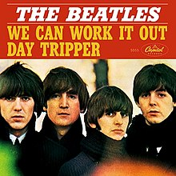
TITUS 3:4-15

Slide 3
TITUS 3:4-15
Crime
Selfishness
Hatred
love?
Abuse
Dishonesty
Unfaithfulness

Slide 4
TITUS 3:4-15

Slide 5
TITUS 3:4-15
Titus 3:4–15 ~ ⁴ But when the kindness and the love of God our Savior toward man appeared, ⁵ not by works of righteousness which we have done, but according to His mercy He saved us, through the washing of regeneration and renewing of the Holy Spirit, ⁶ whom He poured out on us abundantly through Jesus Christ our Savior, ⁷ that having been justified by His grace we should become heirs according to the hope of eternal life.
⁸ This is a faithful saying, and these things I want you to affirm constantly, that those who have believed in God should be careful to maintain good works.

Slide 6
TITUS 3:4-15
Titus 3:4–15 ~ These things are good and profitable to men.
⁹ But avoid foolish disputes, genealogies, contentions, and strivings about the law; for they are unprofitable and useless. ¹⁰ Reject a divisive man after the first and second admonition, ¹¹ knowing that such a person is warped and sinning, being self-condemned.
¹² When I send Artemas to you, or Tychicus, be diligent to come to me at Nicopolis, for I have decided to spend the winter there. ¹³ Send Zenas the lawyer and Apollos on their journey with haste, that they may lack nothing.

Slide 7
TITUS 3:4-15
Titus 3:4–15 ~ ¹⁴ And let our people also learn to maintain good works, to meet urgent needs, that they may not be unfruitful.
¹⁵ All who are with me greet you. Greet those who love us in the faith.
Grace be with you all. Amen.

Slide 8
TITUS 3:4-15

Slide 9
TITUS 3:4-15
How to make someone love you:
Camille, age 9 ~ Shake your hips and hope for the best.
Bart, age 9 ~ One way is to take the girl out to eat. Make sure it’s something she likes to eat.
French fries usually works for me.”
How to tell if 2 people in a restaurant are in love:
Bart, age 9 ~ Lovers will just be staring at each other and their food will get cold ... Other people care more about the food.”
Sandra, age 7 ~ See if the man has lipstick on his face.”

Slide 10
TITUS 3:4-15
Christine, age 9 ~ It’s love if they order one of those desserts that are on fire. They like to order those because it's just like how their hearts are on fire.”
Thoughts on kissing:
How to learn: Carin, age 9 ~ It might help to watch soap operas all day.”
How to tell if 2 people in a restaurant are in love:
When is it OK: Pam, age 7 ~ When they’re rich.”
Tammy, age 10 ~ It’s never okay to kiss a boy.
They always slobber all over you.
That’s why I stopped doing it.”

Slide 11
TITUS 3:4-15
Bart, age 9 ~ I look at kissing like this: Kissing is fine if you like it, but it’s a free country and nobody should be forced to do it.”
Dave, age 8 ~ Be a good kisser. It might make your wife forget that you never take out the trash.
Thoughts on kissing:
The seriousness of love:
Natalie, age 9 ~ Don’t say you love somebody and then change your mind ... Love isn't like picking what movie you want to watch.

Slide 12
TITUS 3:4-15

Slide 13
TITUS 3:4-15
love … toward man ~ philanthrōpia – philanthropy
philos ~ love; anthropos ~ man, mankind

Slide 14
TITUS 3:4-15
Gen. 50:20 ~ But as for you, you meant evil against me;
but God meant it for good …
Ps. 73:26 ~ My flesh and my heart fail
But God is the strength of my heart

Slide 15
TITUS 3:4-15
Eph. 2:3-5 ~ ³ among whom also we all once conducted ourselves in the lusts of our flesh, fulfilling the desires of the flesh and of the mind, and were by nature children of wrath, just as the others.
⁴ But God, who is rich in mercy, because of His great love with which He loved us, ⁵ even when we were dead in trespasses, made us alive together with Christ (by grace you have been saved),

Slide 16
TITUS 3:4-15
Acts 13:28-30 ~ ²⁸ And though they found no cause for death in Him, they asked Pilate that He should be put to death. ²⁹ Now when they had fulfilled all that was written concerning Him, they took Him down from the tree and laid Him in a tomb.
³⁰ But God raised Him from the dead.

Slide 17
TITUS 3:4-15

Slide 18
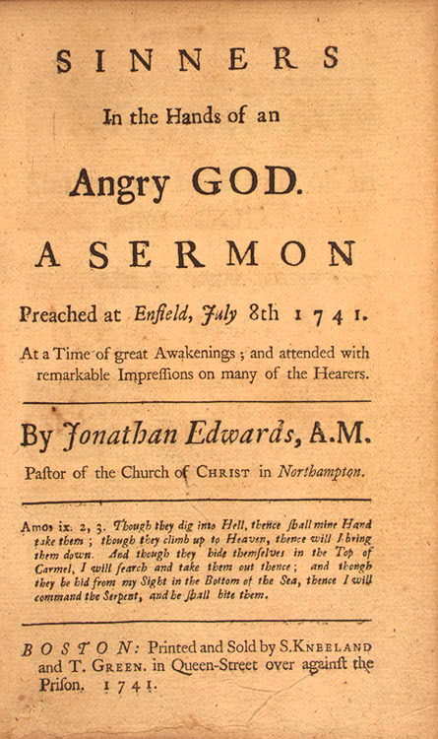
TITUS 3:4-15
Jonathan Edwards (1703–1758) ~ “Unconverted men walk over the pit of hell
on a rotten covering, and there are
innumerable places in this covering so weak that they will not bear their weight, and these places are not seen.
“Your wickedness makes you as it were heavy as lead, and to tend downwards with great weight and pressure towards hell; and if God should let you go, you would immediately sink and swiftly descend and plunge into the bottomless gulf, and your healthy constitution, and your own care and prudence, and best contrivance,

Slide 19
TITUS 3:4-15
Jonathan Edwards (1703–1758) ~ and all your righteousness, would have no more influence
to uphold you and keep you out of hell, than
a spider’s web would have to stop a falling rock.
“The bow of God’s wrath is bent, and the arrow made ready on the string, and justice bends
the arrow at your heart, and strains the bow,
and it is nothing but the mere pleasure of God, and that of an angry God, without any promise or obligation at all , and your own care and prudence, that keeps the arrow one moment from being made drunk with your blood.”

Slide 20
TITUS 3:4-15

Slide 21
TITUS 3:4-15
Rom. 2:4 ~ Or do you despise the riches of His goodness, forbearance, and longsuffering, not knowing that the goodness of God leads you to repentance?

Slide 22
TITUS 3:4-15

Slide 23
TITUS 3:4-15
washing ~ loutron
Eph. 5:26 ~ … that He might sanctify and cleanse her with the washing of water by the word,
regeneration ~ paliggenesia – literally, “born again”

Slide 24
TITUS 3:4-15

Slide 25
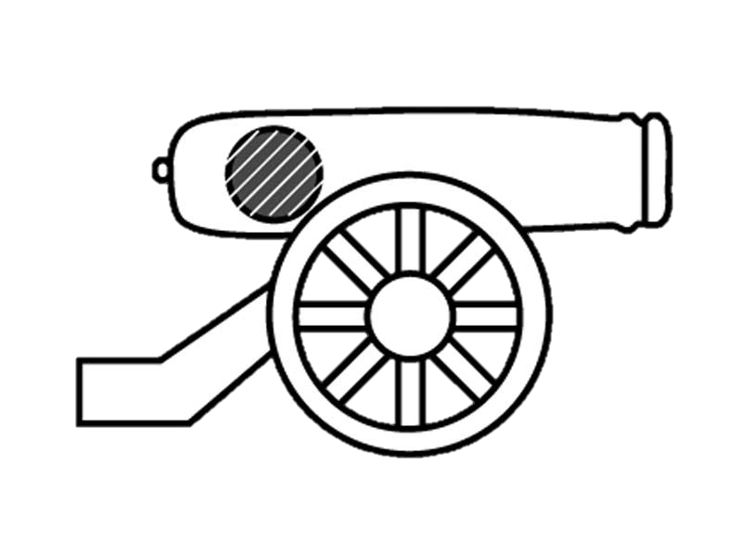
TITUS 3:4-15
This Photo by Unknown Author is licensed under CC BY-SA

Slide 26
TITUS 3:4-15
Heb. 11:24-26 ~ ²⁴ By faith Moses, when he became of age, refused to be called the son of Pharaoh's daughter, ²⁵ choosing rather to suffer affliction with the people of God than to enjoy the passing pleasures of sin, ²⁶ esteeming the reproach of Christ greater riches than the treasures in Egypt; for he looked to the reward.

Slide 27
TITUS 3:4-15

Slide 28
TITUS 3:4-15
1. Man is lost and needs saving.
2. God is infinitely good and has devised a way of salvation.
3. His goodness was manifested in the incarnation of Jesus Christ.
4. We are justified though Jesus’ blood.
5. We are regenerated by the Holy Spirit.
6. The hope of the resurrection of the body, and the final glorification of both it and the soul through all eternity.

Slide 29
TITUS 3:4-15
7. The necessity of obedience to the will of God, and of walking worthy of the calling wherewith they had been called.

Slide 30
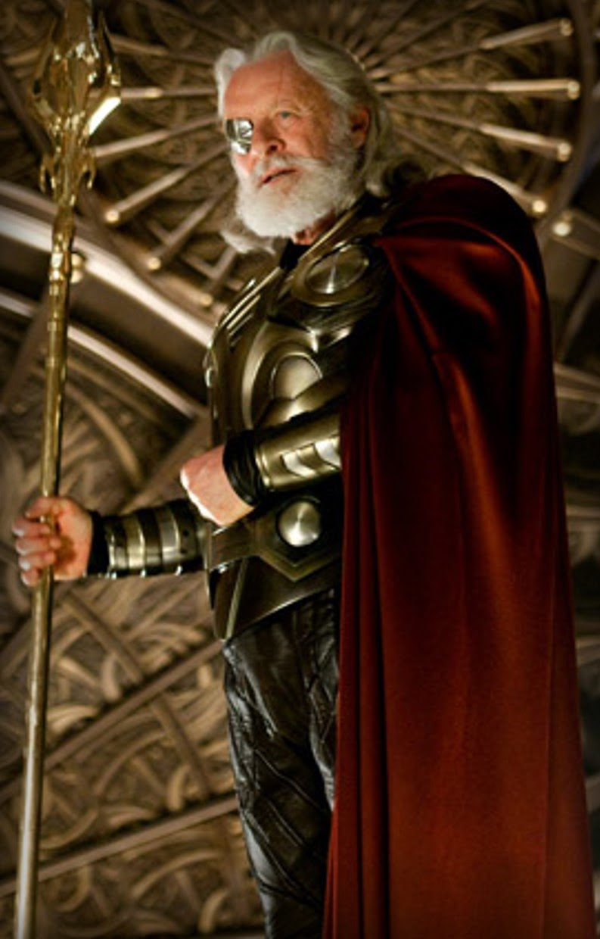
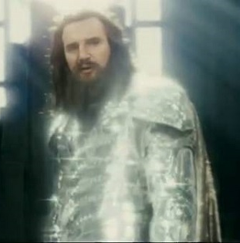
TITUS 3:4-15
Zeus
Odin

Slide 31
TITUS 3:4-15

Slide 32
TITUS 3:4-15
Galatians 5:22-23
kind-ness
good-
ness
self-control
joy
peace
faithfulness
longsuffering
gentleness
Love

Slide 33
TITUS 3:4-15

Slide 34
TITUS 3:4-15
divisive man (v. 10) ~ hairetikos – KJV, heretick
warped ~ literally twisted, turned inside out

Slide 35
TITUS 3:4-15

Slide 36
TITUS 3:4-15
Have pulpit will travel
Have pulpit will travel
Contact Tychicus
Rome
Contact artemas
Rome

Slide 37
TITUS 3:4-15

