Slide 1

TITUS 1:1-9

Slide 2


TITUS 1:1-9
Dates are approximate
Summoned to Nicopolis (AD 65)
Conversion (AD 48)
Delivers “Sorrowful” letter to Corinth (AD 55)
Ordained and sent to Crete
(AD 62)
AD 51
AD 54
AD 57
AD 60
AD 63
Jerusalem Council
(AD 49)
Delivers 2 Corinthians
(AD 56)
Letter to Titus
(AD 64)
Goes to Dalmatia
(AD 66)
Church on Crete started sometime after Acts 2 (AD 32)

Slide 3
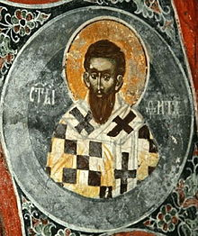
TITUS 1:1-9
Troubleshooter
Peacemaker
Ambassador
Missionary
Administrator
Secretary of State
Titus

Slide 4
TITUS 1:1-9
Gal. 2:3 ~ Yet not even Titus who was with me, being a Greek, was compelled to be circumcised.

Slide 5
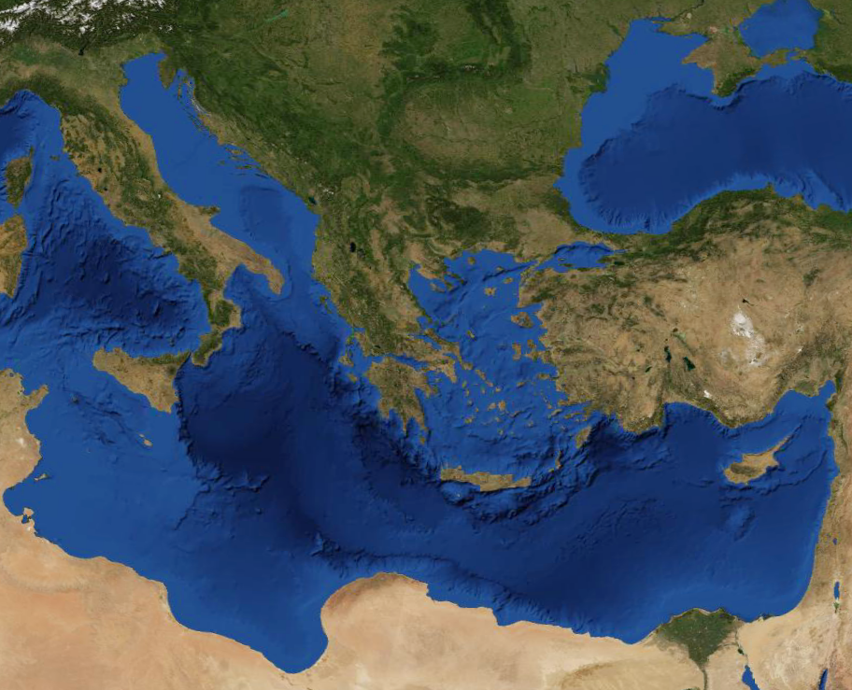
TITUS 1:1-9
Crete

Slide 6
TITUS 1:1-9

Slide 7
TITUS 1:1-9
Titus 1:1-9 ~ ¹ Paul, a bondservant of God and an apostle of Jesus Christ, according to the faith of God’s elect and the acknowledgment of the truth which accords with godliness, ² in hope of eternal life which God, who cannot lie, promised before time began, ³ but has in due time manifested His word through preaching, which was committed to me according to the commandment of God our Savior;
⁴ To Titus, a true son in our common faith:
Grace, mercy, and peace from God the Father and the Lord Jesus Christ our Savior.

Slide 8
TITUS 1:1-9
Titus 1:1-9 ~ ⁵ For this reason I left you in Crete, that you should set in order the things that are lacking, and appoint elders in every city as I commanded you — ⁶ if a man is blameless, the husband of one wife, having faithful children not accused of dissipation or insubordination. ⁷ For a bishop must be blameless, as a steward of God, not self-willed, not quick-tempered, not given to wine, not violent, not greedy for money, ⁸ but hospitable, a lover of what is good, sober-minded, just, holy, self-controlled, ⁹ holding fast the faithful word as he has been taught, that he may be able, by sound doctrine, both to exhort and convict those who contradict.

Slide 9
TITUS 1:1-9

Slide 10
TITUS 1:1-9
“It’s the Lord, my boy, and your time is up.”
“It’s the boy, my Lord, it’s time to get up.”

Slide 11
TITUS 1:1-9

Slide 12

TITUS 1:1-9
Mr. Jones, I’m afraid
I have some bad news … you have Alzheimer’s and cancer
Well … at least I don’t have cancer

Slide 13
TITUS 1:1-9

Slide 14
TITUS 1:1-9
John 6:44a ~ No one can come to Me unless the Father who sent Me draws him;
Eph. 1:4a ~ He chose us in Him before the foundation of the world,
John 15:16a ~ You did not choose Me, but I chose you …

Slide 15
TITUS 1:1-9
Matt. 23:37 ~ “O Jerusalem, Jerusalem, the one who kills the prophets and stones those who are sent to her! How often I wanted to gather your children together, as a hen gathers her chicks under her wings, but you were not willing!
John 3:16 ~ For God so loved the world that He gave His only begotten Son, that whoever believes in Him should not perish but have everlasting life.

Slide 16
TITUS 1:1-9
Acts. 16:30-31 ~ ³⁰ And he brought them out and said, “Sirs, what must I do to be saved?”
³¹ So they said, “Believe on the Lord Jesus Christ, and you will be saved, you and your household.”

Slide 17
TITUS 1:1-9
NIV ~ the knowledge of the truth that leads to godliness
godliness ~ 10x in 1 & 2 Timothy
John 8:32 ~ And you shall know the truth, and the truth shall make you free.
John 8:36 ~ Therefore if the Son makes you free, you shall be free indeed.
1. We are sinners.
2. We are helpless in our condition.
3. God is holy.
4. He took our place.

Slide 18
TITUS 1:1-9

Slide 19
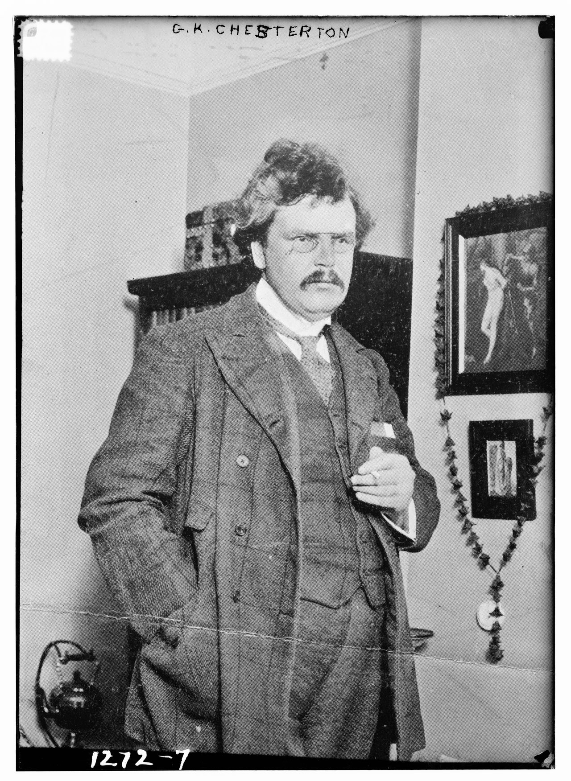
TITUS 1:1-9
hope ~ expectation, confidence
G. K. Chesterton (1874-1936) ~ “As long as matters are really hopeful, hope is a mere flattery or platitude; it is only when everything is hopeless that hope begins to be a strength. Like all the Christian virtues, it is as unreasonable as it is indispensable.”

Slide 20
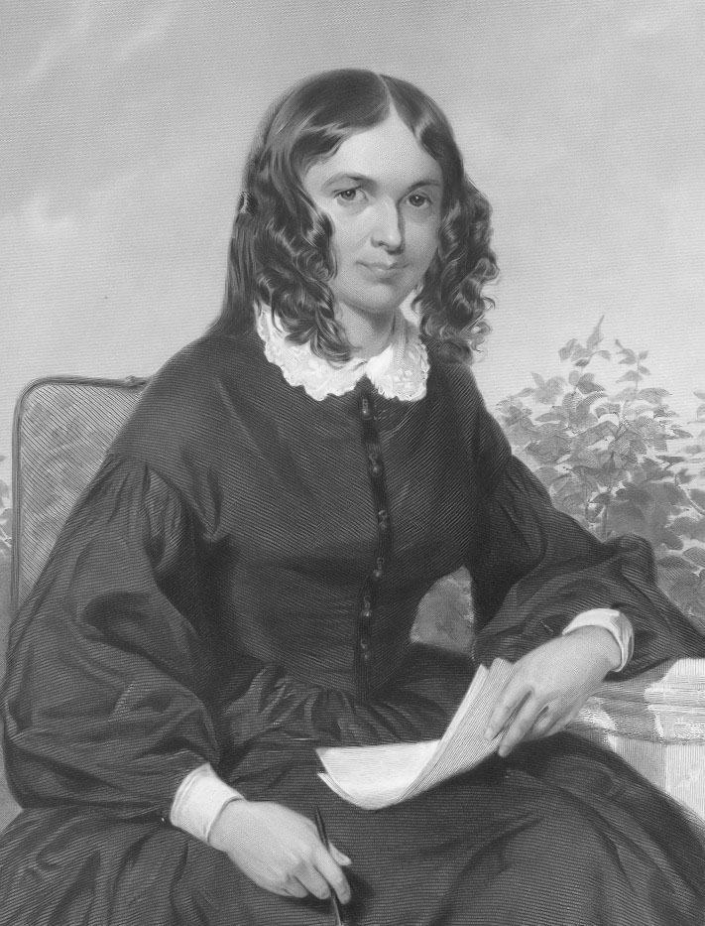
TITUS 1:1-9
Woman with the “flow of blood” ~ Matt. 9:20-22, Mark 5:25-32, Luke 8:43-48
Elizabeth Barrett Browning (1806-1861) ~ “God’s gifts put man’s best dreams to shame.”

Slide 21
TITUS 1:1-9

Slide 22
TITUS 1:1-9
true son ~ KJV, mine own son
Literally, “genuine son” or “legitimately born son”

Slide 23
TITUS 1:1-9
Which One is the Savior?
God our Savior
~ vv. 3&4
Lord Jesus Christ who is God our Savior
~ v. 3
Lord Jesus Christ our Savior
~ v. 4
Hosea 13:4 ~ I am the LORD your God … for there is no savior besides Me.
A. There is no Savior besides God
B. Jesus is a Savior
C. Therefore, Jesus is God

Slide 24
TITUS 1:1-9

Slide 25
TITUS 1:1-9
one wife ~ literally, one-woman man
dissipation ~ asōtia – a (negative particle) + sōzō (to save)
Luke 15:13 ~ he wasted his possessions in prodigal living

Slide 26
TITUS 1:1-9

Slide 27
TITUS 1:1-9
bishop ~ NIV, elder
NASB ~ overseer
episkopos ~ epi (upon) + skopos (to mark – “scope”)

Slide 28
TITUS 1:1-9

Slide 29
TITUS 1:1-9
given to wine ~ paroinos – with wine
$249,000,000,000

Slide 30

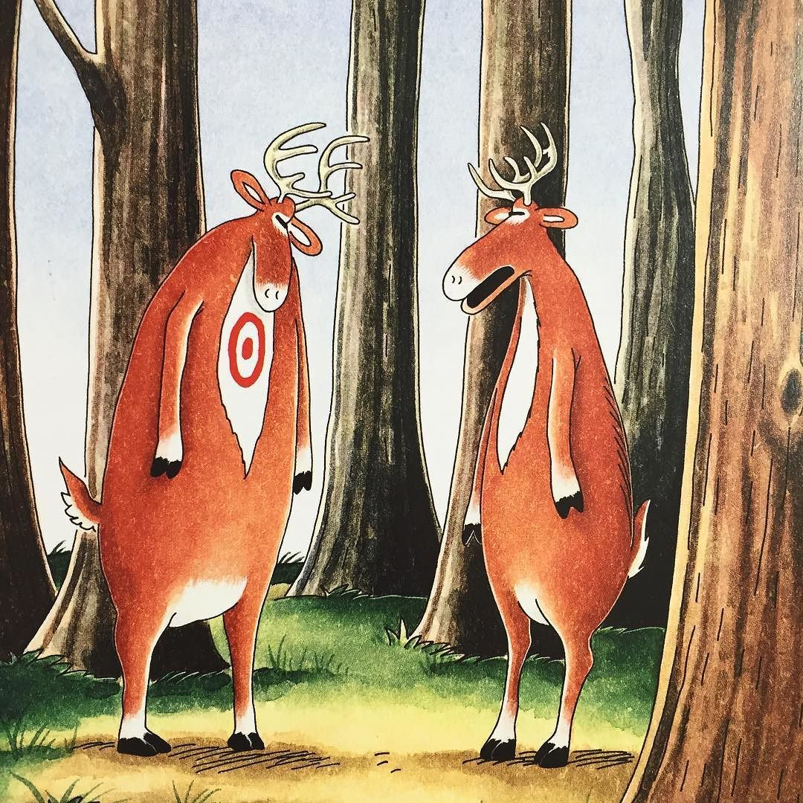
TITUS 1:1-9
Bummer of
a birthmark, Hal

Slide 31
TITUS 1:1-9

Slide 32
TITUS 1:1-9
hospitable ~ philoxenos – Literally “lover of strangers”
lover of what is good ~ KJV, lover of good men

Slide 33
TITUS 1:1-9

Slide 34
TITUS 1:1-9
sound ~ hygiainō (hygiene) – Literally “healthy”
contradict ~ antilegō – against words

Slide 35
TITUS 1:1-9

Slide 36
TITUS 1:1-9
1 Tim. 3:1 ~ If a man desires the position of a bishop, he desires a good work.

Slide 37
TITUS 1:1-9

