Slide 1
3:1-4:22

Slide 2
3:1-4:22

Slide 3
Boaz is a type of Jesus
Naomi is a type of Israel
Ruth is a type of the Church
Orpah is a type of the Shallow Believer
Unnamed Servant is a type of the Holy Spirit
The Field is a type of the World
The Other Kinsman is a type of the Law
The Threshing Floor is a type of the Tribulation
3:1-4:22

Slide 4
"My husband’s brother refuses to raise up a name to his brother in Israel; he will not perform the duty of my husband’s brother." ⁸ Then the elders of his city shall call him and speak to him. But if he stands firm and says, "I do not want to take her," ⁹ then his brother’s wife shall come to him in the presence of the elders, remove his sandal from his foot, spit in his face, and answer and say, "So shall it be done to the man who will not build up his brother’s house." ¹⁰ And his name shall be called in Israel, "The house of him who had his sandal removed."
Deut. 25:5-10 ~ ⁵ If brothers dwell together, and one of them dies and has no son, the widow of the dead man shall not be married to a stranger outside the family; her husband’s brother shall go in to her, take her as his wife, and perform the duty of a husband’s brother to her. ⁶ And it shall be that the firstborn son which she bears will succeed to the name of his dead brother, that his name may not be blotted out of Israel. ⁷ But if the man does not want to take his brother’s wife, then let his brother’s wife go up to the gate to the elders, and say,
3:1-4:22

Slide 5
3:1-4:22

Slide 6
Security ~ same word as in 1:9
The Lord grant that you may find rest, each in the house of her husband
3:1-4:22

Slide 7
3:1-4:22

Slide 8
Maidservant ~ amah – equivalent to doulos
3:1-4:22

Slide 9
3:1-4:22

Slide 10
Wing ~ kanaph – KJV, skirt
Close relative ~ ga'al
3:1-4:22

Slide 11
3:1-4:22

Slide 12
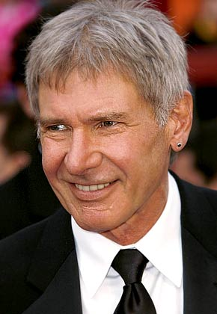
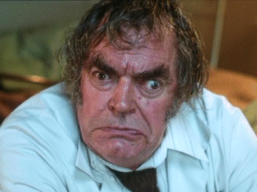
3:1-4:22

Slide 13
3:1-4:22

Slide 14
Friend ~ KJV, such a one
Literally "so and so"
3:1-4:22

Slide 15
3:1-4:22

Slide 16
Deut. 23:2 ~ One of illegitimate birth shall not enter the assembly of the Lord; even to the tenth generation none of his descendants shall enter the assembly of the Lord.
1. Perez
2. Hezron
3. Ram
4. Amimmadab
5. Nashon
6. Salmon
7. Boaz
8. Obed
9. Jesse
10. David
3:1-4:22

Slide 17
3:1-4:22

Slide 18
Oswald Chambers ~ "Are you looking unto Jesus now, in the immediate matter that is pressing, and receiving from Him peace? If so, He will be a gracious benediction of peace in and through you. But if you try to worry it out, you obliterate Him and deserve all you get."
3:1-4:22

Slide 19
Robert Murray McCheyne ~ "If I could hear Christ praying for me in the next room, I would not fear a million enemies …
Yet distance makes no difference. He is praying for me."
3:1-4:22

Slide 20
3:1-4:22

