Slide 1

1:1-22

Slide 2

Judges 21:25 ~ In those days there was no king in Israel; everyone did what was right in his own eyes.
1:1-22

Slide 3

1:1-22

Slide 4
Deut. 25:5-10 ~ ⁵ “If brothers dwell together, and one of them dies and has no son, the widow of the dead man shall not be married to a stranger outside the family; her husband’s brother shall go in to her, take her as his wife, and perform the duty of a husband’s brother to her. ⁶ And it shall be that the firstborn son which she bears will succeed to the name of his dead brother, that his name may not be blotted out of Israel. ⁷ But if the man does not want to take his brother’s wife, then let his brother’s wife go up to the gate to the elders, and say,
‘My husband’s brother refuses to raise up a name to his brother in Israel; he will not perform the duty of my husband’s brother.’ ⁸ Then the elders of his city shall call him and speak to him. But if he stands firm and says, ‘I do not want to take her,’ ⁹ then his brother’s wife shall come to him in the presence of the elders, remove his sandal from his foot, spit in his face, and answer and say, ‘So shall it be done to the man who will not build up his brother’s house.’ ¹⁰ And his name shall be called in Israel, ‘The house of him who had his sandal removed.’
1:1-22

Slide 5
Criteria:
1. Near kin
2. Able
3. Willing
1:1-22

Slide 6
1:1-22

Slide 7
Cast of Characters:
Naomi
Israel
Ruth
Church
Orpah
Shallow believer
Boaz
Jesus
Other kinsman
The Law
1:1-22

Slide 8
1:1-22

Slide 9
Bethlehem ~ house of bread
1:1-22

Slide 10
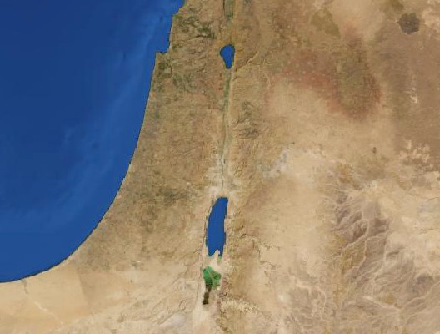
Bethlehem
Moab
1:1-22

Slide 11
1:1-22

Slide 12
Ps. 60:8a ~ Moab is My washpot …
Dwell ~ better, NASB, KJV – sojourn (NIV, live for a while)
1:1-22

Slide 13
1:1-22

Slide 14
Elimelech
My God is King
Naomi
My delight
Mahlon
Puny
Chilion
Pining
Orpah
Gazelle
Ruth
Friendship
1:1-22

Slide 15
1:1-22

Slide 16
John 6:61-69 ~ ⁶¹ When Jesus knew in Himself that His disciples complained about this, He said to them, "Does this offend you? ⁶² What then if you should see the Son of Man ascend where He was before? ⁶³ It is the Spirit who gives life; the flesh profits nothing. The words that I speak to you are spirit, and they are life. ⁶⁴ But there are some of you who do not believe." For Jesus knew from the beginning who they were who did not believe, and who would betray Him. ⁶⁵ And He said, "Therefore I have said to you
that no one can come to Me unless it has been granted to him by My Father."
⁶⁶ From that time many of His disciples went back and walked with Him no more. ⁶⁷ Then Jesus said to the twelve, "Do you also want to go away?"
⁶⁸ But Simon Peter answered Him, "Lord, to whom shall we go? You have the words of eternal life. ⁶⁹ Also we have come to believe and know that You are the Christ, the Son of the living God."
1:1-22

Slide 17
1:1-22

Slide 18
Bethlehem
Moab
1:1-22

Slide 19
1:1-22

Slide 20
God Moves in a Mysterious Way (William Cowper)
God moves in a mysterious way His wonders to perform;
He plants His footsteps in the sea and rides upon the storm.
Deep in unfathomable mines of never-failing skill
He treasures up His bright designs and works His sovereign will.
Ye fearful saints, fresh courage take; the clouds you so much dread
Are big with mercy and shall break in blessings on your head.
Judge not the Lord by feeble sense, but trust Him for His grace;
Behind a frowning providence He hides a smiling face.
His purposes will ripen fast, unfolding every hour;
The bud my have a bitter taste, but sweet will be the flower.
Blind unbelief is sure to err and scan His work in vain;
God is His own interpreter, and He will make it plain.
1:1-22

Slide 21
1:1-22

