Slide 1

Romans 16:1-27
A CD of this message will be available (free of charge) immediately following today’s Bible study.
This message will be available via podcast later this week at calvaryokc.com

Slide 2
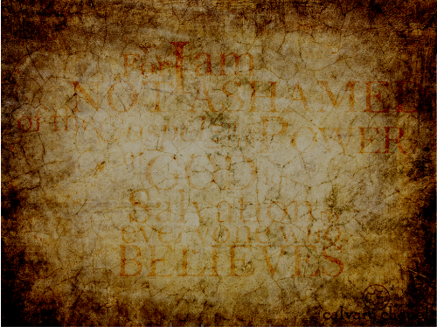
Romans 16:1-27
29 people mentioned
9, possibly 10 women (2 unnamed)
Ken ~ strong or handsome

Slide 3
Romans 16:1-27

Slide 4
Romans 16:1-27
Phoebe ~ radiant
Commend ~ official commendation – hand carried book of Romans
Helper ~ protectress (KJV, succorer) – literally, to stand before

Slide 5
Romans 16:1-27

Slide 6
Romans 16:1-27
Labor ~ kopiaō – work to the point of exhaustion

Slide 7
Romans 16:1-27

Slide 8
Romans 16:1-27
Amplias ~ large
Urbanus ~ city dweller

Slide 9
Romans 16:1-27

Slide 10
Romans 16:1-27
Aristobulus ~ according to tradition took the Gospel to Britain
Possibly the grandson of Herod the Great

Slide 11
Romans 16:1-27

Slide 12
Romans 16:1-27
Herodion ~ diminutive of Herod, "heroic"
Narcissus ~ stupidity (narcotic)

Slide 13
Romans 16:1-27

Slide 14
Romans 16:1-27
Tryphena ~ dainty
Tryphosa ~ delicate

Slide 15
Romans 16:1-27

Slide 16
Romans 16:1-27
A. W. Tozer ~ "The labor of self-love is a heavy one indeed. Think for yourself whether much of your sorrow has not arisen from someone speaking slightingly of you. As long as you set yourself up as a little god to which you must be loyal, how can you hope to find inward peace?"

Slide 17
Romans 16:1-27
C. H. Spurgeon ~ "So there are distinctions and degrees in honor among believers, and these are graduated by the scale of service done. It is an honor to labor for Christ, it is a still greater honor to labor much. If, then, any, in joining the Christian church, desire place or position, honor or respect, the way to it is this - labor, and labor much."

Slide 18
Romans 16:1-27

Slide 19
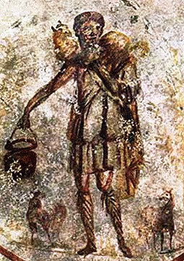
Romans 16:1-27
Rufus ~ red - not Paul's blood brother
Possibly son of Simon the Cyrenian
Asyncritus ~ incomparable
Hermas ~ tradition: One of the 70 disciples, wrote "Shepherd of Hermas"

Slide 20
Romans 16:1-27

Slide 21
Romans 16:1-27
Philologus ~ lover of the Word
Julia ~ soft haired
Nereus ~ lump
Olympas ~ heavenly

Slide 22
Romans 16:1-27

Slide 23
Romans 16:1-27
Urge ~ same as 12:1 and 15:30
Note ~ skopeō
Offenses ~ skandalon

Slide 24
Romans 16:1-27
SOUND
TEACHING

Slide 25
Romans 16:1-27
Sound Doctrine
False Doctrine
Truth-o-meter
What I believe
Things I disagree with
Aberrant beliefs
Heresy

Slide 26
Romans 16:1-27
Acts 20:30 ~ Also from among yourselves men will rise up, speaking perverse things, to draw away the disciples after themselves.

Slide 27
Romans 16:1-27

Slide 28
Romans 16:1-27
Shortly ~ swiftly, quickly
Rev. 22:20 ~ He who testifies to these things says, "Surely I am coming quickly." Amen. Even so, come, Lord Jesus!

Slide 29
Romans 16:1-27

Slide 30
Romans 16:1-27
Tertius ~ third (slave name)
Quartus (v. 23) ~ fourth

Slide 31
Romans 16:1-27

