Slide 1

Romans 14:14-15:6
A CD of this message will be available (free of charge) immediately following today’s Bible study.
This message will be available via podcast later this week at calvaryokc.com

Slide 3
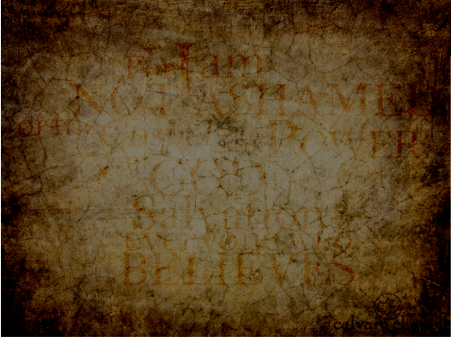

Romans 14:14-15:6
Chapter 1
Chapter 12:1-2
Chapter 2
Chapter 3
Chapter 4
Chapter 5
Chapter 6
Chapter 7
Chapter 12:3-16:27
Chapter 9
Chapter 10
Chapter 11

Slide 4
Romans 14:14-15:6

Slide 5
Romans 14:14-15:6
Right
Wrong
GRAY
GREY

Slide 6
Romans 14:14-15:6

Slide 7
Romans 14:14-15:6
KJV, I know and am persuaded
John Trapp ~ "Many, on the contrary, are persuaded before they know; and such will not be persuaded to know."

Slide 8
Romans 14:14-15:6

Slide 9
Romans 14:14-15:6
Spoken of as evil ~ blasphēmeō

Slide 10
Romans 14:14-15:6

Slide 11
Romans 14:14-15:6
Martin Luther ~ "A Christian man is a most free lord of all, subject to none. A Christian man is a most dutiful servant of all, subject to all."

Slide 12
Romans 14:14-15:6

Slide 13
Romans 14:14-15:6
16% school-age children make moral judgments based on "what God or Scripture tells them is right"
45% ~ based on their "own personal experience"

Slide 14
Romans 14:14-15:6
Warren Wiersbe ~ "Both the strong believer and the weak believer need to grow. The strong believer needs to grow in love; the weak believer needs to grow in knowledge … To gear the ministry of a Sunday School class or local church only to the baby Christians is to hinder their growth as well as the ministry of the more mature saints. The weak must learn from the strong, and the strong must love the weak."

Slide 15
Romans 14:14-15:6

Slide 16
Romans 14:14-15:6
The Living Bible ~ ¹ Even if we believe that it makes no difference to the Lord whether we do these things, still we cannot just go ahead and do them to please ourselves; for we must bear the "burden" of being considerate of the doubts and fears of others--of those who feel these things are wrong. ² Let's please the other fellow, not ourselves, and do what is for his good and thus build him up in the Lord.

Slide 17
Romans 14:14-15:6
J. B. Phillips ~ ¹ We who have strong faith ought to shoulder the burden of the doubts and qualms of others and not just to go our own sweet way. ² We should consider the good of our neighbour and help to build up his character.

Slide 18
Romans 14:14-15:6

Slide 19
Romans 14:14-15:6
Matt. 12:10-13 ~ ¹⁰ And behold, there was a man who had a withered hand. And they asked Him, saying, "Is it lawful to heal on the Sabbath?"— that they might accuse Him.
¹¹ Then He said to them, "What man is there among you who has one sheep, and if it falls into a pit on the Sabbath, will not lay hold of it and lift it out? ¹² Of how much more value then is a man than a sheep? Therefore it is lawful to do good on the Sabbath." ¹³ Then He said to the man, "Stretch out your hand." And he stretched it out, and it was restored as whole as the other.

Slide 20
Romans 14:14-15:6
Matt. 17:25b – 27 ~ ^{25b} "What do you think, Simon? From whom do the kings of the earth take customs or taxes, from their sons or from strangers?"
²⁶ Peter said to Him, "From strangers."
Jesus said to him, "Then the sons are free. ²⁷ Nevertheless, lest we offend them, go to the sea, cast in a hook, and take the fish that comes up first. And when you have opened its mouth, you will find a piece of money; take that and give it to them for Me and you."

Slide 21
Romans 14:14-15:6

Slide 22
Romans 14:14-15:6
Acts 16:3 ~ Paul wanted to have him (Timothy) go on with him. And he took him and circumcised him because of the Jews who were in that region, for they all knew that his father was Greek.

Slide 23
Romans 14:14-15:6
Gal. 2:1-3 ~ ¹ Then after fourteen years I went up again to Jerusalem with Barnabas, and also took Titus with me. ² And I went up by revelation, and communicated to them that gospel which I preach among the Gentiles, but privately to those who were of reputation, lest by any means I might run, or had run, in vain. ³ Yet not even Titus who was with me, being a Greek, was compelled to be circumcised.

Slide 24
Romans 14:14-15:6
Patience ~ hupomonē ~ patience, endurance, perseverance

Slide 25
Romans 14:14-15:6

Slide 26
Romans 14:14-15:6
Strengths
Weaknesses

Slide 27
Romans 14:14-15:6
Eph. 4:15-16 ~ ¹⁵ but, speaking the truth in love, may grow up in all things into Him who is the head — Christ — ¹⁶ from whom the whole body, joined and knit together by what every joint supplies, according to the effective working by which every part does its share, causes growth of the body for the edifying of itself in love.

Slide 28
Romans 14:14-15:6

Slide 29
Romans 14:14-15:6

