Slide 1

Romans 14:1-13
A CD of this message will be available (free of charge) immediately following today’s Bible study.
This message will be available via podcast later this week at calvaryokc.com

Slide 2
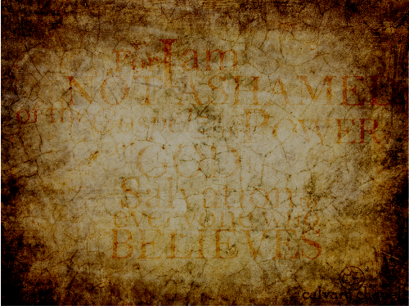

Romans 14:1-13
Chapter 1
Chapter 12:1-2
Chapter 2
Chapter 12:3-16:27
Chapter 3
Chapter 4
Chapter 5
Chapter 6
Chapter 7
Chapter 9
Chapter 10
Chapter 11

Slide 3
Romans 14:1-13
"Truth without love is brutality; love without truth is sentimentality."

Slide 4
Romans 14:1-13

Slide 5
Romans 14:1-13
Doubtful things ~ i.e. that which is debatable
NLT ~ … and don't argue with them about what they think is right or wrong.

Slide 6
Romans 14:1-13

Slide 7
Romans 14:1-13
Reasons why Christians are weak in the faith:
1) Ignorance of the Word
2) Legalism
3) Tradition

Slide 8
Romans 14:1-13

Slide 9
Romans 14:1-13
But we are told to judge:
1 Cor. 11:31 ~ For if we would judge ourselves, we would not be judged.
Gal. 6:1 ~ Brethren, if a man is overtaken in any trespass, you who are spiritual restore such a one in a spirit of gentleness, considering yourself lest you also be tempted. (also 1 Cor. 5)

Slide 10
Romans 14:1-13
But we are told to judge:
Matt. 7:15-20 ~ ¹⁵ Beware of false prophets, who come to you in sheep's clothing, but inwardly they are ravenous wolves. ¹⁶ You will know them by their fruits. Do men gather grapes from thornbushes or figs from thistles? ¹⁷ Even so, every good tree bears good fruit, but a bad tree bears bad fruit. ¹⁸ A good tree cannot bear bad fruit, nor can a bad tree bear good fruit.

Slide 11
Romans 14:1-13
But we are told to judge:
¹⁹ Every tree that does not bear good fruit is cut down and thrown into the fire. ²⁰ Therefore by their fruits you will know them.
Rom. 16:17 ~ Now I urge you, brethren, note those who cause divisions and offenses, contrary to the doctrine which you learned, and avoid them.

Slide 12
Romans 14:1-13

Slide 13
Romans 14:1-13
Smoking
Movies
Drinking
TV
Parenting

Slide 14
Romans 14:1-13

Slide 15
Romans 14:1-13
Sunday = sun god
Saturday = Saturn

Slide 16
Romans 14:1-13

Slide 17
Romans 14:1-13
Holidays
Proper Dress
Bible Translations
Home Schooling
Boycotts
Standard of Living

Slide 18
Romans 14:1-13

Slide 19
Romans 14:1-13
Judgment seat (v. 10) ~ bēma
Me
You

Slide 20
Romans 14:1-13
Phil. 3:13-14 ~ ¹³ Brethren, I do not count myself to have apprehended; but one thing I do, forgetting those things which are behind and reaching forward to those things which are ahead, ¹⁴ I press toward the goal for the prize of the upward call of God in Christ Jesus.

Slide 21
Romans 14:1-13

