Slide 1

Romans 13:1-7
•
A CD of this message will be available (free of charge) immediately following today’s Bible study.
This message will be available via podcast later this week at calvaryokc.com

Slide 2
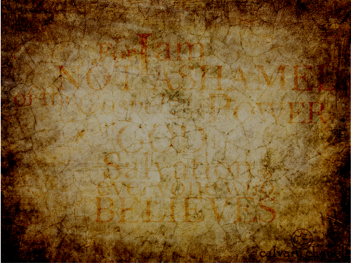
Romans 13:1-7
1 Pet. 2:17 ~ Honor all people. Love the brotherhood. Fear God. Honor the king.
Romans
AD 57
Paul imprisoned
AD 60-62
1 Peter between
AD 64-67
AD 60
AD 65

Slide 3
Romans 13:1-7
1 Tim. 2:1-3 ~ ¹ Therefore I exhort first of all that supplications, prayers, intercessions, and giving of thanks be made for all men, ² for kings and all who are in authority, that we may lead a quiet and peaceable life in all godliness and reverence. ³ For this is good and acceptable in the sight of God our Savior,

Slide 4
Romans 13:1-7
IS THERE EVER A TIME WHEN WE SHOULD SAY "NO!"
1) When we are commanded to do something contrary to God's word ~ Daniel 3:16 (also Ex. 1 & 2)
2) When we are forbidden to worship God according to our conscience ~ Daniel 6:10
3) When we are forbidden to share the Gospel ~ Acts 4:19; 5:29

Slide 5
Romans 13:1-7
IS THERE EVER A TIME WHEN WE SHOULD SAY "NO!"
4) When the evil of obeying is greater than the evil of disobeying ~ Esther 4:16
Rahab
Dietrich Bonhoeffer

Slide 6
Romans 13:1-7

Slide 7
Romans 13:1-7
John Knox
1554
Samuel Rutherford
1644
John Locke
1695
1550
1575
1600
1625
1650
1675
"A Godly Warning or Admonition to the Faithful in London, Newcastle, and Berwick"
"Lex Rex"
"The Reasonableness of Christianity"

Slide 8
Romans 13:1-7
John MacArthur ~ "People have mistakenly linked democracy and political freedom to Christianity. That’s why many contemporary evangelicals believe the American Revolution was completely justified, both politically and scripturally. They follow the arguments of the Declaration of Independence, which declares that life, liberty, and the pursuit of happiness are divinely endowed rights … But such a position is contrary

Slide 9
Romans 13:1-7
to the clear teachings and commands of Romans 13:1-7. So the United States was actually born out of a violation of New Testament principles, and any blessings God has bestowed on America have come in spite of that disobedience by the Founding Fathers.”

Slide 10
Romans 13:1-7

Slide 11
Romans 13:1-7
Proposed national motto (1776): "Rebellion to tyrants is obedience to God"

Slide 12
Romans 13:1-7

Slide 13
Romans 13:1-7
David Barton ~ "King George III dispatched 25,000 British troops to invade his own Colonies, enter the homes of his own citizens to take their private possessions and goods, and imprison them without trials – all in violation of his own British Common Law, English Bill of Rights, and Magna Carta (centuries old documents that formed the basis of the covenant between British rulers and citizens)."

Slide 14
Romans 13:1-7

Slide 15
Romans 13:1-7
1 Pet. 2:13-15 ~ ¹³ Therefore submit yourselves to every ordinance of man for the Lord's sake, whether to the king as supreme, ¹⁴ or to governors, as to those who are sent by him for the punishment of evildoers and for the praise of those who do good. ¹⁵ For this is the will of God, that by doing good you may put to silence the ignorance of foolish men –

Slide 16
Romans 13:1-7

Slide 17
Romans 13:1-7
Gen. 9:6 ~ Whoever sheds man’s blood,
By man his blood shall be shed;
For in the image of God
He made man

Slide 18
Romans 13:1-7

