Slide 1

Romans 12:9-21
A CD of this message will be available (free of charge) immediately following today’s Bible study.
This message will be available via podcast later this week at calvaryokc.com

Slide 2
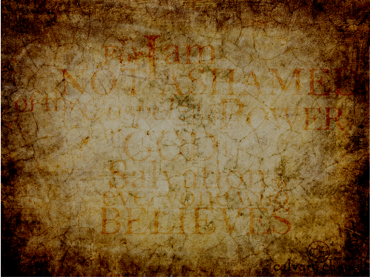
Romans 12:9-21
Rom. 12:1 ~ I beseech you therefore, brethren, by the mercies of God, that you present your bodies a living sacrifice, holy, acceptable to God, which is your reasonable service.

Slide 3
Romans 12:9-21

Slide 4



Romans 12:9-21
Sen. William B.
Spong
Hong Kong
Sen. Hiram
Fong
Bill
Ping Pong
Ding Dong
Bell

Slide 5
Romans 12:9-21

Slide 6
Romans 12:9-21
J. B. Philips ~ Let us have no imitation of Christian love. Let us have a genuine break with evil and a real devotion to good.
Abhor ~ literally, to hate away from
Cling ~ literally, to glue

Slide 7
Romans 12:9-21

Slide 8
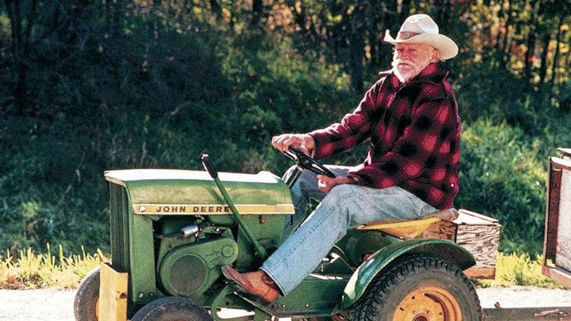
Romans 12:9-21
Kindly affectionate ~ family love
NIV, NASB ~ Be devoted to one another
Brotherly love ~ philadelphia
Or, Let your camaraderie lead to family love

Slide 9
Romans 12:9-21

Slide 10
Romans 12:9-21
NIV ~ Never be lacking in zeal
KJV ~ Not slothful in business

Slide 11
Romans 12:9-21

Slide 12
Romans 12:9-21
Fervent ~ boiling

Slide 13
Romans 12:9-21

Slide 14
Romans 12:9-21
456x in Bible: It came to pass

Slide 15
Romans 12:9-21

Slide 16
Romans 12:9-21
Distributing ~ koinonia – to have all things in common
Given ~ to pursue (28 of 44x = persecute)
Hospitality ~ lover of strangers

Slide 17
Romans 12:9-21

Slide 18
Romans 12:9-21
Bless ~ eulogia – eulogy

Slide 19
Romans 12:9-21

Slide 20
Romans 12:9-21
Opinion ~ KJV, conceits
NASB ~ own estimation
Literally, yourself

Slide 21
Romans 12:9-21

