Slide 1

Romans 12:3-8
A CD of this message will be available (free of charge) immediately following today’s Bible study.
This message will be available via podcast later this week at calvaryokc.com

Slide 2
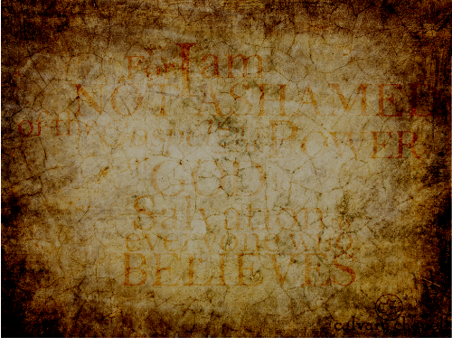
Romans 12:3-8
and I am the widow's mite."
Sandy Adams ~ "God is almighty …

Slide 3
Romans 12:3-8
A. W. Tozer ~ "Religion today is not transforming people; rather it is being transformed by the people. It is not raising the moral level of society; it is descending to society's own level, and congratulating itself that it has scored a victory because society is smilingly accepting its surrender."

Slide 4
Romans 12:3-8

Slide 5

Romans 12:3-8

Slide 6
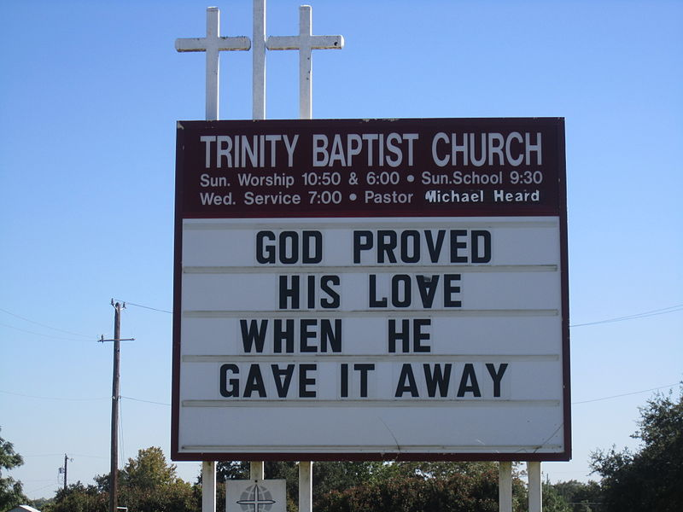


Romans 12:3-8
"DEDICATING
YOURSELVES
TO SERVICE"
# 126 - I SHALL
NOT BE
MOVED

Slide 7
Romans 12:3-8
"GIVING"
# 47 - JESUS
PAID IT
ALL

Slide 8
Romans 12:3-8
"THE
SIN OF
GOSSIPING"
# 211 – I LOVE
TO TELL
THE STORY

Slide 9
Romans 12:3-8
# 178 – WHY
NOT
TONIGHT?

Slide 10
Romans 12:3-8
COME AND HEAR
OUR PASTOR'S
LAST SERMON
# 306 – WHAT
FRIEND WE HAVE
IN JESUS

Slide 11
Romans 12:3-8

Slide 12
Romans 12:3-8
Soberly ~ sōphroneō –sōzō (to save) to make whole + phrēn (diaphragm) understanding

Slide 13
Romans 12:3-8

Slide 14
Romans 12:3-8
set the members, each one of them, in the body just as He pleased. ¹⁹ And if they were all one member, where would the body be?
²⁰ But now indeed there are many members, yet one body. ²¹ And the eye cannot say to the hand, "I have no need of you"; nor again the head to the feet, "I have no need of you." ²² No, much rather, those members of the body which seem to be weaker are necessary.
1 Cor. 12:14-22 ~ ¹⁴ For in fact the body is not one member but many.
¹⁵ If the foot should say, "Because I am not a hand, I am not of the body," is it therefore not of the body? ¹⁶ And if the ear should say, "Because I am not an eye, I am not of the body," is it therefore not of the body? ¹⁷ If the whole body were an eye, where would be the hearing? If the whole were hearing, where would be the smelling? ¹⁸ But now God has

Slide 15
Romans 12:3-8

Slide 16
Romans 12:3-8
fro and carried about with every wind of doctrine, by the trickery of men, in the cunning craftiness of deceitful plotting, ¹⁵ but, speaking the truth in love, may grow up in all things into Him who is the head—Christ—¹⁶ from whom the whole body, joined and knit together by what every joint supplies, according to the effective working by which every part does its share, causes growth of the body for the edifying of itself in love.
Eph. 4:11–16 ~ ¹¹ And He Himself gave some to be apostles, some prophets, some evangelists, and some pastors and teachers, ¹² for the equipping of the saints for the work of ministry, for the edifying of the body of Christ, ¹³ till we all come to the unity of the faith and of the knowledge of the Son of God, to a perfect man, to the measure of the stature of the fullness of Christ; ¹⁴ that we should no longer be children, tossed to and

Slide 17
Romans 12:3-8

Slide 18
Romans 12:3-8
Football ~ "22 men on the field in desperate need of rest, being cheered on or put down by 60,000 fans in the stands desperately in need of exercise."

Slide 19
Romans 12:3-8
Gifts ~ charisma ~ used 17x in New Testament
2 categories: speaking and ministering

Slide 20
Romans 12:3-8

Slide 21
Romans 12:3-8
4 kinds:
1. I don't do windows
2. I'll do anything you ask
3. The "Olive-Garden church worker"
4. I'll look for ways to serve
Christina Aguilera ~ "I'm not really religious but very spiritual. I give money to this company that manufactures hearing aids on a regular basis. More people should really hear me sing. I have a gift from God."

Slide 22
Romans 12:3-8

Slide 23
Romans 12:3-8
Prophecy ~ prophēteia – to speak forth
Calvin ~ "The peculiar gift of explaining revelation."
1 Cor. 14:3 ~ But he who prophesies speaks ﻿﻿edification and ﻿﻿exhortation and comfort to men.

Slide 24
Romans 12:3-8

Slide 25
Romans 12:3-8
Ministering ~ diakonia (deacon) service

Slide 26

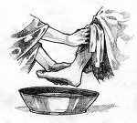
Romans 12:3-8
The First
Church
of the
baptismoftheHolySpiritwiththe
evidenceofthegiftofservice
evidenceofspeakingintongues

Slide 27
Romans 12:3-8

Slide 28
Romans 12:3-8
Exhorts ~ same as vs. 1 (beseech) – parakaleō (called alongside)
To give that which is needed or lacking

Slide 29
Romans 12:3-8

Slide 30
Romans 12:3-8
Liberality ~ KJV, simplicity; NIV, NASB, generously
haplotēs – literally, without braids

Slide 31
Romans 12:3-8

Slide 32
Romans 12:3-8
Cheerfulness ~ hilarotēs

Slide 33
Romans 12:3-8

Slide 34
Romans 12:3-8
Tim Keller ~ "The thing we would remember from meeting a truly gospel-humble person is how much the seemed to be totally interested in us. Because the essence of gospel-humility is not thinking more of myself or less of myself, it is thinking of myself less."

Slide 35
Romans 12:3-8

