Slide 1

Romans 9:22-10:13
A CD of this message will be available (free of charge) immediately following today’s Bible study.
This message will be available via podcast later this week at calvaryokc.com

Slide 2
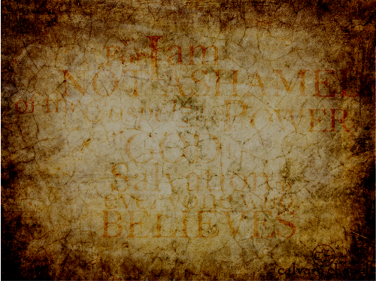
Romans 9:22-10:13
Man's
Freewill
God's
Sovereignty

Slide 3
Romans 9:22-10:13

Slide 4
Romans 9:22-10:13

Slide 5
Romans 9:22-10:13

Slide 6
Romans 9:22-10:13
Matt. 5:20 ~ Unless your righteousness is greater than that of the Pharisees, you're toast (Merrihew Standard Version)

Slide 7
Romans 9:22-10:13

Slide 8
Romans 9:22-10:13
1Cor 1:23 ~ but we preach Christ crucified, to the Jews a stumbling block and to the Greeks foolishness …

Slide 9
Romans 9:22-10:13

Slide 10
Romans 9:22-10:13
Chapter 9
Chapter 10
National
Individual

Slide 11
Romans 9:22-10:13

Slide 12
Romans 9:22-10:13
Saved ~ sōtēria

Slide 13
Romans 9:22-10:13

Slide 14
Romans 9:22-10:13
Is. 64:6 But we are all like an unclean thing,
And all our righteousnesses are like filthy rags;
We all fade as a leaf,
And our iniquities, like the wind,
Have taken us away.

Slide 15
Romans 9:22-10:13
Phil. 3:8-9 ~ ⁸ Yet indeed I also count all things loss for the excellence of the knowledge of Christ Jesus my Lord, for whom I have suffered the loss of all things, and count them as rubbish, that I may gain Christ
⁹ and be found in Him, not having my own righteousness, which is from the law, but that which is through faith in Christ, the righteousness which is from God through faith.

Slide 16
Romans 9:22-10:13

Slide 17
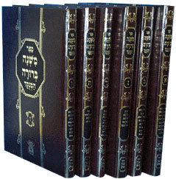


Romans 9:22-10:13
613 Precepts ~ 365 negative/248 postive
Misnah (c. AD 200)
Talmud
Gemara (AD 350-400)
48 volumes

Slide 18
Romans 9:22-10:13

Slide 19
Romans 9:22-10:13
Confess ~ homologeō - to say the same thing

Slide 20
Romans 9:22-10:13

Slide 21
Romans 9:22-10:13
1 Cor. 12:3 ~ … no one speaking by the Spirit of God calls Jesus accursed, and no one can say that Jesus is Lord except by the Holy Spirit.
With the heart ~ inward
With the mouth ~ outward

Slide 22
Romans 9:22-10:13

