Slide 1

Romans 8:27-39
A CD of this message will be available (free of charge) immediately following today’s Bible study.
This message will be available via podcast later this week at calvaryokc.com

Slide 2
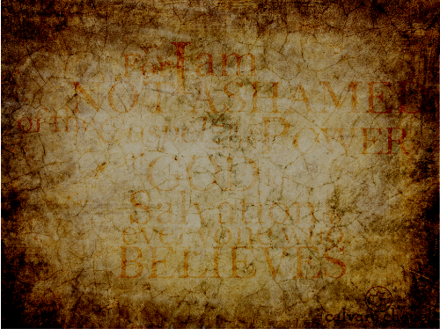
Romans 8:27-39
Johnny Carson ~ "If life was fair, Elvis would be alive and all the impersonators would be dead."

Slide 3
Romans 8:27-39

Slide 4
Romans 8:27-39
R. A. Torrey ~ "… a soft pillow for a tired heart."
That that is is that that is not is not is not that it it is
,
,
;
!
?
.

Slide 5
Romans 8:27-39

Slide 6
Romans 8:27-39
Calvinism ~ Reformed theology
Arminianism ~ Freewill

Slide 7
Romans 8:27-39
John Calvin
1509-1564
Jacobus Arminius
1559-1609

Slide 8
Romans 8:27-39
Foreknew ~ proginoskō
pro (before) + ginōskō (to know)
To know beforehand
Predestined ~ proorizō
pro (before) + horizō (to determine, limit or mark out a boundary)
To determine beforehand

Slide 9
Romans 8:27-39
GOD
Past
Future
Present

Slide 10
Romans 8:27-39
.

Slide 11
Romans 8:27-39
John 3:18-20 ~ ¹⁸ He who believes in Him is not condemned; but he who does not believe is condemned already, because he has not believed in the name of the only begotten Son of God. ¹⁹ And this is the condemnation, that the light has come into the world, and men loved darkness rather than light, because their deeds were evil. ²⁰ For everyone practicing evil hates the light and does not come to the light, lest his deeds should be exposed.

Slide 12
Romans 8:27-39
Henry Ward Beecher ~ "The elect are whosoever will; the non-elect are whosoever won't."

Slide 13
Romans 1:1-12

Slide 14
Romans 8:27-39
NLT ~ Who dares accuse us whom God has chosen for his own? Will God? No! He is the one who has given us right standing with himself.

Slide 15
Romans 1:1-12

Slide 16
Romans 8:27-39
More than conquerors ~ hupernikaō
huper ~ over, above
nikaō ~ (Wuest) "to conquer, to carry off the victory, come off victorious"

Slide 17
Romans 1:1-12

Slide 18

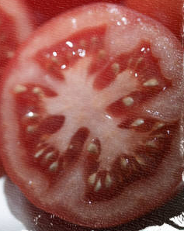
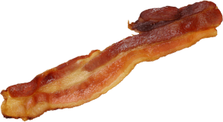
Romans 8:27-39
No
separation
(vv. 35-39)
No condemnation
(vv. 1-4)
No defeat
(vv.4-34)

Slide 19
Romans 1:1-12

Slide 20
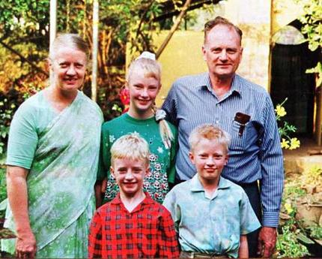

Romans 8:27-39

Slide 21
Romans 1:1-12

