Slide 1
Romans 8:12-17
A CD of this message will be available (free of charge) immediately following today’s Bible study.
This message will be available via podcast later this week at calvaryokc.com

Slide 2
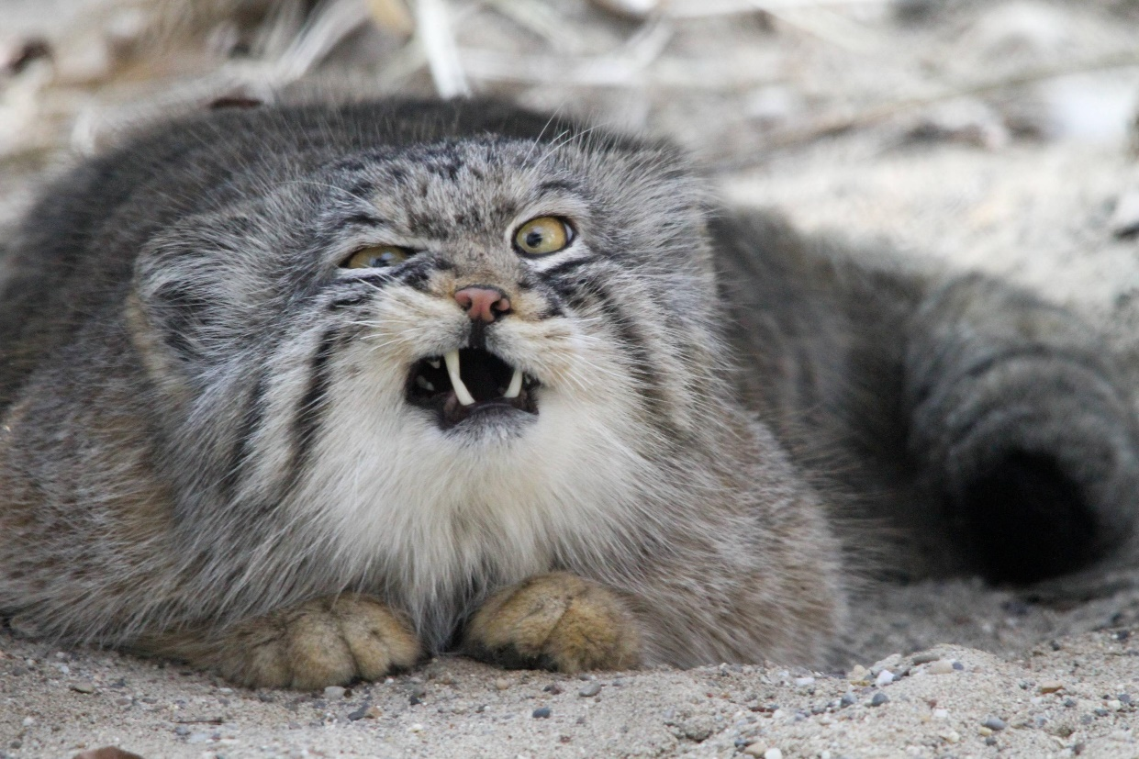
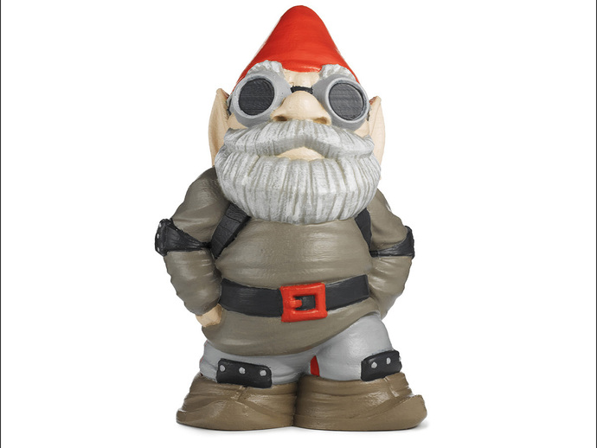
Romans 8:12-17
Steal human’s food
Kill their plants
Annoying music
Love mischief

Slide 3
Romans 8:12-17

Slide 4
Romans 8:12-17
errors
heirs
Are we of God?

Slide 5
Romans 8:12-17

Slide 6
Romans 8:12-17
Warren Wiersbe ~ "It is not enough for us to have the Spirit; the Spirit must have us! Only then can He share with us the abundant, victorious life that can be ours in Christ. We have no obligation to the flesh, because the flesh has only brought trouble into our lives."

Slide 7
Romans 8:12-17

Slide 8
Romans 8:12-17
Live ~ present tense – the idea of continually living
Put to death ~ KJV, mortify
John Trapp ~ "We must not think to pass from the mire to heaven, to dance with the devil all day, and sup with Christ at night, to fly to heaven with pleasant wings. Beetles love dunghills better than ointments; and swine love mud better than a garden; so do swinish people their lusts, better than the lives of their souls."

Slide 9
Romans 8:12-17

Slide 10
Romans 8:12-17
Led ~ passive voice (we yield to Him)
Augustine ~ "Love God and do what you want."

Slide 11
Romans 8:12-17

Slide 12
Romans 8:12-17
2 Tim. 1:7 ~ For God has not given us a spirit of fear, but of power and of love and of a sound mind.
Adoption ~ huiothesia
huios ~ son
tithēmi ~ lay, put, lay down, appoint
"Son-placement"

Slide 13
Romans 8:12-17

Slide 14
Romans 8:12-17
Marvin Vincent ~ "The process of legal adoption by which the chosen heir became entitled not only to the reversion of the property but to the civil status, to the burdens as well as the rights of the adopter—became, as it were, his other self, one with him … "

Slide 15
Romans 8:12-17
Roman adoption
1) Lost all rights to former life
1) Reckon the old man dead
2) Became full heir
2) Acknowledge utter weakness
3) Past debts canceled
3) Recognize new position
4) Absolutely son of the father
4) Walk accordingly

Slide 16
Romans 8:12-17
Romans 13:13–14 ~ ¹³ Let us walk properly, as in the day, not in revelry and drunkenness, not in lewdness and lust, not in strife and envy. ¹⁴ But put on the Lord Jesus Christ, and make no provision for the flesh, to fulfill its lusts.

Slide 17
Romans 8:12-17

