Slide 1
Romans 7:13-25
A CD of this message will be available (free of charge) immediately following today’s Bible study.
This message will be available via podcast later this week at calvaryokc.com

Slide 2
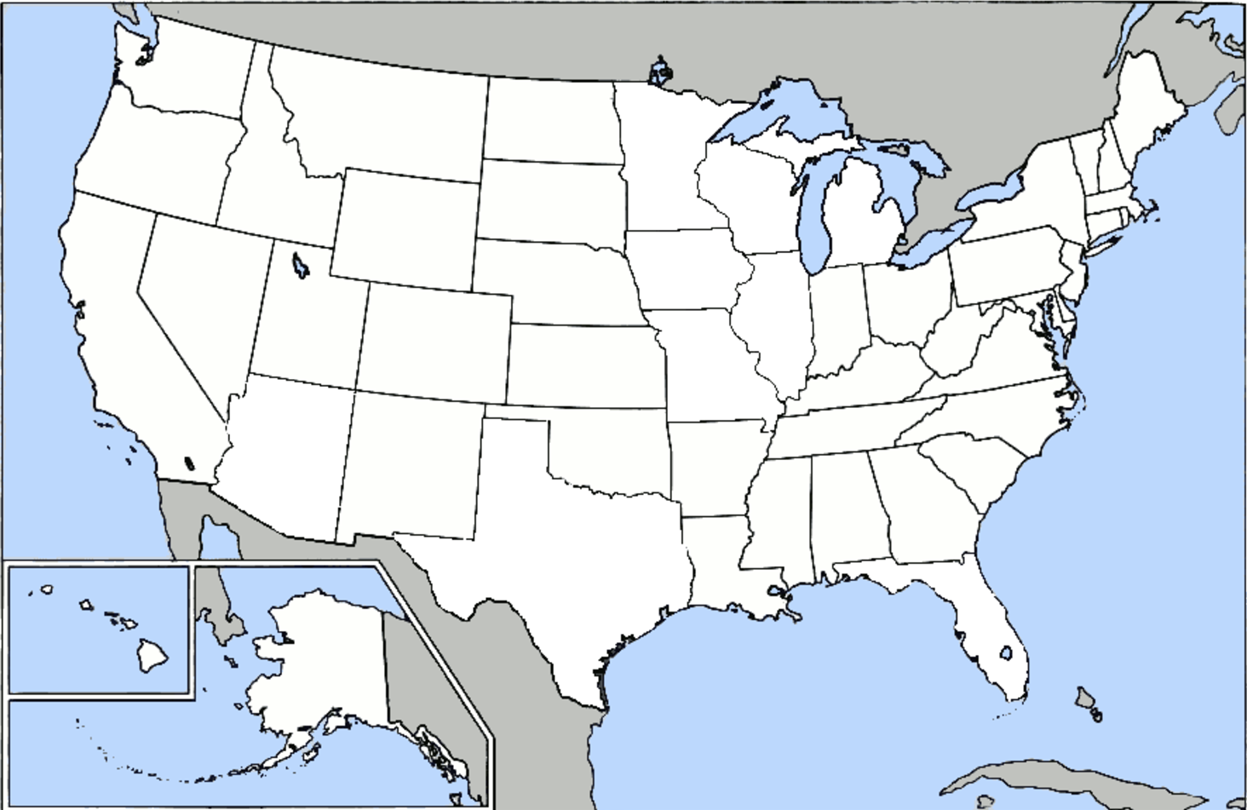
Romans 7:13-25

Slide 3
Romans 7:13-25

Slide 4
Romans 7:13-25
C. H. Spurgeon ~ "Why didn’t he say, 'exceeding black,' or 'exceeding horrible,' or 'exceedingly deadly'? Why, because there is nothing in the world so bad as sin. When he wanted to use the very worst word he could find: to call sin by, he called it by its own name, and reiterated it: 'sin,' 'exceeding sinful.'"

Slide 5
Romans 7:13-25

Slide 6
Romans 7:13-25
NIV ~ We know that the law is spiritual; but I am unspiritual, sold as a slave to sin.
Carnal ~ sarkinos (adj.)

Slide 7
Romans 7:13-25

Slide 8
Romans 7:13-25
Will ~ thelō – to want, desire
Practice ~ prassō – usually translated do (commit, keep)

Slide 9
Romans 7:13-25

Slide 10
Romans 7:13-25
C. S. Lewis ~ "No man knows how bad he is until he has tried to be good."
3 kinds of men:
Natural ~ unsaved man
Spiritual ~ saved man with eyes on God
Carnal ~ saved man with eyes on his flesh

Slide 11
Romans 7:13-25

Slide 12
Romans 7:13-25
Murphy Goes To Church
The Law of the Latecomer's Lament
The last seats to be filled are in the middle of the front pews.
The Law of the Perpetual Recession
When the economy is bad, people give less. When the economy is good, people give less

Slide 13
Romans 7:13-25
Murphy Goes To Church
The Law of the Multiple Choice
When presented with several optional dates for a special church event, the board will pick the one which conflicts with a Women's Fellowship meeting (and we know who will win that battle).
The Law of Winging it
The words printed on the projector screen and the ones being sung by the worship team never match exactly.

Slide 14
Romans 7:13-25
Murphy Goes To Church
The Law of a Moment of Weakness
The idiot driver you honk at on the way to church will end up sitting right next to you
The Law of Lasting Impressions
The time you accidentally use a permanent marker on the white board, will be during the annual "sex talk."

Slide 15
Romans 7:13-25
Murphy Goes To Church
The Law of Small Group Bible Studies
People with the shallowest insights dominate discussions.
The Law of the Bluffer's Refuge
You can get away with anything by saying, "According to the original Greek…."

Slide 16
Romans 7:13-25

Slide 17
Romans 7:13-25
Wretched ~ originally “wretched through the exhaustion of hard labor” (Vincent)
Matt. 5:3 ~ Blessed are the poor in spirit,
For theirs is the kingdom of heaven.

Slide 18
Romans 7:13-25

Slide 19
Romans 7:13-25
I, me, my, myself ~ 40x in vv. 13-25

Slide 20
Romans 7:13-25

