Slide 1

Romans 6:1-10
A CD of this message will be available (free of charge) immediately following today’s Bible study.
This message will be available via podcast later this week at calvaryokc.com

Slide 2
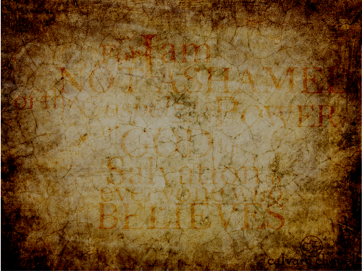
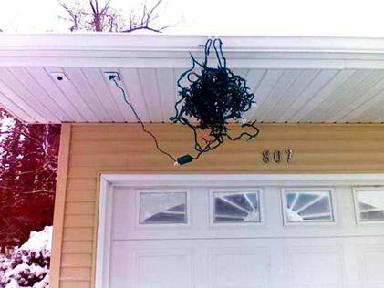
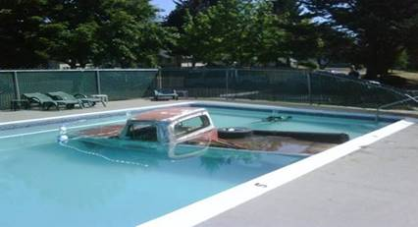
Romans 6:1-10

Slide 3
Romans 6:1-10

Slide 4
Romans 6:1-10
Rom 5:10 ~ For if when we were enemies we were reconciled to God through the death of His Son, much more, having been reconciled, we shall be saved by His life.

Slide 5
Romans 6:1-10

Slide 6
Romans 6:1-10
Problem: How can I gain control over a sin nature that no longer has any right over me, yet continues to try?
Answer: Being holy is not something I do or attain; rather it is something I am therefore live.

Slide 7
Romans 6:1-10
Chapters 4-5 ~ we are set free from the penalty of sin
Chapters 6-8 ~ we are set free from the power of sin

Slide 8
Romans 6:1-10

Slide 9
Romans 6:1-10
Antinomianism
anti ~ instead of
nomos ~ law
1 : one who holds that under the gospel dispensation of grace the moral law is of no use or obligation because faith alone is necessary to salvation
2 : one who rejects a socially established morality

Slide 10
Romans 6:1-10

Slide 11
Romans 6:1-10
RECOGNIZE THE DATA (vv. 3-10)
RECKON THE DEATH (vv. 11-12)
REMIT OUR DEVICES (vv. 13-23)

Slide 12
Romans 6:1-10

Slide 13
Romans 6:1-10
1st fact: We are identified into Jesus death

Slide 14
Romans 6:1-10

Slide 15
Romans 6:1-10
United ~ sumphutos
sun ~ with
phuō ~ to spring up, to plant
Grafted ~ draws life from the host
2nd fact: This identification allows me to be "grafted" into Him

Slide 16
Romans 6:1-10

Slide 17
Romans 6:1-10
3rd fact: This engrafting is past tense
Done away with ~ katargeō
kata ~ according to
argos ~
(TDNT) means "inactive" or "inoperative." It is used in the sense of "indolent," "unemployed," "useless," "unserviceable"
4th fact: This past tense death renders my "old man" "inactive"

Slide 18
Romans 6:1-10

Slide 19
Romans 6:1-10
5th fact: My inactive old man is free from sin

Slide 20
Romans 6:1-10

Slide 21
Romans 6:1-10
6th fact: My identification with Jesus brings me life

Slide 22
Romans 6:1-10

