Slide 1

Romans 5:1-8
A CD of this message will be available (free of charge) immediately following today’s Bible study.
This message will be available via podcast later this week at calvaryokc.com

Slide 2
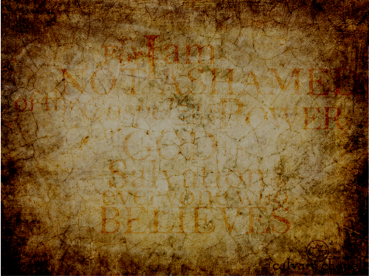
Romans 5:1-8
F
A
I
T
H
orsaking
ll
rust
im

Slide 3
Romans 5:1-8

Slide 4
Romans 5:1-8
Abraham Jacob Heschel (God in Search of Man: a Philosophy of Judaism) ~ "Religion declined not because it was refuted, but because it became irrelevant, dull, oppressive, insipid. When faith is completely replaced by creed, worship by discipline, love by habit; when the crisis of today is ignored because of the splendor of the past; when faith becomes an heirloom rather than a living fountain; when religion speaks only in the name of authority rather than with the voice of compassion – its message becomes meaningless."

Slide 5
Romans 5:1-8

Slide 6
Romans 5:1-8
Martin Luther ~ "In the whole Bible there is hardly another chapter which can equal this triumphant text."

Slide 7
Romans 5:1-8

Slide 8
Romans 5:1-8
Phil. 4:6-7 ~ ⁶ Be anxious for nothing, but in everything by prayer and supplication, with thanksgiving, let your requests be made known to God; ⁷ and the peace of God, which surpasses all understanding, will guard your hearts and minds through Christ Jesus.

Slide 9
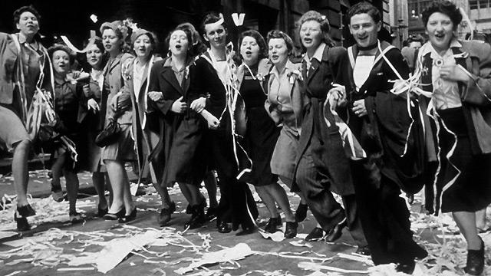
Romans 5:1-8

Slide 10
Romans 5:1-8

Slide 11
Romans 5:1-8
Have ~ perfect tense – "describes an action which is viewed as having been completed in the past, once and for all, not needing to be repeated."
Sanctification
The Christian Life
Justification
Glorification

Slide 12
Romans 5:1-8

Slide 13
Romans 5:1-8
Glory in, not for tribulations
thlipsis; pressure, a crushing

Slide 14
Romans 5:1-8
Benefits of tribulation:
Discipline
Strengthening, increasing faith
Comfort others(2 Cor. 1:3-7)
Reveal our hearts
Reveal our helplessness
Conform us into Christ's image

Slide 15
Romans 5:1-8

Slide 16
Romans 5:1-8
Perseverance ~ hupomonē – to remain under
KJV, patience
NLT, endurance

Slide 17
Romans 5:1-8
Life's experiences
Life
thlipsis
hupomonē

Slide 18
Romans 5:1-8
Martin Luther ~ "Whatever virtues tribulation finds us in, it develops more fully. If anyone is carnal, weak, blind, wicked, irascible, haughty, and so forth, tribulation will make him more carnal, weak, blind, wicked and irritable. On the other hand, if one is spiritual, strong, wise, pious, gentle and humble, he will become more spiritual, powerful, wise, pious, gentle and humble."

Slide 19
Romans 5:1-8

Slide 20
Romans 5:1-8
Character ~ dokimē – mettle that has been tried and tested
KJV, experience
NASB, proven character

Slide 21
Romans 5:1-8

Slide 22
Romans 5:1-8
Hope ~ elpis – a confident expectation
Hope is future tense faith …
or faith is present tense hope
J. B. Phillips, steady hope
v. 2, happy certainty

Slide 23
Romans 5:1-8
David Guzik ~ "Lord, bring it on. I know you love me and carefully measure every trial and have a loving purpose to accomplish in every tribulation. Lord, I won’t seek trials and search out tribulation, but I won’t despise them or lose hope when they come. I trust Your love in everything You allow."

Slide 24
Romans 5:1-8

Slide 25
Romans 5:1-8
2 Cor. 12:9 ~ And He said to me, "My grace is sufficient for you, for My strength is made perfect in weakness." Therefore most gladly I will rather boast in my infirmities, that the power of Christ may rest upon me.
Disappoint ~ kataischunō
KJV, ashamed
Literally, put to shame because of disappointment

Slide 26
Romans 5:1-8

Slide 27
Romans 5:1-8
Wuest ~ But God is constantly proving His own love to us, because while we were yet sinners, Christ in behalf of us died.
Heb. 9:12 ~ Not with the blood of goats and calves, but with His own blood He entered the Most Holy Place once for all, having obtained eternal redemption.

Slide 28
Romans 5:1-8

