Slide 1

Romans 4:13-25
A CD of this message will be available (free of charge) immediately following today’s Bible study.
This message will be available via podcast later this week at calvaryokc.com

Slide 2
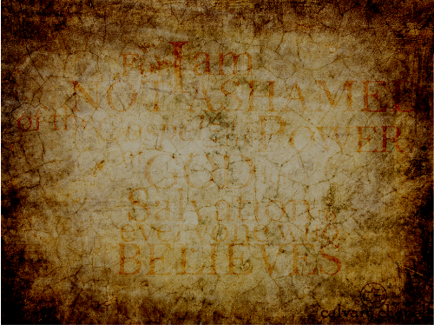
Romans 4:13-25
Dear Lord,
So far today, I am doing
alright. I have not gossiped,
lost my temper, been greedy,
grumpy, nasty, selfish, or self-
indulgent. I have not whined, complained, cursed, or eaten any chocolate. I have charged nothing on my credit card.
But, Lord, I'm gonna be getting out of bed in a minute and from here on out, I'm gonna need Your help.

Slide 3
Romans 4:13-25

Slide 4
Romans 4:13-25
NLT ~ For the law always brings punishment on those who try to obey it. (The only way to avoid breaking the law is to have no law to break!)

Slide 5
Romans 4:13-25

Slide 6
Romans 4:13-25
NLT ~ Even when there was no reason for hope, Abraham kept hoping – believing that he would become the father of many nations. For God had said to him, "That's how many descendants you will have!"

Slide 7
Romans 4:13-25
WHAT IT'S NOT:
WHAT IS FAITH?
It is not a feeling
It is not merely believing a fact to be true
It is not a positive mental attitude

Slide 8
Romans 4:13-25
WHAT IS FAITH?
Heb. 11:1 ~ Now faith is the substance of things hoped for, the evidence of things not seen.

Slide 9
Romans 4:13-25
WHAT IS FAITH?
1. Consider the Truth
NIV ~ Without weakening in his faith, he faced the fact that his body was as good as dead.
NASB ~ And without becoming weak in faith he contemplated his own body.
Heb. 11:11a ~ By faith Sarah herself also received strength to conceive seed,
Heb. 11:12a ~ Therefore from one man, and him as good as dead,

Slide 10
Romans 4:13-25
WHAT IS FAITH?
2. Constantly pressing on
Heb. 11:8 ~ By faith Abraham obeyed when he was called to go out to the place which he would receive as an inheritance. And he went out, not knowing where he was going.

Slide 11
Romans 4:13-25
WHAT IS FAITH?
3. Continually patient
Heb. 11:10 ~ for he waited for the city which has foundations, whose builder and maker is God.
Heb.11:13a ~ These all died in faith, not having received the promises, but having seen them afar off were assured of them, embraced them …

Slide 12
Romans 4:13-25
WHAT IS FAITH?
4. Convinced of God's ability
Heb. 11:11b ~ … she bore a child when she was past the age, because she judged Him faithful who had promised.
Heb.11:12b ~ were born as many as the stars of the sky in multitude--innumerable as the sand which is by the seashore.

Slide 13
Romans 4:13-25

