Slide 1

Romans 3:19-31
A CD of this message will be available (free of charge) immediately following today’s Bible study.
This message will be available via podcast later this week at calvaryokc.com

Slide 2
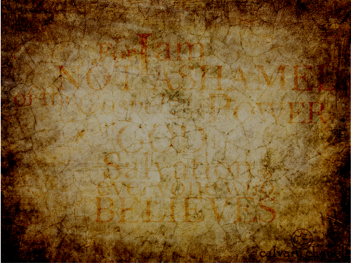
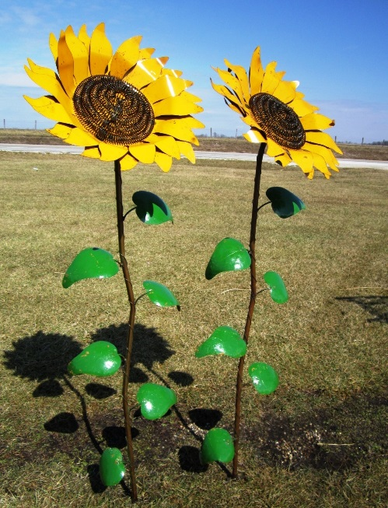
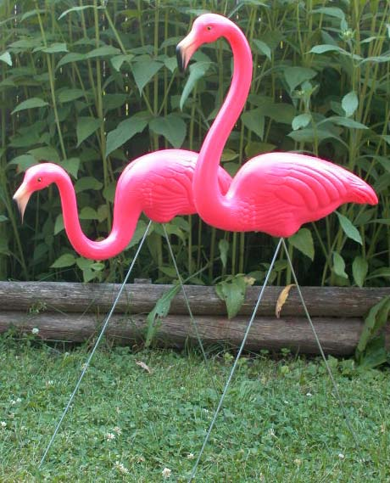
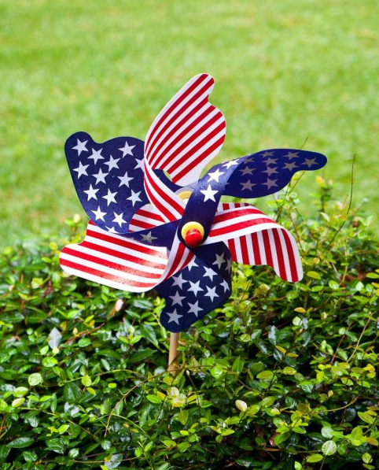
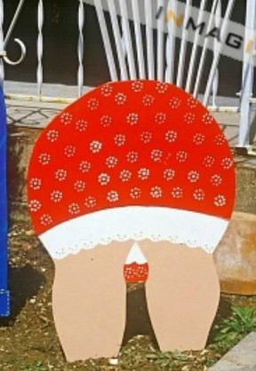
Romans 3:19-31
$6
$10
$8

Slide 3
Romans 3:19-31

Slide 4
Romans 3:19-31
Ex. 30:10 ~ And Aaron shall make atonement upon its horns once a year with the blood of the sin offering of atonement; once a year he shall make atonement upon it throughout your generations. It is most holy to the Lord.
Atonement ~ kippur – to cover

Slide 5
Romans 3:19-31

Slide 6
Romans 3:19-31
Gen. 6:8 ~ But Noah found grace in the eyes of the LORD.
Gen. 15:6 ~ And he (Abraham) believed in the Lord, and He accounted it to him for righteousness.
Hab. 2:4 ~ …But the just shall live by faith.

Slide 7
Romans 3:19-31

Slide 8
Romans 3:19-31
Fall short ~ present tense – i.e. falling short

Slide 9
Romans 3:19-31
4" Steel cable
Cotton thread
5,280'
Grand Canyon

Slide 10
Romans 3:19-31
Freely ~ dōrean – has the idea of underservedness
Rev. 21:6 ~ Then He said to me, "It is done. I am the Alpha and the Omega, the beginning and the end. I will give to the one who thirsts from the spring of the water of life without cost."
John 15:25 ~ But they have done this to fulfill the word that is written in their Law, "They hated Me without a cause."

Slide 11
Romans 3:19-31

Slide 12
Romans 3:19-31
2 Cor. 5:21 ~ For He made Him who knew no sin to be sin for us, that we might become the righteousness of God in Him.
Propitiation (v. 25) ~ hilasmos - mercy seat (Heb. 9:5)
"To gain or regain the favor or goodwill of; to appease, conciliate or pacify."
NLT ~ For God sent Jesus to take the punishment for our sins and to satisfy God’s anger against us.

Slide 13
Romans 3:19-31

Slide 14
Romans 3:19-31
Philips ~ Are we then undermining the Law with this insistence on faith? Not a bit of it! We put the Law in its proper place.

Slide 15
Romans 3:19-31

