Slide 1

Romans 2:17-29
A CD of this message will be available (free of charge) immediately following today’s Bible study.
This message will be available via podcast later this week at calvaryokc.com

Slide 2
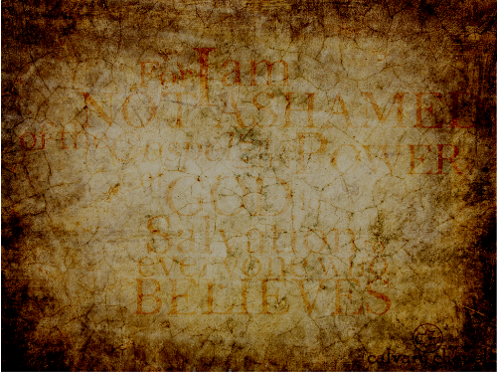
Romans 2:17-29
1:18-32
2:1-16
2:17-29
Heathen
High-minded
Hypocrite
Reprobate
Right-acting
Religious
Pagan
Proper
Pious

Slide 3
Romans 2:17-29

Slide 4
Romans 2:17-29
Legalism: "Simply put, legalism is the belief, stated or supposedly implied that law, not faith, is the pre-eminent principle of redemption." (www.websters-online-dictionary.com)

Slide 5
Romans 2:17-29

Slide 6
Romans 2:17-29
Isaiah 42:6–7 ~ ⁶ I, the Lord, have called You in righteousness,
And will hold Your hand;
I will keep You and give You as a covenant to the people,
As a light to the Gentiles,
⁷ To open blind eyes,
To bring out prisoners from the prison,
Those who sit in darkness from the prison house.

Slide 7
Romans 2:17-29

Slide 8
Romans 2:17-29
Foolish ~ aphrōn – without a mind

Slide 9
Romans 2:17-29

Slide 10
Romans 2:17-29
Rob temples ~ heirosuleō
heiros + sulaō
KJV, commit sacrilege

Slide 11
Romans 1:1-12
Mal. 3:8–10 ~ ⁸ "Will a man rob God?
Yet you have robbed Me!
But you say,
'In what way have we robbed You?'
In tithes and offerings.
⁹ You are cursed with a curse,
For you have robbed Me,
Even this whole nation.
¹⁰ Bring all the tithes into the storehouse,
That there may be food in My house,
And try Me now in this,"

Slide 12
Romans 2:17-29
Says the Lord of hosts,
"If I will not open for you the windows of heaven
And pour out for you such blessing
That there will not be room enough to receive it."

Slide 13
Romans 2:17-29

Slide 14
Romans 2:17-29
Col. 2:11–14 ~ ¹¹ In Him you were also circumcised with the circumcision made without hands, by putting off the body of the sins of the flesh, by the circumcision of Christ, ¹² buried with Him in baptism, in which you also were raised with Him through faith in the working of God, who raised Him from the dead. ¹³ And you, being dead in your trespasses and the uncircumcision of your flesh, He has

Slide 15
Romans 2:17-29
made alive together with Him, having forgiven you all trespasses, ¹⁴ having wiped out the handwriting of requirements that was against us, which was contrary to us. And He has taken it out of the way, having nailed it to the cross.

Slide 16
Romans 2:17-29

Slide 17
Romans 2:17-29
Deut. 10:16 ~ Therefore circumcise the foreskin of your heart, and be stiff- necked no longer.

Slide 18
Romans 2:17-29
NLT ~ ²⁸ For you are not a true Jew just because you were born of Jewish parents or because you have gone through the Jewish ceremony of circumcision.
²⁹ No, a true Jew is one whose heart is right with God. And true circumcision is not a cutting of the body but a change of heart produced by God’s Spirit. Whoever has that kind of change seeks praise from God, not from people.

Slide 19
Romans 2:17-29

Slide 20
Romans 2:17-29
2 Corinthians 3:4–6 ~ ⁴ And we have such trust through Christ toward God. ⁵ Not that we are sufficient of ourselves to think of anything as being from ourselves, but our sufficiency is from God, ⁶ who also made us sufficient as ministers of the new covenant, not of the letter but of the Spirit; for the letter kills, but the Spirit gives life.

Slide 21
Romans 2:17-29

