Slide 1
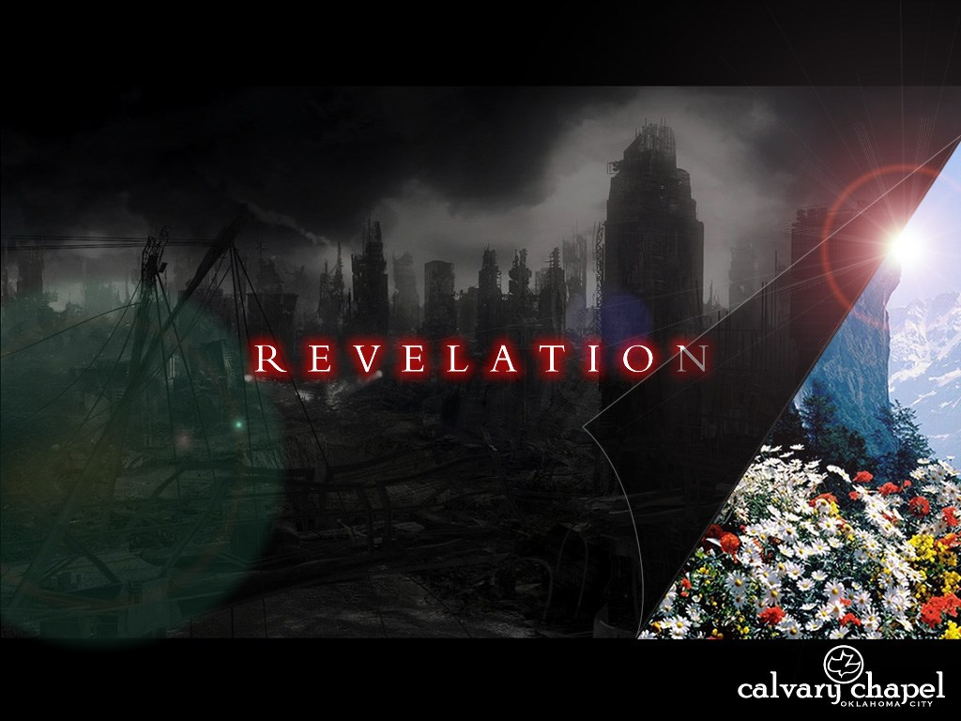
A free CD of this message will be available following the service
2 2 . 1 – 2 1
This message will also be available for podcast later in the week a calvaryokc.com

Slide 2
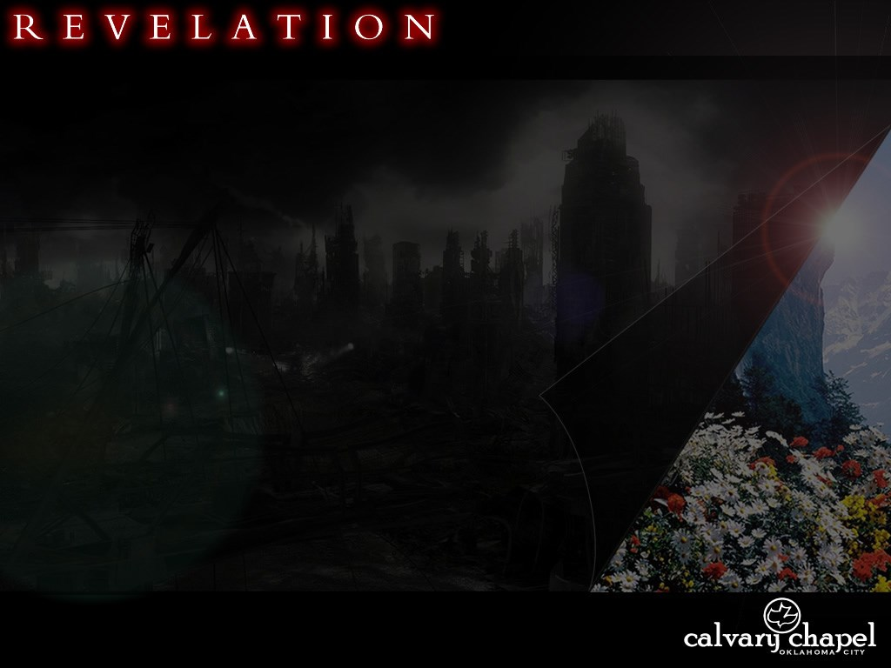
2 2 . 1 – 2 1
99

Slide 3
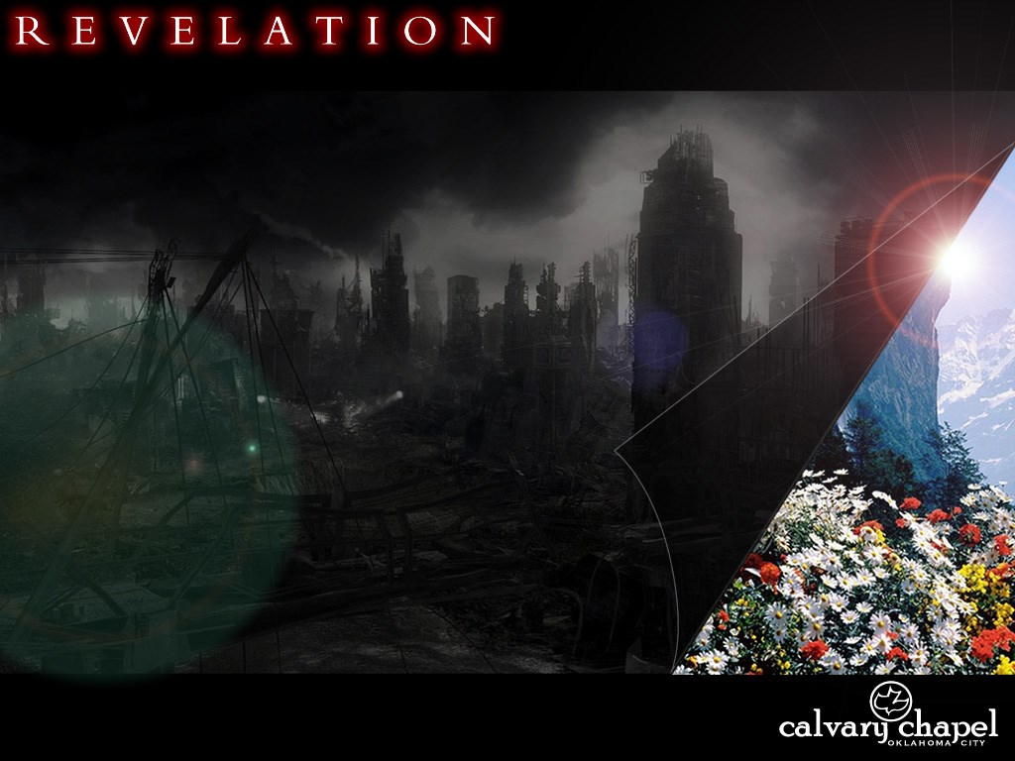
2 2 . 1 – 2 1

Slide 4
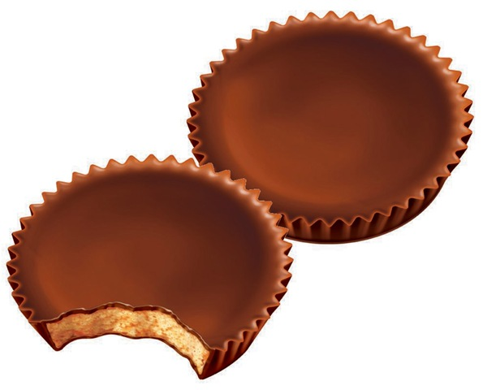
2 2 . 1 – 2 1
NLT ~ On each side of the river grew a tree of life, bearing twelve crops of fruit, with a fresh crop each month.
Fruit ~ reeseoi peanutos butteron cupomai

Slide 5
2 2 . 1 – 2 1

Slide 6
2 2 . 1 – 2 1
Healing ~ therapeia – therapeutic (i.e. well-being)

Slide 7
2 2 . 1 – 2 1

Slide 8
2 2 . 1 – 2 1
Luke 17: 7-10 ~ ⁷ And which of you, having a servant plowing or tending sheep, will say to him when he has come in from the field, "Come at once and sit down to eat"? ⁸ But will he not rather say to him, "Prepare something for my supper, and gird yourself and serve me till I have eaten and drunk, and afterward you will eat and drink"? ⁹ Does he thank that servant because he did the things that were commanded him?
I think not. ¹⁰ So likewise you, when you have done all those things which you are commanded, say, "We are unprofitable servants. We have done what was our duty to do."

Slide 9
2 2 . 1 – 2 1

Slide 10
2 2 . 1 – 2 1
Quickly ~ tachus – rapidly
2 Pet. 3:8 ~ But, beloved, do not forget this one thing, that with the Lord one day is as a thousand years, and a thousand years as one day.

Slide 11
2 2 . 1 – 2 1
Rev. 1:3 ~ Blessed is he who reads and those who hear the words of this prophecy, and keep those things which are written in it; for the time is near.
Keep ~ tēreō – to attend to, to preserve and protect

Slide 12
2 2 . 1 – 2 1

Slide 13
2 2 . 1 – 2 1
Dan. 12:4 ~ But you, Daniel, shut up the words, and seal the book until the time of the end; many shall run to and fro, and knowledge shall increase.
Time ~ not chronos – time, but kairos – opportune moment or season

Slide 14
2 2 . 1 – 2 1

Slide 15
2 2 . 1 – 2 1
Dwight L. Moody ~ "Men full of the Spirit can look right into heaven."

Slide 16
2 2 . 1 – 2 1

Slide 17
2 2 . 1 – 2 1
2 Pet. 3:10-12 ~ ¹⁰ But the day of the Lord will come as a thief in the night, in which the heavens will pass away with a great noise, and the elements will melt with fervent heat; both the earth and the works that are in it will be burned up. ¹¹ Therefore, since all these things will be dissolved, what manner of persons ought you to be in holy conduct and godliness, ¹² looking for and hastening the coming of the day of God, because of
which the heavens will be dissolved, being on fire, and the elements will melt with fervent heat?
Hastening ~ speudos – speed

Slide 18
2 2 . 1 – 2 1
CS Lewis ~ "Can we believe that God ever really modifies His action in response to the suggestions of men? For infinite wisdom does not need telling what is best, and infinite goodness needs no urging to do it. But neither does God need any of those things that are done by finite agents, whether living or inanimate. He could, if He chose, repair our bodies miraculously without food; or give us food without the aid of farmers, bakers, and butchers, or knowledge without the aid of learned men; or convert the
heathen without missionaries. Instead, He allows soils and weather and animals and the muscles, minds, and wills of men to cooperate in the execution of His will... It is not really stranger, nor less strange, that my prayers should affect the course of events than that my other actions should do so. They have not advised or changed God's mind – that is, His overall purpose. But that purpose will be realized in different ways according to the actions, including the prayers, of His creatures."

Slide 19
2 2 . 1 – 2 1

Slide 20
2 2 . 1 – 2 1
Do His commandments ~ NIV, NASB, wash their robes

Slide 21
2 2 . 1 – 2 1

Slide 22
2 2 . 1 – 2 1
Root
Offspring
Preexistence
Incarnation

Slide 23
2 2 . 1 – 2 1

Slide 24
2 2 . 1 – 2 1
Deut. 4:2 ~ You shall not add to the word which I command you, nor take from it, that you may keep the commandments of the Lord your God which I command you.
Prov. 30:5-6 ~ ⁵ Every word of God is pure;
He is a shield to those who put their trust in Him.
⁶ Do not add to His words,
Lest He rebuke you, and you be found a liar.

Slide 25
2 2 . 1 – 2 1

Slide 26
2 2 . 1 – 2 1
C. S. Lewis ~ "Heaven will solve our problems, but not, I think, by showing us subtle reconciliations between all our apparently contradictory notions. The notions will all be knocked from under our feet. We shall see that there never was any problem."

Slide 27
2 2 . 1 – 2 1

