Slide 1
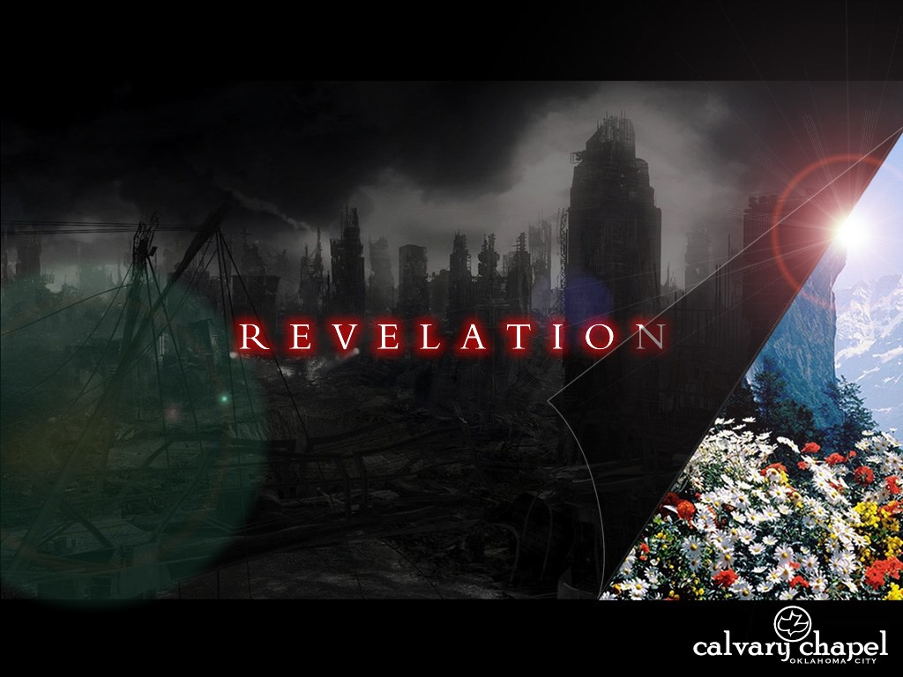
A free CD of this message will be available following the service
21 . 9 – 2 7
This message will also be available for podcast later in the week a calvaryokc.com

Slide 2
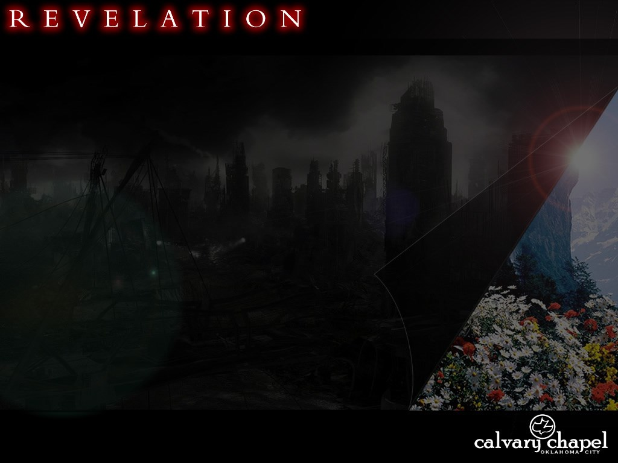
21 . 9 – 2 7
Eph. 5.30-32 ~ ³⁰ For we are members of His body, of His flesh and of His bones. ³¹ For this reason a man shall leave his father and mother and be joined to his wife, and the two shall become one flesh. ³² This is a great mystery, but I speak concerning Christ and the church.

Slide 3
21 . 9 – 2 7
David Guzik ~ "Our instinct is to romantically consider innocence as man’s perfect state, and wish Adam would have never done what he did. But we fail to realize that redeemed man is greater than innocent man; that we gain more in Jesus than we ever lost in Adam. God’s perfect state is one of redemption, not innocence."

Slide 4
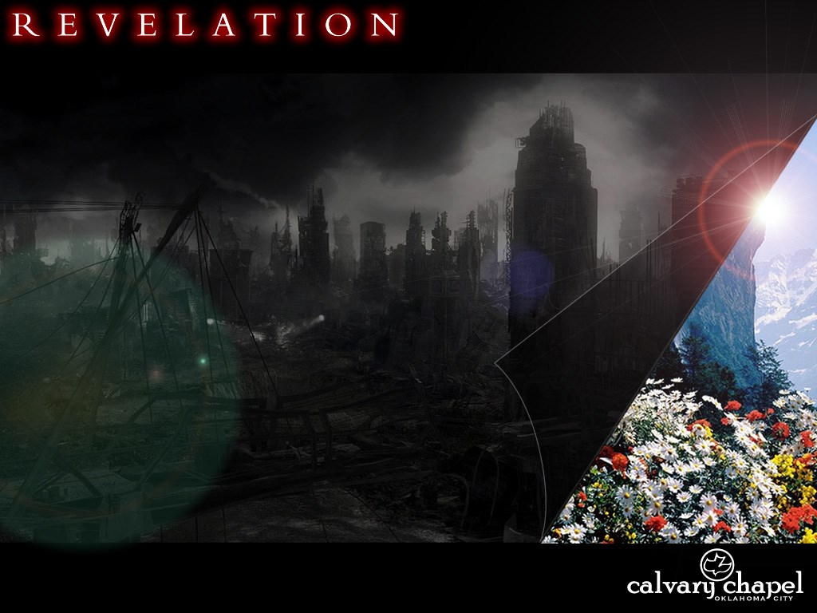
21 . 9 – 2 7

Slide 5
21 . 9 – 2 7
J. Vernon McGee: cube in a sphere
Harry Ironside: pyramid
J. A. Seiss, Donald Grey Barnhouse: cube

Slide 6
21 . 9 – 2 7
1400 mi
1400 mi
1400 mi

Slide 7
21 . 9 – 2 7

Slide 8
21 . 9 – 2 7
C. S. Lewis ~ "Looking for God—or Heaven—by exploring space is like reading or seeing all Shakespeare's plays in the hope that you will find Shakespeare as one of the characters."

Slide 9
21 . 9 – 2 7

Slide 10
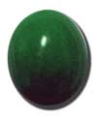
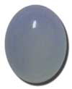
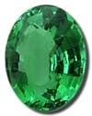
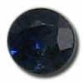
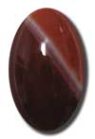
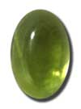
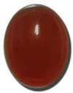
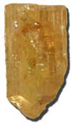
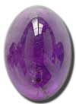
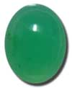
21 . 9 – 2 7
Jasper
Sapphire
Chalcedony
Emerald
Sardonyx
Sardius
Chrysolite
Beryl
Topaz
Chrysoprase
Jacinth
Amethyist

Slide 11
21 . 9 – 2 7

Slide 12
21 . 9 – 2 7
Transparent ~ diaphanēs – to let light through

Slide 13
21 . 9 – 2 7

Slide 14
21 . 9 – 2 7
Joni Eareckson Tada ~ "The best we can hope for in this life is a knothole peek at the shining realities ahead. Yet a glimpse is enough. It's enough to convince our hearts that whatever sufferings and sorrows currently assail us aren't worthy of comparison to that which waits over the horizon."

Slide 15
21 . 9 – 2 7

Slide 16
21 . 9 – 2 7
Billy Graham ~ "God will prepare everything for our perfect happiness in heaven, and if it takes my dog being there, I believe he'll be there."

Slide 17
21 . 9 – 2 7

Slide 18
21 . 9 – 2 7
2 Cor. 12.3-4 ~ ³ And I know such a man—whether in the body or out of the body I do not know, God knows— ⁴ how he was caught up into Paradise and heard inexpressible words, which it is not lawful for a man to utter.
Heb. 9.27 ~ And as it is appointed for men to die once, but after this the judgment,

Slide 19
21 . 9 – 2 7

Slide 20
21 . 9 – 2 7
2 Pet. 3.11 ~ Therefore, since all these things will be dissolved, what manner of persons ought you to be in holy conduct and godliness,
1 John 3:3 ~ And everyone who has this hope in Him purifies himself, just as He is pure.

Slide 21
21 . 9 – 2 7

Slide 22
21 . 9 – 2 7
Key words:
Apocalypse ~ apokalupsis – unveiling (not catastrophe or the end of the world
Shortly ~ tachos – also quickly, speedily
Action will be sudden when it comes
After these things (this) ~ meta tauta (9x in Revelation)

Slide 23
21 . 9 – 2 7

Slide 24
21 . 9 – 2 7
Babylonians used a base 6 system
A B C D E F G H I
6 9 18 24 30 36 42 48 54
J K L M N O P Q R
60 66 72 78 84 90 96 102 108
S T U V W X Y Z
114 120 126 132 138 144 150 154
K I S S I N G E R
66 54 114 114 54 84 42 30 108
= 666

Slide 25
21 . 9 – 2 7

Slide 26
21 . 9 – 2 7
J. A. Seiss, Donald Grey Barnhouse: cube
Harry Ironside: pyramid
J. Vernon McGee: cube in a sphere

