Slide 1
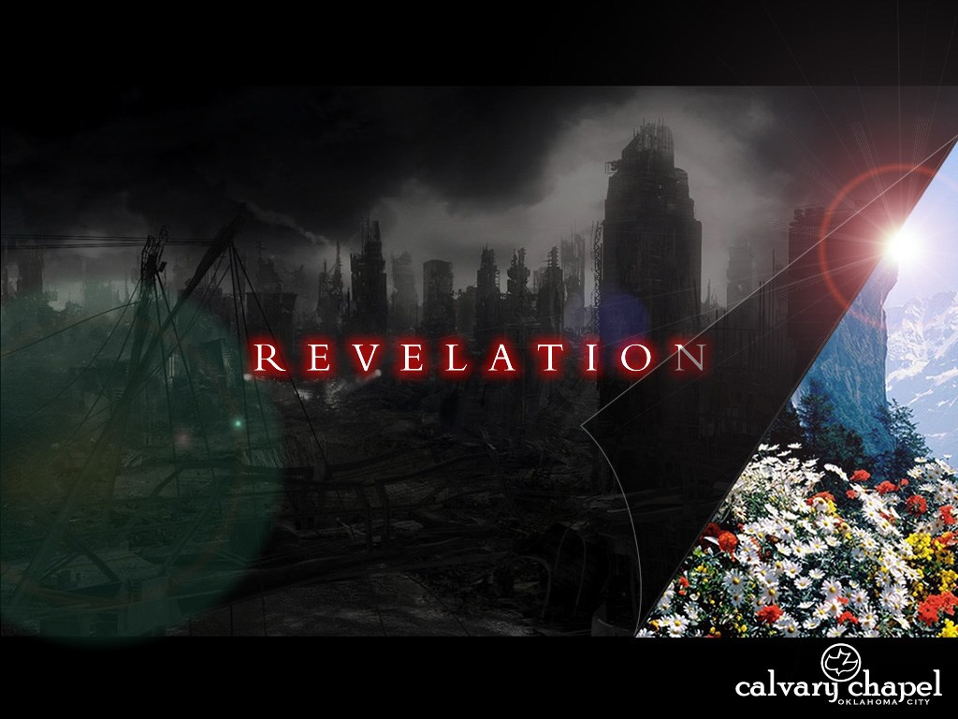
A free CD of this message will be available following the service
20 . 7 – 2 1 . 8
This message will also be available for podcast later in the week a calvaryokc.com

Slide 2
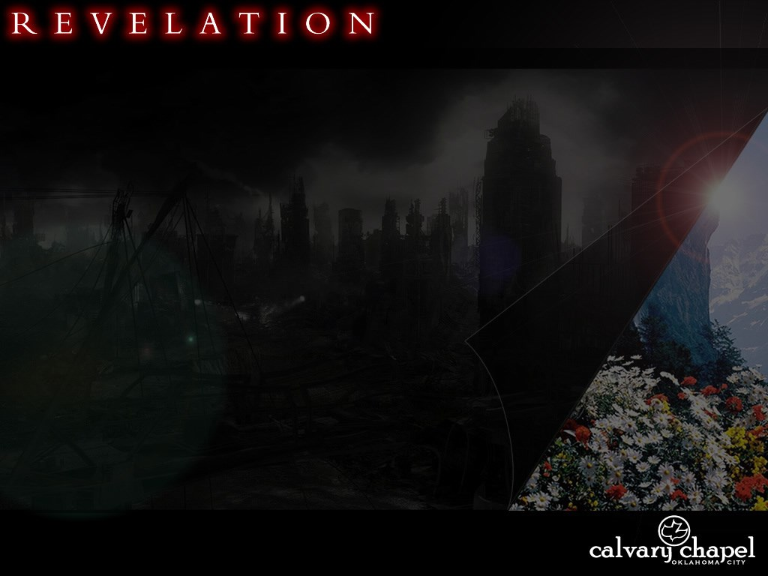
2 0 . 7 – 2 1 . 8
2 Cor. 5:10 ~ For we must all appear before the judgment seat of Christ, that each one may receive the things done in the body, according to what he has done, whether good or bad.
Judgment Seat ~ bēma

Slide 3
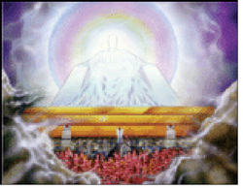
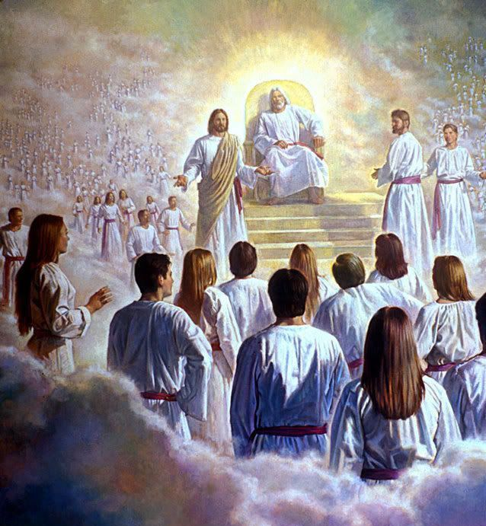
2 0 . 7 – 2 1 . 8
Bēma Judgment
White Throne Judgment

Slide 4
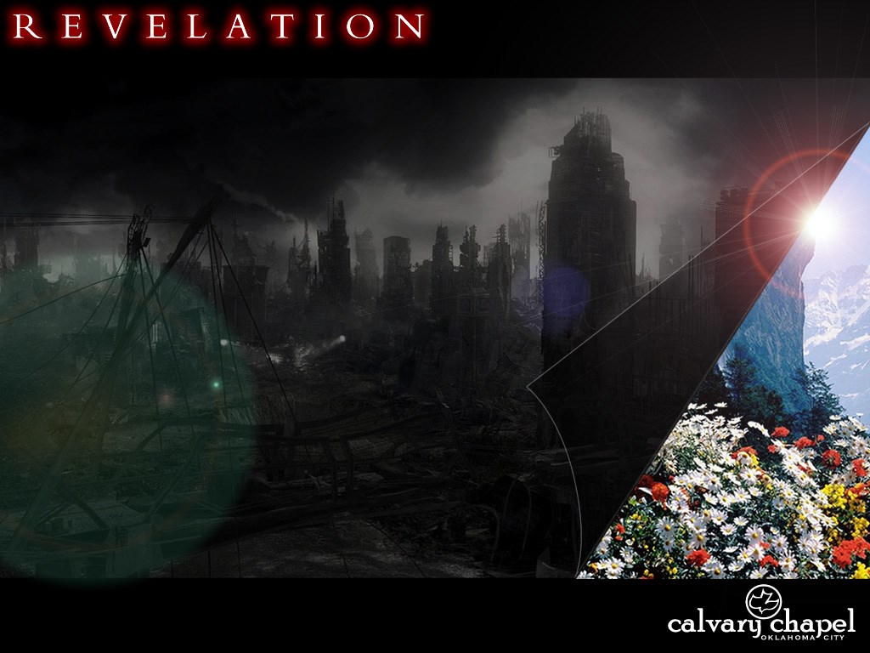
2 0 . 7 – 2 1 . 8

Slide 5
2 0 . 7 – 2 1 . 8
Billy Sunday ~ "Hell is the highest reward that the devil can offer you for being a servant of his."
Billy Graham ~ "If we had more hell in the pulpit, we would have less hell in the pew."

Slide 6
2 0 . 7 – 2 1 . 8

Slide 7
2 0 . 7 – 2 1 . 8
Is. 65:17 ~ For behold, I create new heavens and a new earth; and the former shall not be remembered or come to mind.
Create ~ bara – out of nothing

Slide 8
2 0 . 7 – 2 1 . 8
Is. 66:22 ~ "For as the new heavens and the new earth which I will make shall remain before Me," says the Lord, "So shall your descendants and your name remain."
Make ~asah – to do or to fashion

Slide 9
2 0 . 7 – 2 1 . 8

Slide 10
2 0 . 7 – 2 1 . 8
2 Pet. 3:10 ~ But the day of the Lord will come as a thief in the night, in which the heavens will pass away with a great noise, and the elements will melt with fervent heat; both the earth and the works that are in it will be burned up.

Slide 11
2 0 . 7 – 2 1 . 8

Slide 12
2 0 . 7 – 2 1 . 8
Tabernacle ~ skēnē – tent
I Cor. 13:12 ~ For now we see in a mirror, dimly, but then face to face. Now I know in part, but then I shall know just as I also am known.
1 Jn. 3:2 ~ Beloved, now we are children of God; and it has not yet been revealed what we shall be, but we know that when He is revealed, we shall be like Him, for we shall see Him as He is.

Slide 13
2 0 . 7 – 2 1 . 8

Slide 14
2 0 . 7 – 2 1 . 8
Is. 65:17 ~ For behold, I create new heavens and a new earth; and the former shall not be remembered or come to mind.

Slide 15
2 0 . 7 – 2 1 . 8

Slide 16
2 0 . 7 – 2 1 . 8
It is done ~ 3rd person plural
Literally, all things are finished
Freely ~ dōrean – undeservedness
Better than NIV, NASB ~ without cost
Is. 55:1 ~ Ho! Everyone who thirsts, come to the waters; and you who have no money, come, buy and eat. yes, come, buy wine and milk without money and without price.

Slide 17
2 0 . 7 – 2 1 . 8

Slide 18
2 0 . 7 – 2 1 . 8
1 Jn. 5:4 ~ For whatever is born of God overcomes the world. And this is the victory that has overcome the world—our faith.
Faith ~ pistis (noun)
pisteuō (verb) ~ Usually translated believe
To trust in, rely on and cling to

Slide 19
2 0 . 7 – 2 1 . 8
John 3:16-18 ~ ¹⁶ For God so loved the world that He gave His only begotten Son, that whoever believes in Him should not perish but have everlasting life. ¹⁷ For God did not send His Son into the world to condemn the world, but that the world through Him might be saved. ¹⁸ He who believes in Him is not condemned; but he who does not believe is condemned already, because he has not believed in the name of the only begotten Son of God.

Slide 20
2 0 . 7 – 2 1 . 8

Slide 21
2 0 . 7 – 2 1 . 8
Cowards ~ not fearful as in the KJV

Slide 22
2 0 . 7 – 2 1 . 8

