Slide 1
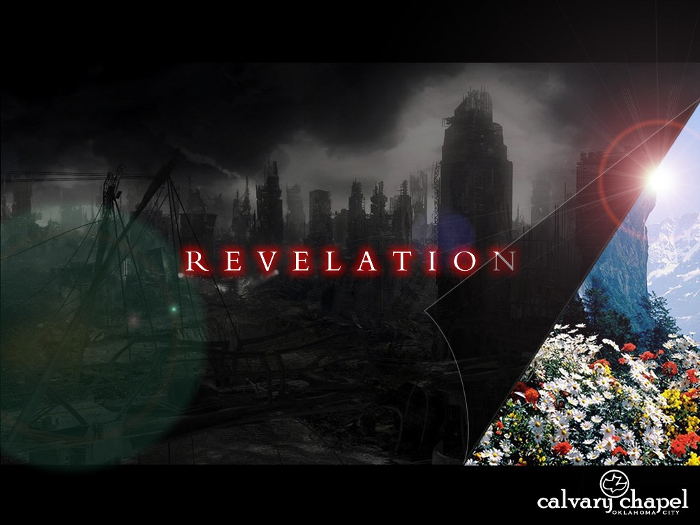
A free CD of this message will be available following the service
1 9 . 1 1 - 2 0 : 6
This message will also be available for podcast later in the week a calvaryokc.com

Slide 2
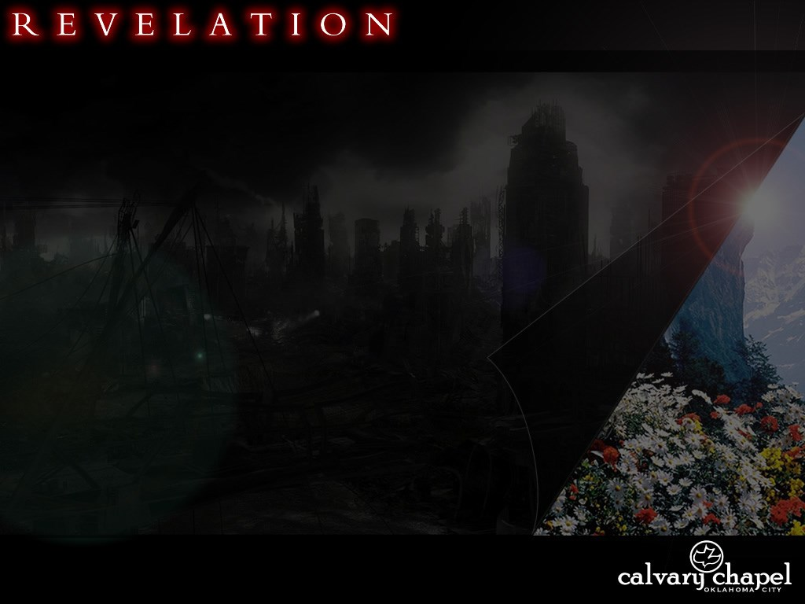
1 9 . 1 1 – 2 0 : 6
Faithful
2 Tim. 2:13 ~ If we are faithless, He remains faithful; He cannot deny Himself.
1 Jn. 1:9 ~ If we confess our sins, He is faithful and just to forgive us our sins and to cleanse us from all unrighteousness.

Slide 3
1 9 . 1 1 – 2 0 : 6
True
Ps. 138:2 ~ I will worship toward Your holy temple, and praise Your name for Your lovingkindness and Your truth; for You have magnified Your word above all Your name.

Slide 4
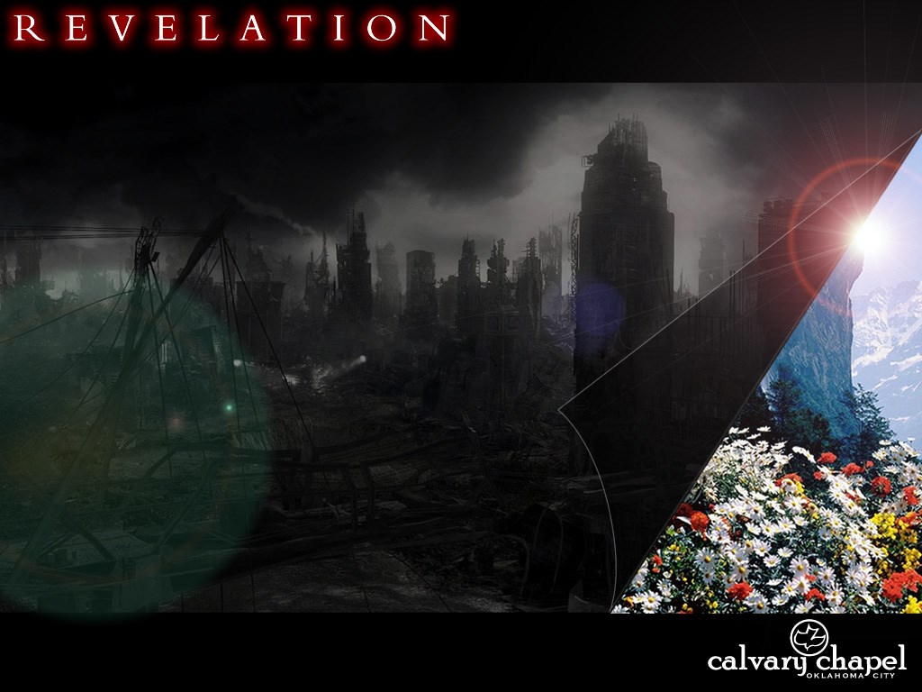
1 9 . 1 1 – 2 0 : 6

Slide 5
1 9 . 1 1 – 2 0 : 6
Crowns ~ not the stephanos of 6:2
; but diadēmos – a royal crown

Slide 6
1 9 . 1 1 – 2 0 : 6

Slide 7
1 9 . 1 1 – 2 0 : 6
Is. 63:1–4 ~ ¹ Who is this who comes from Edom,
With dyed garments from Bozrah,
This One who is glorious in His apparel,
Traveling in the greatness of His strength?—
"I who speak in righteousness, mighty to save."
² Why is Your apparel red,
And Your garments like one who treads in the winepress?
³ "I have trodden the winepress alone, And from the peoples no one was with Me.
For I have trodden them in My anger,
And trampled them in My fury;
Their blood is sprinkled upon My garments,
And I have stained all My robes.
⁴ For the day of vengeance is in My heart,
And the year of My redeemed has come."

Slide 8
1 9 . 1 1 – 2 0 : 6

Slide 9
1 9 . 1 1 – 2 0 : 6
Jude 14b–15 ~ ¹⁴ Now Enoch, the seventh from Adam, prophesied about these men also, saying, "Behold, the Lord comes with ten thousands of His saints, ¹⁵ to execute judgment on all, to convict all who are ungodly among them of all their ungodly deeds which they have committed in an ungodly way, and of all the harsh things which ungodly sinners have spoken against Him.“

Slide 10
1 9 . 1 1 – 2 0 : 6

Slide 11
1 9 . 1 1 – 2 0 : 6
Rule ~ not archē or hegeomai, but poimanō (to shepherd)

Slide 12
1 9 . 1 1 – 2 0 : 6

Slide 13
1 9 . 1 1 – 2 0 : 6
Matt 24:31-33 ~ ³¹ When the Son of Man comes in His glory, and all the holy angels with Him, then He will sit on the throne of His glory. ³² All the nations will be gathered before Him, and He will separate them one from another, as a shepherd divides his sheep from the goats. ³³ And He will set the sheep on His right hand, but the goats on the left.

Slide 14
1 9 . 1 1 – 2 0 : 6

Slide 15
1 9 . 1 1 – 2 0 : 6
Thousand years ~ chilioi etos – 6x in 6 verses
Millennium ~ L. mille (1,000) + annus (year)

Slide 16
1 9 . 1 1 – 2 0 : 6
Amillennialism: Belief there will be a continuous parallel of good and evil in the world between the 1st and 2nd Coming of Christ. The Kingdom of God is now present in the world through the Word, His Spirit and His Church.
Adherents: Church of Christ, Church of God (Anderson, IN), many Reformed theologians, Roman Catholic Church

Slide 17
1 9 . 1 1 – 2 0 : 6
Postmillennialism: Belief the Kingdom of God is now extended through teaching, preaching and evangelism. The world is to be Christianized resulting in a long period of peace and prosperity, followed by Christ’s return.
Adherents: Most modern Reformed theologians, "Christian Reconstructionists"

Slide 18
1 9 . 1 1 – 2 0 : 6
Rom. 11:25-27 ~ ²⁵ For I do not desire, brethren, that you should be ignorant of this mystery, lest you should be wise in your own opinion, that blindness in part has happened to Israel until the fullness of the Gentiles has come in. ²⁶ And so all Israel will be saved, as it is written:
"The Deliverer will come out of Zion,
And He will turn away ungodliness from Jacob;
²⁷ For this is My covenant with them,
When I take away their sins."

Slide 19
1 9 . 1 1 – 2 0 : 6
Premillennialism: Belief in the concept of two-stages in the Coming of Christ. He will come for His Church (Rapture) and then with His Church (Revelation). There is a consistent distinction between Israel and the Church throughout history.
Adherents: Most modern evangelicals
Oswald Allis ~ "The entire view of the Millennium is based upon a few obscure passages from Revelation 20."

Slide 20
1 9 . 1 1 – 2 0 : 6
Sample Millennial passages ~
Ps. 72:1-20; Is. 2:2-5; Is. 11:1-10; Is. 66:19-24; Ez. 37:21-28; Ez. 47:1-12; Zeph. 3:8-12; Mic. 4:1-13; Zech. 14:8-11, Zech. 14:16-21; Matt. 19:28; Luke 22:28-30; Rev. 20:4-6
Isaiah 35

Slide 21
1 9 . 1 1 – 2 0 : 6
1845 Old Testament references to the Messiah physically reigning from Jerusalem; 318 references in the New Testament
After these things ~ meta tauta – last of 10x

Slide 22
1 9 . 1 1 – 2 0 : 6

Slide 23
1 9 . 1 1 – 2 0 : 6
Rom. 8:18 ~ For I consider that the sufferings of this present time are not worthy to be compared with the glory which shall be revealed in us.

Slide 24
1 9 . 1 1 – 2 0 : 6

Slide 25
1 9 . 1 1 – 2 0 : 6
1st Resurrection
1st Easter morning
Tribulation saints
Approx. 2000 years

Slide 26
1 9 . 1 1 – 2 0 : 6

