Slide 1

A free CD of this message will be available following the service
1 8 . 1 – 2 4
This message will also be available for podcast later in the week a calvaryokc.com

Slide 2
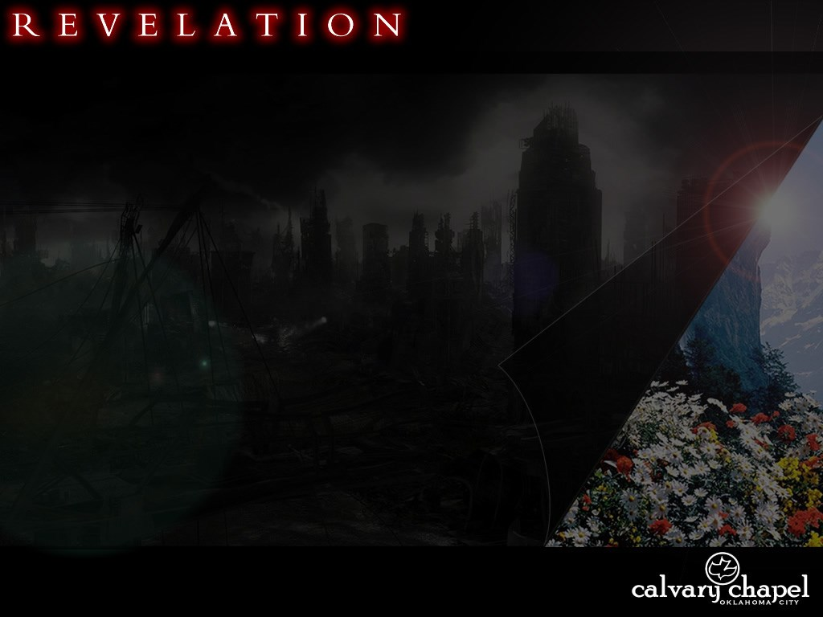

1 8 . 1 – 2 4
Baptist
Nazarene

Slide 3
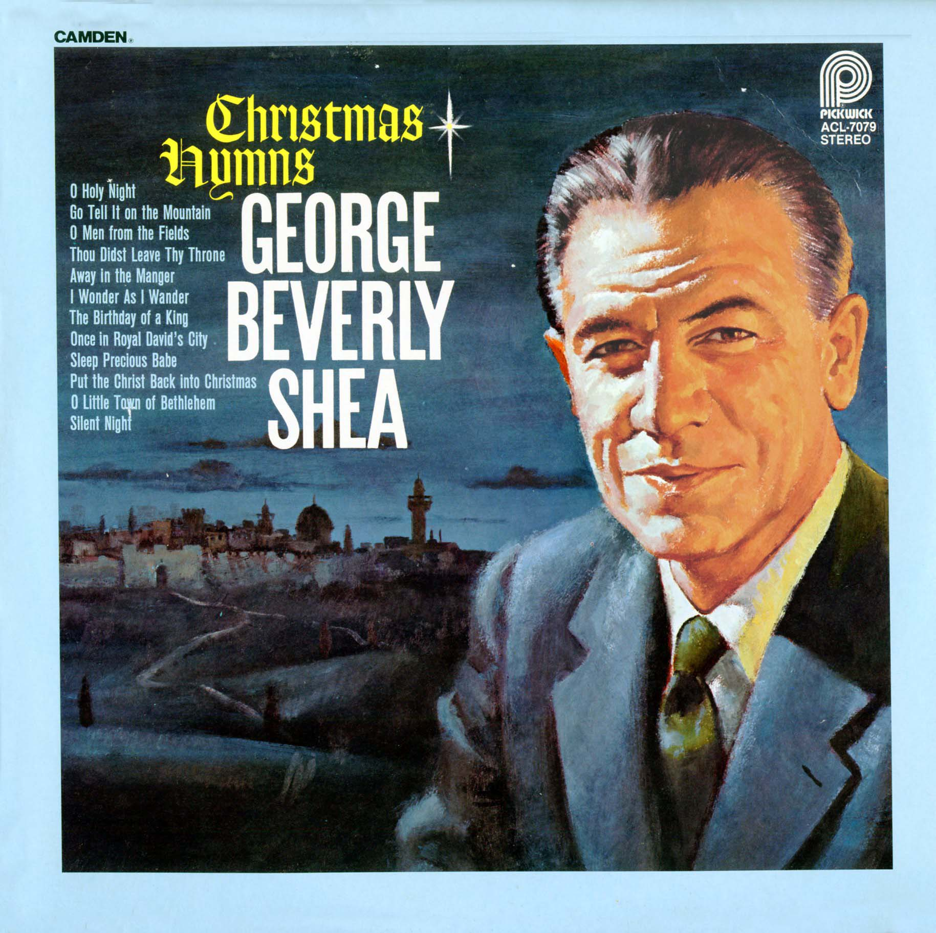
1 8 . 1 – 2 4

Slide 4
1 8 . 1 – 2 4

Slide 5

1 8 . 1 – 2 4

Slide 6
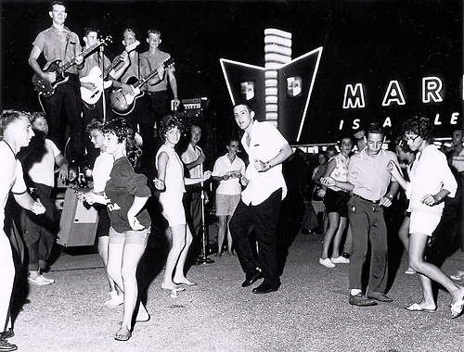
1 8 . 1 – 2 4

Slide 7
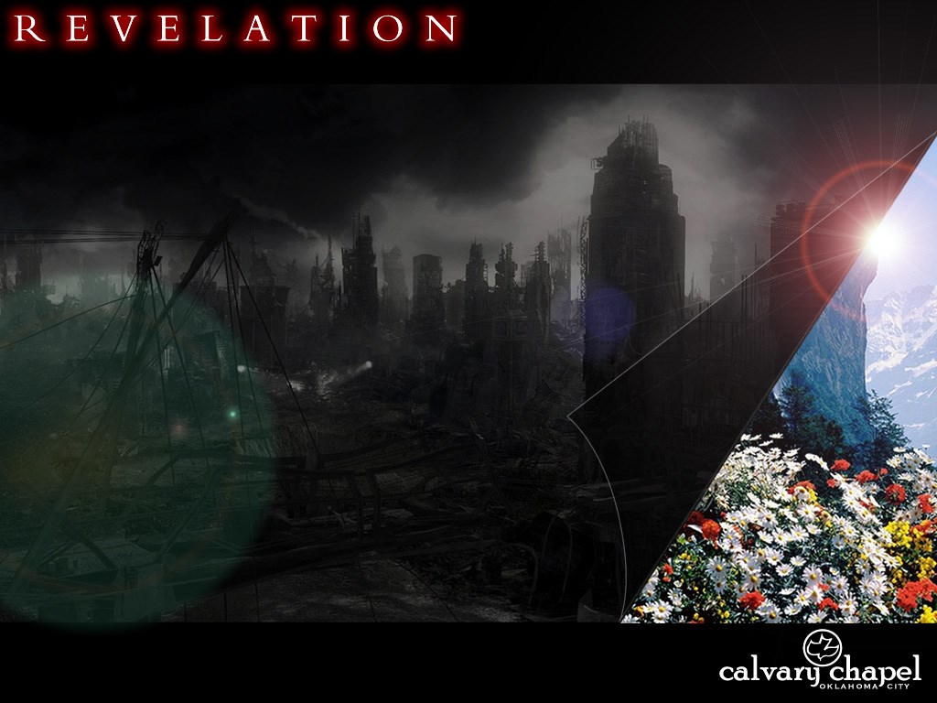
1 8 . 1 – 2 4

Slide 8
1 8 . 1 – 2 4
World ~ kosmos is that system that is set in order against God

Slide 9
1 8 . 1 – 2 4

Slide 10
1 8 . 1 – 2 4
Abundance ~ dunamis

Slide 11
1 8 . 1 – 2 4

Slide 12
1 8 . 1 – 2 4
1 Cor. 10:31 ~ Therefore, whether you eat or drink, or whatever you do, do all to the glory of God.

Slide 13
1 8 . 1 – 2 4

Slide 14
1 8 . 1 – 2 4
Repay her double ~ Literally, the double is doubled

Slide 15
1 8 . 1 – 2 4

Slide 16
1 8 . 1 – 2 4
Henry Barclay Swete ~ "With a touch of grim humour he paints them as standing at a safe distance from the conflagration, and contenting themselves with idle lamentations."

Slide 17
1 8 . 1 – 2 4

Slide 18
1 8 . 1 – 2 4
Longed for ~ epithumia (to burn upon)
KJV, lusted
Martin Luther ~ "I have held many things in my hands, and I have lost them all; but whatever I have placed in God's hands, that I still possess.”

Slide 19
1 8 . 1 – 2 4

Slide 20
1 8 . 1 – 2 4
Lust of the eyes, lust of the flesh and the Pride of Life
"Well, I see something and I want it
Bam! Right now!
No questions asked
Don't worry how much it costs me now or later
I want it and I want it fast"

Slide 21
1 8 . 1 – 2 4

Slide 22
1 8 . 1 – 2 4
Oswald Chambers ~ "It is because people live in the things they possess instead of in their relationship to God, that God at times seems cruel."
Luke 12:15 ~ And He said to them, “Take heed and beware of covetousness, for one’s life does not consist in the abundance of the things he possesses."

Slide 23
1 8 . 1 – 2 4
Avenged ~ literally, judged your judgment upon her
1st command to rejoice in Revelation

Slide 24
1 8 . 1 – 2 4

Slide 25
1 8 . 1 – 2 4
Sorcery ~ pharmakeia

Slide 26
1 8 . 1 – 2 4

