Slide 1

A free CD of this message will be available following the service
1 7 . 1 – 1 8
This message will also be available for podcast later in the week a calvaryokc.com

Slide 2

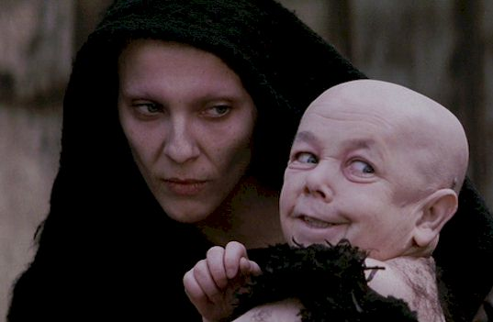
1 7 . 1 – 1 8
Gen. 3:15 ~ And I will put enmity between you and the woman,
And between your seed and her Seed; he shall bruise your head,
And you shall bruise His heel.

Slide 3
1 7 . 1 – 1 8
1 Tim. 4:1–3 ~ ¹ Now the Spirit expressly says that in latter times some will depart from the faith, giving heed to deceiving spirits and doctrines of demons, ² speaking lies in hypocrisy, having their own conscience seared with a hot iron, ³ forbidding to marry, and commanding to abstain from foods which God created to be received with thanksgiving by those who believe and know the truth.

Slide 4
1 7 . 1 – 1 8
Expansion of 14:8 ~ And another angel followed, saying, "Babylon is fallen (chap. 17), is fallen (chap. 18), that great city, because she has made all nations drink of the wine of the wrath of her fornication."

Slide 5
1 7 . 1 – 1 8
Ps. 2:1-7 ~ ¹ Why do the nations rage,
And the people plot a vain thing
² The kings of the earth set themselves,
And the rulers take counsel together,
FAgainst the Lord and against His Anointed, saying,
³ “Let us break Their bonds in pieces
And cast away Their cords from us.”
⁴ He who sits in the heavens shall laugh;
The Lord shall hold them in derision.
⁵ Then He shall speak to them in His wrath,
And distress them in His deep displeasure:
^{6 “}Yet I have set My King
On My holy hill of Zion.
⁷ I will declare the decree:
The Lord has said to Me,
‘You are My Son,
Today I have begotten You.”

Slide 6
1 7 . 1 – 1 8
World ~ kosmos
From kosmeō – to set in order
In NT, the kosmos is that system that is set in order against God

Slide 7
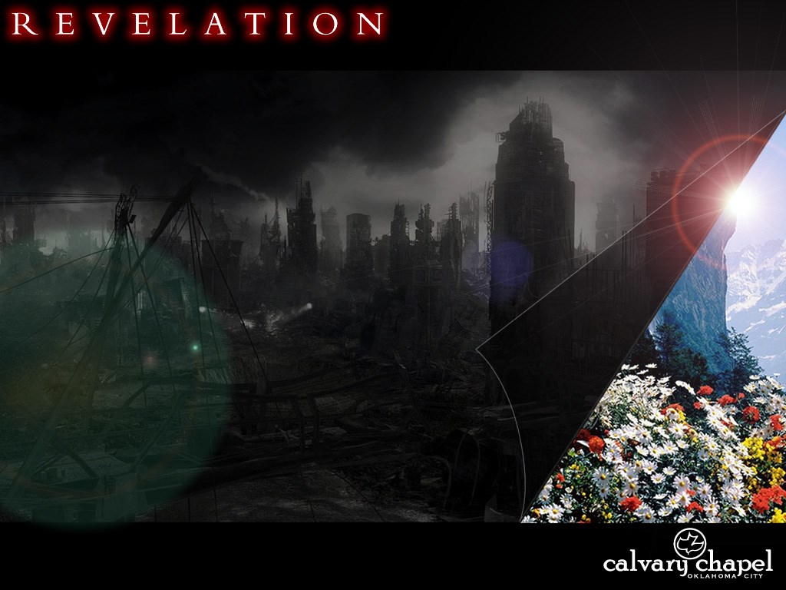
1 7 . 1 – 1 8

Slide 8
1 7 . 1 – 1 8

Slide 9
1 7 . 1 – 1 8
Religion – a belief in a supernatural power regarded as creator
[ME religioun, <OF religion, <L religio, perhaps from religare, to tie fast]
Related to our word ligament (anything used in binding)

Slide 10
1 7 . 1 – 1 8

Slide 11
1 7 . 1 – 1 8
Five have fallen
1) Julius, 2) Tiberius, 3) Caligula, 4) Claudius, 5) Nero,
One is
6) Domitian,
Other has not yet come
7) Antichrist,
8) Antichrist "resurrected"

Slide 12
1 7 . 1 – 1 8
Five have fallen
1) Augustus, 2) Tiberius, 3) Caligula, 4) Claudius, 5) Nero,
One is
6) Domitian,
Other has not yet come
7) Antichrist,
8) Antichrist "resurrected"

Slide 13
1 7 . 1 – 1 8
Five have fallen
1) Egypt, 2) Assyria, 3) Babylon, 4) Persia, 5) Greece,
One is
6) Rome,
Other has not yet come
7) Revived Roman Empire,
8) Antichrist

Slide 14
1 7 . 1 – 1 8

Slide 15
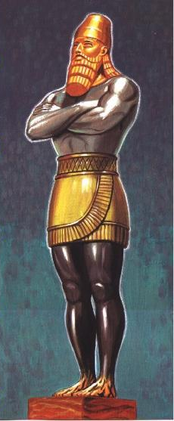
1 7 . 1 – 1 8
Dan. 2: 41-44 ~ ⁴¹ Whereas you saw the feet and toes, partly of potter’s clay and partly of iron, the kingdom shall be divided; yet the strength of the iron shall be in it, just as you saw the iron mixed with ceramic clay. ⁴² And as the toes of the feet were partly of iron and partly of clay, so the kingdom shall be partly strong and partly fragile. ⁴³As you saw iron mixed with ceramic clay, they will
mingle with the seed of men; but they will not adhere to one another, just as iron does not mix ith clay. ⁴⁴And in the days of these kings the God of heaven will set up a kingdom which shall never be destroyed; and the kingdom shall not be left to other people; it shall break in pieces and consume all these kingdoms, and it shall stand forever.

Slide 16
1 7 . 1 – 1 8

