Slide 1
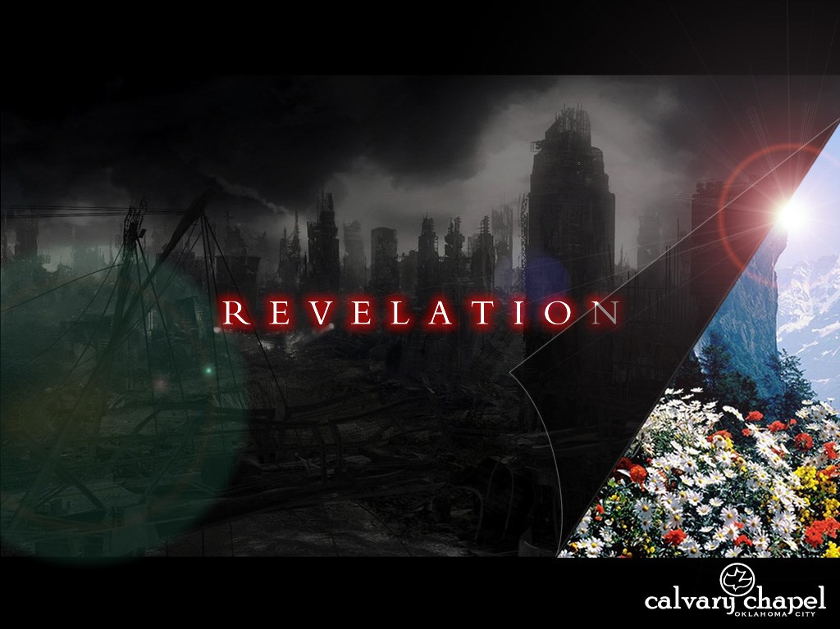
A free CD of this message will be available following the service
1 6 . 7 – 2 2
This message will also be available for podcast later in the week a calvaryokc.com

Slide 2
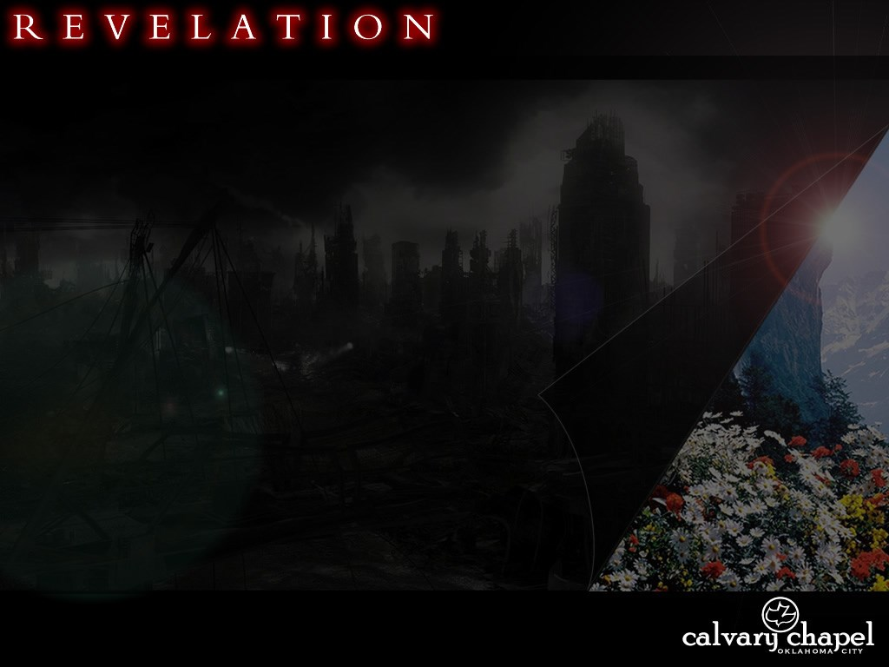
1 6 . 8 – 2 2
Eugene Peterson ~ "Surely, after all these centuries it is time to...call the perpetrators of these cruelties on the carpet and wipe the condescending smiles off their faces with a once-for-all judgment."

Slide 3
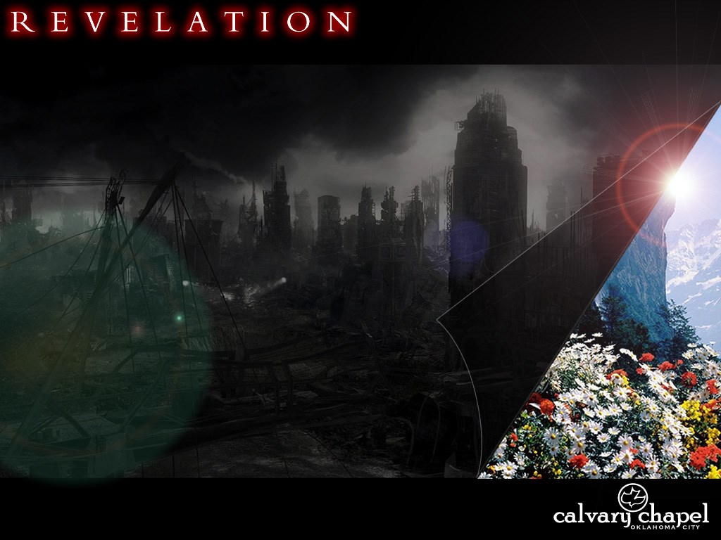
1 6 . 8 – 2 2

Slide 4
1 6 . 8 – 2 2
4th trumpet, 8:12 ~ 1/3 sun, moon and stars struck

Slide 5
1 6 . 8 – 2 2

Slide 6
1 6 . 8 – 2 2
Great ~ 1st of 10x in vv. 9-22

Slide 7
1 6 . 8 – 2 2
C. H. Spurgeon ~ "Judgment may produce a carnal repentance - a repentance that is of the flesh, and after the manner of the sinful nature of men. In this repentance the depravity of the heart remains the same in essence, though it takes another form of showing itself. Though the man changes, he is not savingly changed: he becomes another man, but not a new man. The same sin rules in him, but it is
called by another name, and wears another dress. The stone is carved into a more sightly shape, but it is not turned into flesh. The iron is cast into another image, but it is not transformed into gold. This carnal repentance is caused by fear. Does not every thief repent of robbery when he is convicted and sent to jail? Does not every murderer repent of his crime when he stands under the fatal tree?”

Slide 8
1 6 . 8 – 2 2
“This is real penitence, when the man gives glory to the justice of God, even though it condemns him. O my hearer, do you thus repent? Is sin really sinful to you? Do you see its desert of hell? If not, your repentance needs to be repented of.”

Slide 9
1 6 . 8 – 2 2
Ray Stedman ~ "The terrible folly of unbelief, of refusing God's grace, is that you gradually lose the capacity to repent. At last you reach a state of hardness of heart which no longer can respond or does respond to what God is doing. It is too late to pray!"

Slide 10
1 6 . 8 – 2 2

Slide 11
1 6 . 8 – 2 2
5th trumpet, 9:1 ~ star (Satan) releases locusts

Slide 12
1 6 . 8 – 2 2

Slide 13
1 6 . 8 – 2 2
6th trumpet, 9:13 ~ war
Greek word for east ~ anatolē (a rising)
Here, it adds word for sun ~ hēlios
Literally, kings from the rising sun

Slide 14
1 6 . 8 – 2 2

Slide 15
1 6 . 8 – 2 2
7-headed dragon
Unholy Trinity
Antichrist
False Prophet

Slide 16
1 6 . 8 – 2 2

Slide 17
1 6 . 8 – 2 2
Joel 3:12-14 ~ ¹² Let the nations be wakened, and come up to the Valley of Jehoshaphat;
For there I will sit to judge all the surrounding nations.
¹³ Put in the sickle, for the harvest is ripe.
Come, go down;
For the winepress is full,
The vats overflow —
For their wickedness is great."
¹⁴ Multitudes, multitudes in the valley of decision!
For the day of the Lord is near in the valley of decision.

Slide 18
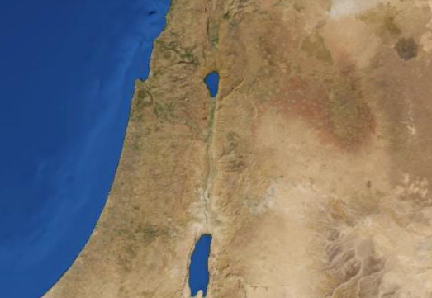
1 6 . 8 – 2 2
Valley of Megiddo
Jerusalem
Valley of Jehoshaphat

Slide 19
1 6 . 8 – 2 2

Slide 20
1 6 . 8 – 2 2
7th trumpet, 11:15 ~ Jesus takes control

Slide 21
1 6 . 8 – 2 2

Slide 22
1 6 . 8 – 2 2
Heb. 12:25–26 ~ ²⁵ See that you do not refuse Him who speaks. For if they did not escape who refused Him who spoke on earth, much more shall we not escape if we turn away from Him who speaks from heaven, ²⁶ whose voice then shook the earth; but now He has promised, saying, “Yet once more I shake not only the earth, but also heaven.”

Slide 23
1 6 . 8 – 2 2

Slide 24
1 6 . 8 – 2 2
Fierceness ~ thumos – passionate anger
Wrath ~ orgē – settled disposition
14:10 ~ he himself shall also drink of the wine of the wrath of God, which is poured out full strength into the cup of His indignation.
John Walvoord ~ "The combination of thumos and orgē connotes the strongest kind of outpouring of divine judgment."

Slide 25
1 6 . 8 – 2 2

Slide 26
1 6 . 8 – 2 2
Talent ~ between 108 and 130 lb.
Lev. 24:16 ~ And whoever blasphemes the name of the Lord shall surely be put to death. All the congregation shall certainly stone him, the stranger as well as him who is born in the land.

Slide 27
1 6 . 8 – 2 2
A place of weeping and gnashing of teeth (Matt. 25:30)
A place of no rest (Rev. 14:11)
A place of unsatisfied desires (Luke 16:24)
A place of outer darkness (Matt. 22:13)
A lake of fire (Rev. 20:14)
A place of torments (Luke 16:23)
A place of everlasting destruction (2 Thess. 1:9)
A place that burns with fire and brimstone (Rev. 22:8)
A place where the fire is not quenched (Mark 9:44)
A place of the bottomless pit (Rev. 9:2)

Slide 28
1 6 . 8 – 2 2

Slide 29
1 6 . 8 – 2 2
The Calvary Road, pp. 48-49 ~
In order to break our wills to His, God brings us to the foot of the Cross and there shows us what real brokenness is. We see those wounded Hands and Feet, the Face of Love crowned with thorns, and we see the complete brokenness of the One who said, "Not my will, but Thine be done," as He drank the bitter cup of our sin to its dregs. So the way to be broken is to
look on Him and to realize it was our sin which nailed Him there. Then as we see the love and brokenness of the God who died in our place, our hearts will become strangely melted and we will want to be broken for Him and we shall pray,
Oh, to be saved from myself, dear Lord,
Oh, to be lost in Thee,
Oh, that it might be no more I,
But Christ that lives in me.

Slide 30
1 6 . 8 – 2 2

Slide 31
1 . 1 - 20
Babylonians used a base 6 system
A B C D E F G H I
6 9 18 24 30 36 42 48 54
J K L M N O P Q R
60 66 72 78 84 90 96 102 108
S T U V W X Y Z
114 120 126 132 138 144 150 154
K I S S I N G E R
66 54 114 114 54 84 42 30 108
= 666

