Slide 1
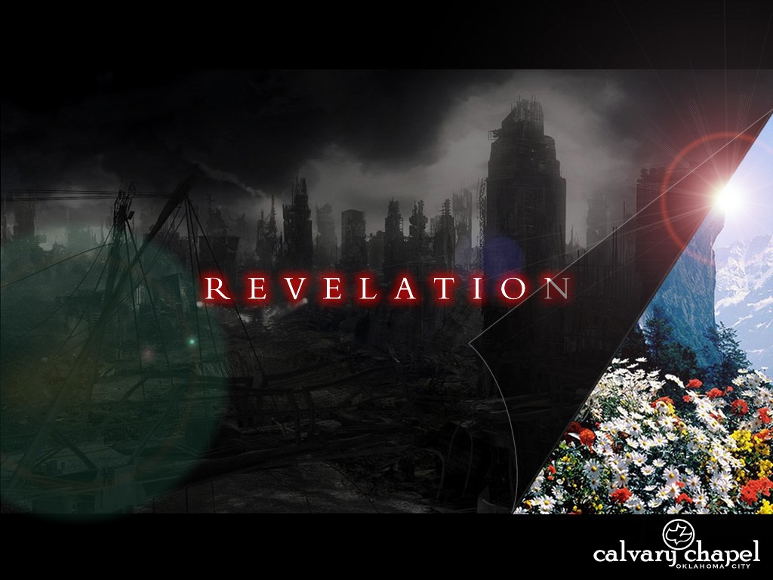
A free CD of this message will be available following the service
1 5 . 1 – 1 6 . 7
This message will also be available for podcast later in the week a calvaryokc.com

Slide 2
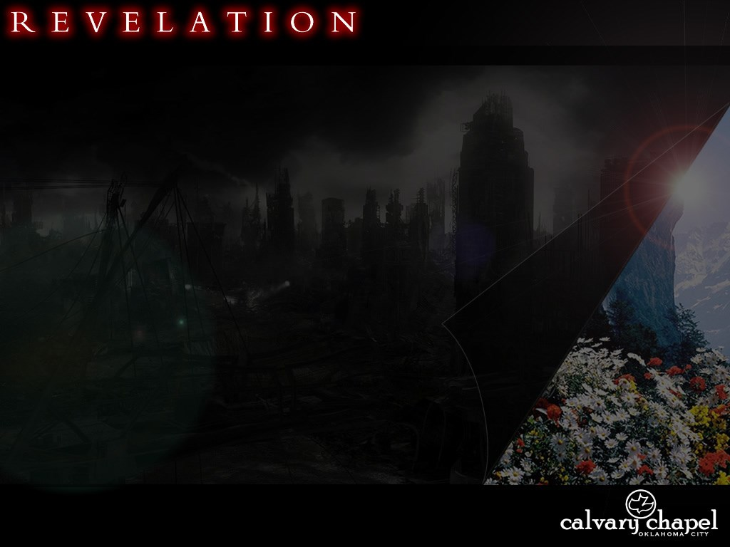
7 YR
RAPTURE
2ND COMING
7TH TRUMPET
7TH BOWL
7TH SEAL
TRUMPETS 1-6
BOWLS 1-6
SEALS 1-6
SEALS, TRUMPETS, BOWLS

Slide 3
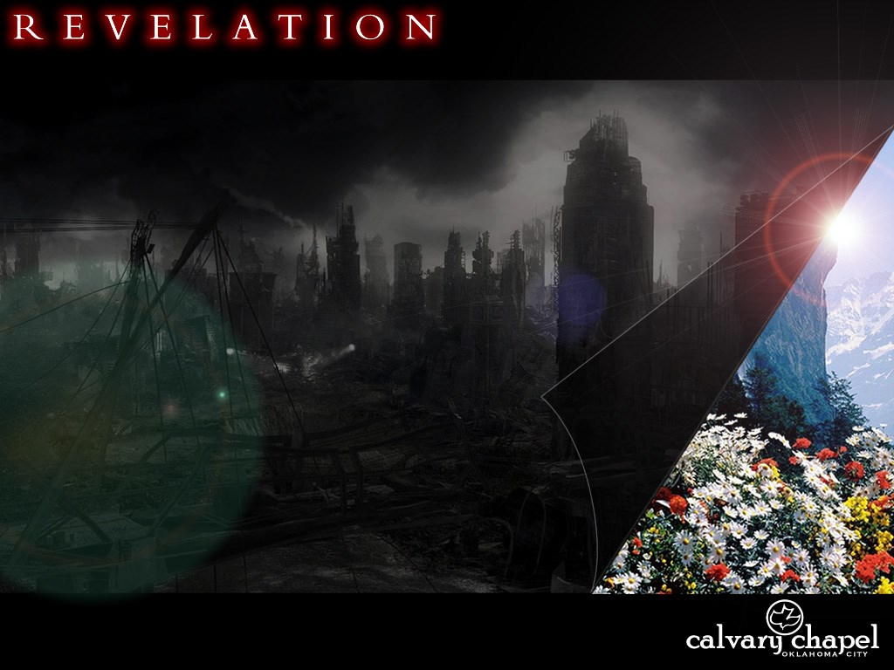
1 5 . 1 – 1 6 . 7

Slide 4
1 5 . 1 – 1 6 . 7
Is complete ~
NLT, which would bring God’s wrath to completion.

Slide 5
1 5 . 1 – 1 6 . 7

Slide 6
1 5 . 1 – 1 6 . 7
You/Your ~ 7x in 2 verses

Slide 7
1 5 . 1 – 1 6 . 7

Slide 8
1 5 . 1 – 1 6 . 7
40:16 ~ Thus Moses did; according to all that the Lord had commanded him, so he did.

Slide 9
1 5 . 1 – 1 6 . 7

Slide 10
1 5 . 1 – 1 6 . 7
Loud ~ megas (great) occurs 12x in chapter 16

Slide 11
1 5 . 1 – 1 6 . 7

Slide 12
1 5 . 1 – 1 6 . 7
Trumpets
Recipient of Judgment
Bowls
8:1–7
1
The Earth
1
16:1-2
8:8–9
2
The Sea
2
16:3
8:10-11
3
The Rivers
3
16:4-7
8:12-13
4
The Heavens
4
16:8-9
9:1-2
5
Mankind
5
16:10-11
9:13–21
6
Army/Euphrates
6
16:12-16

Slide 13
1 5 . 1 – 1 6 . 7
1st trumpet, 8:7 ~ hail, fire, blood – 1/3 vegetation
Loathsome ~ KJV, noisome

Slide 14
1 5 . 1 – 1 6 . 7

Slide 15
1 5 . 1 – 1 6 . 7
2nd trumpet, 8:8 ~ mountain into the sea – 1/3 blood

Slide 16
1 5 . 1 – 1 6 . 7

Slide 17
1 5 . 1 – 1 6 . 7
2nd trumpet, 8:8 ~ mountain into the sea – 1/3 blood

Slide 18
1 5 . 1 – 1 6 . 7

Slide 19
1 5 . 1 – 1 6 . 7
3rd trumpet, 8:10 ~ falling star (Wormwood) – bitter water

Slide 20
1 5 . 1 – 1 6 . 7

Slide 21
1 5 . 1 – 1 6 . 7
Even so ~ amēn

Slide 22
1 5 . 1 – 1 6 . 7

