Slide 1

A free CD of this message will be available following the service
1 4 . 6 - 20
This message will also be available for podcast later in the week a calvaryokc.com

Slide 2
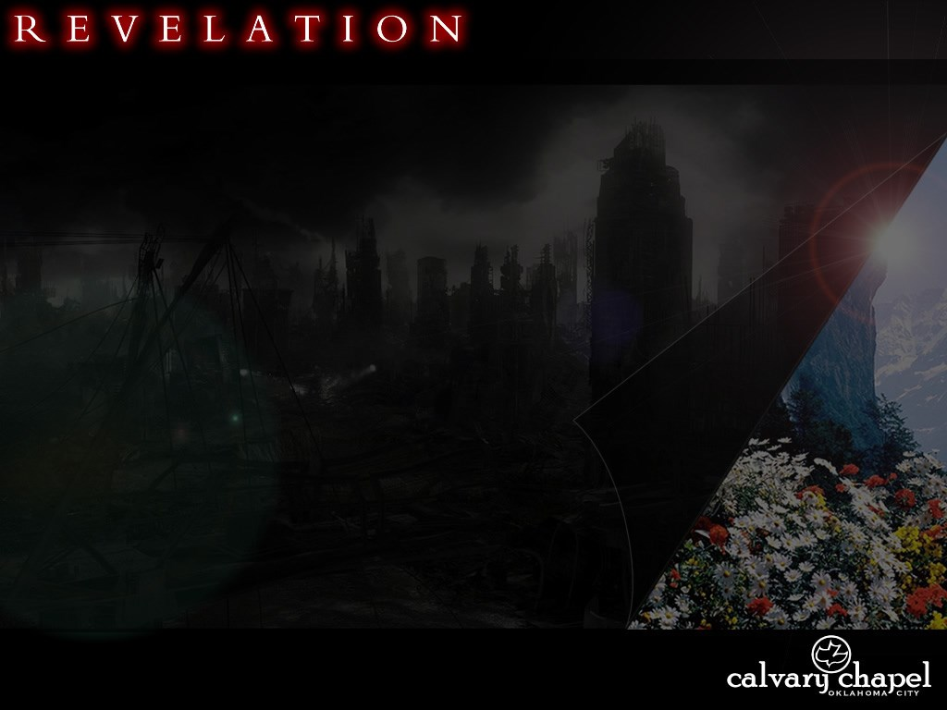
1 4 . 6 – 2 0
The end is near! Turn you self around now! Before it’s
too late!

Slide 3
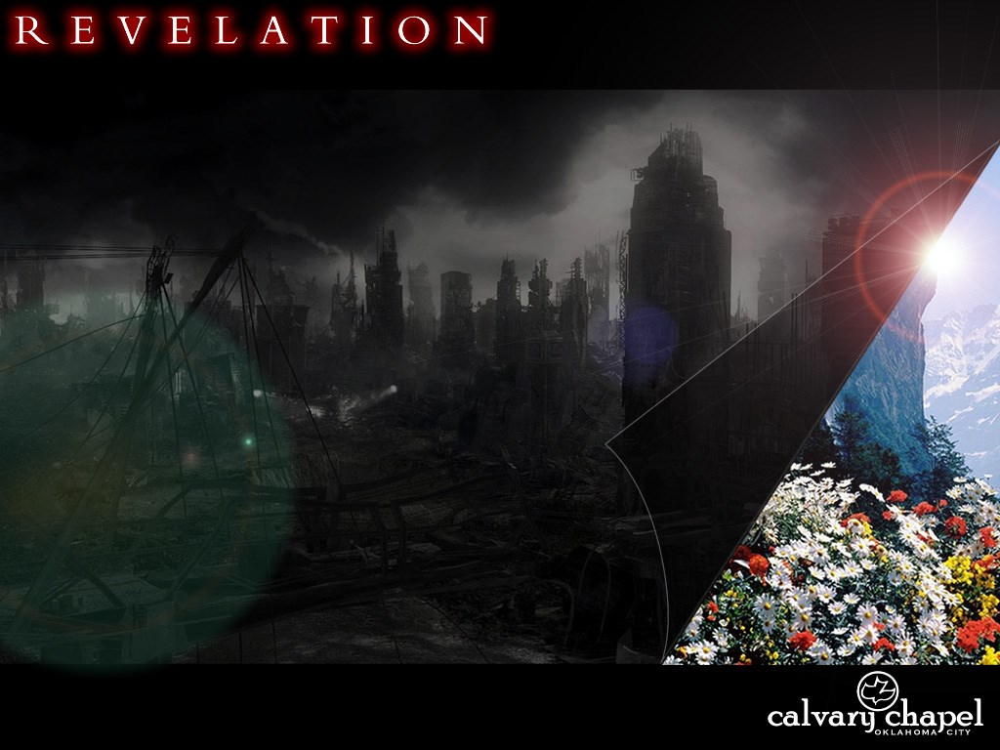
1 4 . 6 – 2 0

Slide 4
1 4 . 6 – 2 0
Everlasting ~ aiōnios – eternal
Dwell on the earth
katoikountas epi tēs gēs
Matt. 24.14 ~ And this gospel of the kingdom will be preached in all the world as a witness to all the nations, and then the end will come.

Slide 5
1 4 . 6 – 2 0

Slide 6
1 4 . 6 – 2 0
John Walvoord ~ "Prophetically, ‘Babylon’ sometimes refers to a literal city, sometimes to a religious system, sometimes to a political system, all stemming from the evil character of historic Babylon."

Slide 7
1 4 . 6 – 2 0

Slide 8
1 4 . 6 – 2 0
Jam. 4.4 ~ Adulterers and adulteresses! Do you not know that friendship with the world is enmity with God? Whoever therefore wants to be a friend of the world makes himself an enemy of God.

Slide 9
1 4 . 6 – 2 0

Slide 10
1 4 . 6 – 2 0
Wrath ~ thumos – passionate anger
Indignation ~ orgē – settled disposition

Slide 11
1 4 . 6 – 2 0

Slide 12
1 4 . 6 – 2 0
Forever and ever ~ literally, into eternity of eternity

Slide 13
1 4 . 6 – 2 0
Leon Morris ~ "The modern vogue for dispensing with hell has no counterpart in Revelation."
John Trapp ~ "Would to God men would everywhere think and talk more of hell, and of that eternity of extremity that they shall never else be able to avoid or to abide. Surely one good means to escape hell is to take a turn or two in hell by our daily meditations."

Slide 14
1 4 . 6 – 2 0

Slide 15
1 4 . 6 – 2 0
⁵ Then He shall speak to them in His wrath,
And distress them in His deep displeasure:
⁶ “Yet I have set My King
On My holy hill of Zion.
⁷ I will declare the decree:
The Lord has said to Me,
‘You are My Son,
Today I have begotten You.”
Ps. 2:1-7 ~ ¹ Why do the nations rage,
And the people plot a vain thing?
² The kings of the earth set themselves,
And the rulers take counsel together,
Against the Lord and against His Anointed, saying,
³ “Let us break Their bonds in pieces
And cast away Their cords from us.”
⁴ He who sits in the heavens shall laugh;
The Lord shall hold them in derision.

Slide 16
1 4 . 6 – 2 0

Slide 17
1 4 . 6 – 2 0
Patience ~ hupomonē – NASB, perseverance; NIV, patient endurance
Ps. 30:5b ~ … Weeping may endure for a night, but joy comes in the morning.

Slide 18
1 4 . 6 – 2 0

Slide 19
1 4 . 6 – 2 0
Ripe ~ occurs 18x (only time translated ripe)
1x, stiffens
3x, dried or dries
13x, withered or withered away

Slide 20
1 4 . 6 – 2 0

Slide 21
1 4 . 6 – 2 0
Is. 63:1-3 ~ ¹ Who is this who comes from Edom,
With dyed garments from Bozrah,
This One who is glorious in His apparel,
Traveling in the greatness of His strength?—
“I who speak in righteousness, mighty to save.”
² Why is Your apparel red,
And Your garments like one who treads in the winepress?
³ “I have trodden the winepress alone,
And from the peoples no one was with Me.
For I have trodden them in My anger,
And trampled them in My fury;
Their blood is sprinkled upon My garments,
And I have stained all My robes.
⁴ For the day of vengeance is in My heart,
And the year of My redeemed has come.

Slide 22
1 4 . 6 – 2 0

Slide 23
1 4 . 6 – 2 0
Joseph Seiss ~ "What strength have grapes against the weight and power of a man when he comes to set his feet upon them? And the riper they are, the more helpless . . . The heel of Omnipotence is upon them, and they can only break and sink beneath it."

Slide 24
1 4 . 6 – 2 0

Slide 25
1 4 . 6 – 2 0
Calvin ~ "I would rather be on the side that seems to be losing today but will win finally than to be on the side that seems to be winning today but is going to lose eternally."

Slide 26
1 4 . 6 – 2 0
C. S. Lewis ~ "When the author walks on the stage the play is over. God is going to invade, all right...something so beautiful to some of us and so terrible to others that none of us will have any choice left. For this time it will be God without disguise...it will be too late then to choose your side. There is no use saying you choose to lie down when it has become impossible to stand up."

Slide 27
1 4 . 6 – 2 0

