Slide 1

A free CD of this message will be available following the service
1 3 . 1 0 – 1 4 . 5
This message will also be available for podcast later in the week a calvaryokc.com

Slide 2
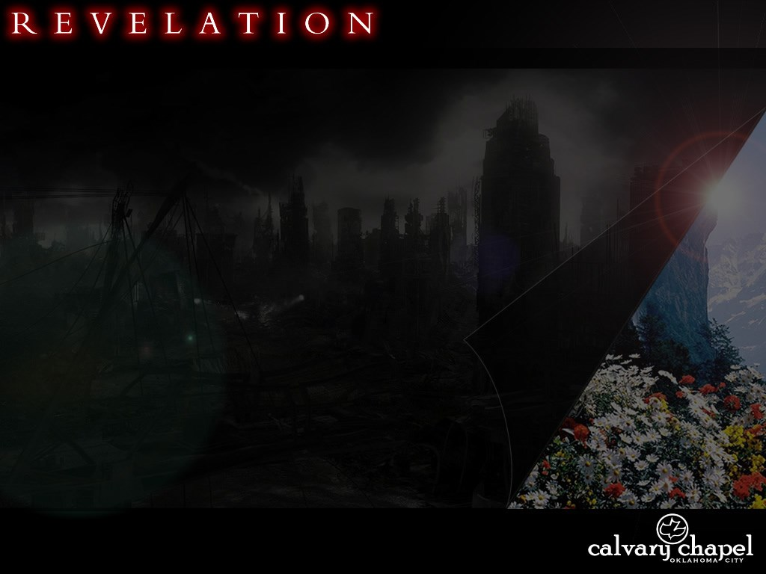
1 3 . 1 0 – 1 4 . 5
Another ~ allos
– another of the same kind

Slide 3
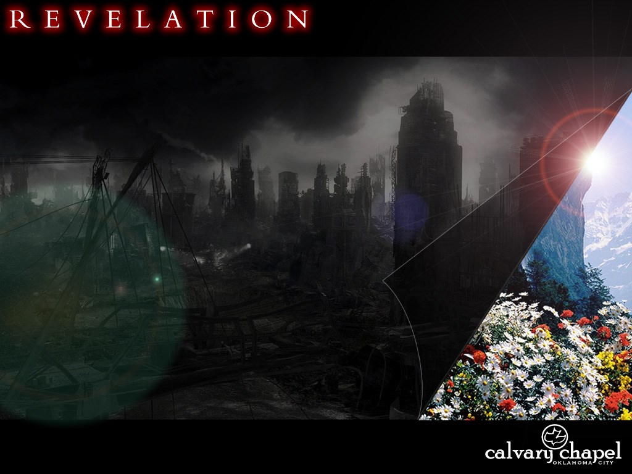
1 3 . 1 0 – 1 4 . 5

Slide 4
1 3 . 1 0 – 1 4 . 5
1st Beast
2nd Beast
Out of the Sea
Out of the Earth
Political
Religious
Antichrist
False Prophet

Slide 5
1 3 . 1 0 – 1 4 . 5
7-headed dragon
Unholy Trinity
Antichrist
False Prophet

Slide 6
1 3 . 1 0 – 1 4 . 5

Slide 7
1 3 . 1 0 – 1 4 . 5
Image ~ eikōn

Slide 8
1 3 . 1 0 – 1 4 . 5

Slide 9

1 3 . 1 0 – 1 4 . 5
V
L
D
N
S
A
U
R
U
U
P
E
I
O
C
V
T
E
P
R
V
I = 1
100
V = 5
5
5
L = 50
50
C = 100
500
D = 500
1
+
5
666

Slide 10
1 3 . 1 0 – 1 4 . 5
S
A
N
T
A
C
L
A
U
S
T
A
N
S = 19
A = 1
A = 1
N = 14
111 x 6 = 666
B = 2
T = 20
C = 3
A = 1
D = 4
C = 3
E = 5, etc.
L = 12
A = 1
U = 21
+
S = 19
111

Slide 11
1 3 . 1 0 – 1 4 . 5

