Slide 1
A free CD of this message will be available following the service
1 2 . 1 2 – 1 3 . 1 0
This message will also be available for podcast later in the week a calvaryokc.com

Slide 2
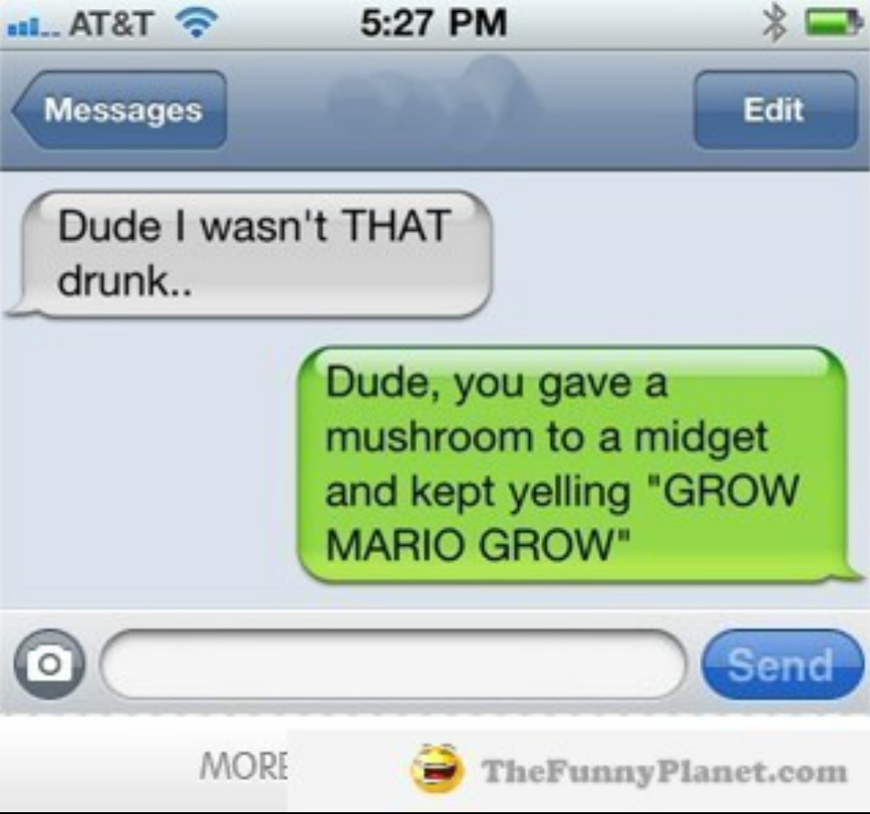
1 2 . 1 2 – 1 3 . 1 0
If you are sleeping, send me your dreams. If you are eating, send me a bite. If you are drinking send me a sip. If you are laughing, send me your smile. If you are crying, send me your tears. I love you!

Slide 3
1 2 . 1 2 – 1 3 . 1 0
I am on the commode. Please advise.

Slide 4
1 2 . 1 2 – 1 3 . 1 0

Slide 5
1 2 . 1 2 – 1 3 . 1 0
Time = one year
Times = two years
3 ½ years
½ time = ½ year

Slide 6
1 2 . 1 2 – 1 3 . 1 0

Slide 7
1 2 . 1 2 – 1 3 . 1 0
Ps. 124:1-5 ~ ¹ If it had not been the Lord who was on our side,
Let Israel now say—
² “If it had not been the Lord who was on our side,
When men rose up against us,
³ Then they would have swallowed us alive,
When their wrath was kindled against us;
⁴ Then the waters would have overwhelmed us,
The stream would have gone over our soul;
⁵ Then the swollen waters
Would have gone over our soul.”

Slide 8
1 2 . 1 2 – 1 3 . 1 0

Slide 9
1 2 . 1 2 – 1 3 . 1 0
John Walvrood ~ "The persecution of Israel is part of the satanic program to thwart and hinder the work of God . . . Israel is hated by Satan not because of any of its own characteristics but because she is the chosen of God and essential to the overall purpose of God for time and eternity."

Slide 10
1 2 . 1 2 – 1 3 . 1 0

Slide 11
1 2 . 1 2 – 1 3 . 1 0
Anti ~ means against or before
Is. 14:13-14 ~ ¹³ For you have said in your heart: "I will ascend into heaven, I will exalt my throne above the stars of God; I will also sit on the mount of the congregation On the farthest sides of the north; ¹⁴ I will ascend above the heights of the clouds, I will be like the Most High."

Slide 12
1 2 . 1 2 – 1 3 . 1 0
Seven heads
Egyptian
Assyrian
Babylonian
Medo-Persian
Greek
Roman
Revived Roman Empire

Slide 13
1 2 . 1 2 – 1 3 . 1 0

Slide 14
1 2 . 1 2 – 1 3 . 1 0
Daniel 7:1-7 ~ reversed order
Daniel
Revelation
Lion
Beast
Bear
Leopard
Leopard
Bear
Beast
Lion

Slide 15
1 2 . 1 2 – 1 3 . 1 0

Slide 16
1 2 . 1 2 – 1 3 . 1 0
2 Thess. 2:9 ~ The coming of the lawless one is according to the working of Satan, with all power, signs, and lying wonders,

Slide 17
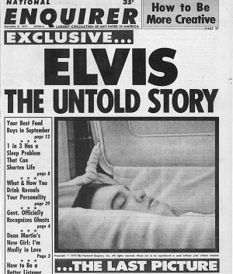
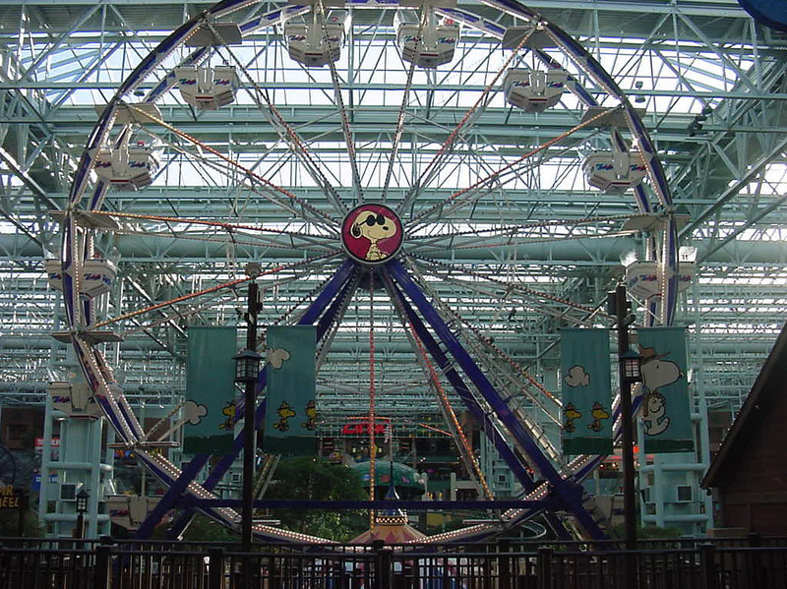
1 2 . 1 2 – 1 3 . 1 0
“I SAW THE ANTICHRIST
RIDING THE FERRIS WHEEL
AT THE MALL OF AMERICA!”

Slide 18
1 2 . 1 2 – 1 3 . 1 0

Slide 19
1 2 . 1 2 – 1 3 . 1 0
John 5:43 ~ I have come in My Father’s name, and you do not receive Me; if another comes in his own name, him you will receive.

Slide 20
1 2 . 1 2 – 1 3 . 1 0

Slide 21
1 2 . 1 2 – 1 3 . 1 0
2 Thess. 2:4 ~ who opposes and exalts himself above all that is called God or that is worshiped, so that he sits as God in the temple of God, showing himself that he is God.

Slide 22
1 2 . 1 2 – 1 3 . 1 0

Slide 23
1 2 . 1 2 – 1 3 . 1 0
Rev. 2: 7, 11, 17, 29; 3:6, 13, 22 ~ He who has an ear, let him hear what the Spirit says to the churches.

Slide 24
1 2 . 1 2 – 1 3 . 1 0

Slide 25
1 2 . 1 2 – 1 3 . 1 0
Chapter 1
“Hell won’t be so bad, especially with all your friends there besides heaven will be so boring”
Chapter 3
My Bible
Chapter 4
“Relative is a big word in Satan’s vocabulary”
“Christianity is a crutch”
“The devil made me do it”
“A good God would never send people to hell”
“Be sincere, do the best you can, and don’t hurt anyone”
“If it feels good, do it”
Chapter 5
“Christianity is so personal it ought to be kept to oneself”
Chapter 6
Chapter 8
“Don’t be so heavenly minded you’re no earthly good”
Chapter 9
“God helps those who help themselves”
Chapter 11
Chapter 15
Chapter16
satan

Slide 26
1 2 . 1 2 – 1 3 . 1 0

