Slide 1

A free CD of this message will be available following the service
1 2 . 1 – 1 1
This message will also be available for podcast later in the week a calvaryokc.com

Slide 2
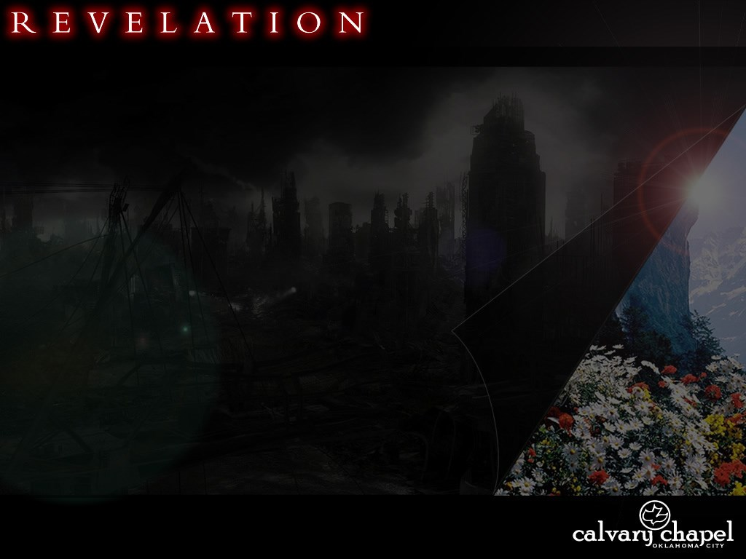
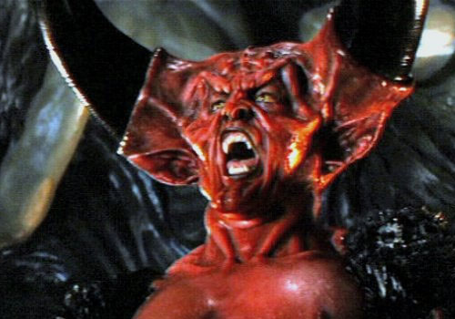

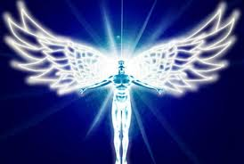
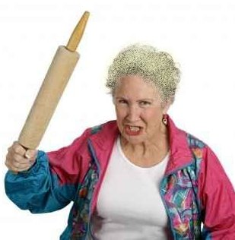


1 2 . 1 – 1 1
Angel of Light

Slide 3
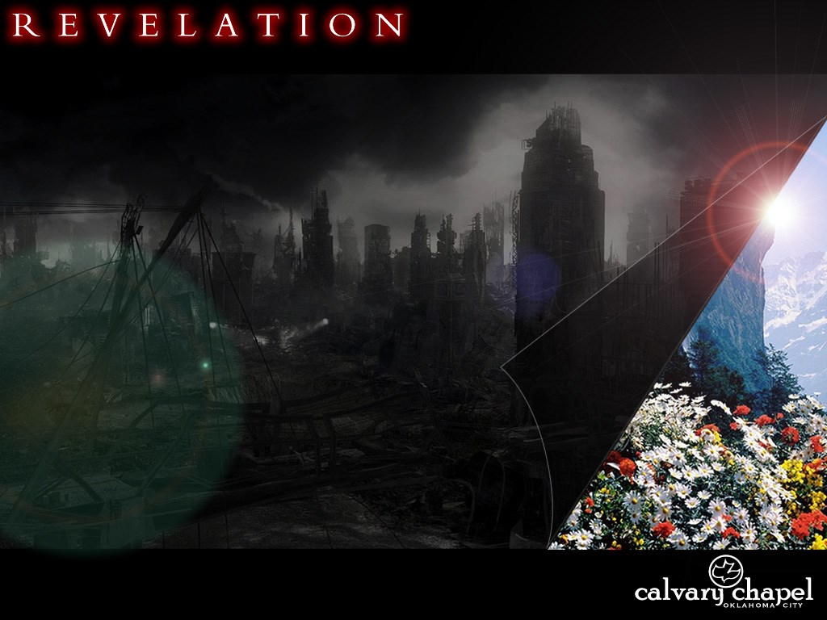
1 2 . 1 – 1 1

Slide 4
1 2 . 1 – 1 1
Sign ~ sēmeion – attesting sign

Slide 5
1 2 . 1 – 1 1

Slide 6
1 2 . 1 – 1 1
Woman is not:
The Body of Christ
The Roman Catholic Church
Mary Baker Eddy (Christian Science)
The Assumption of Mary (v. 6, then)

Slide 7
1 2 . 1 – 1 1
Gen. 37:9 ~ Then he dreamed still another dream and told it to his brothers, and said, “Look, I have dreamed another dream. And this time, the sun, the moon, and the eleven stars bowed down to me.”

Slide 8
1 2 . 1 – 1 1

Slide 9
1 2 . 1 – 1 1
Red ~ purros – only here and the fiery red horse (6:4)

Slide 10
1 2 . 1 – 1 1

Slide 11
1 2 . 1 – 1 1
Gen. 3:15 ~ And I will put enmity
Between you and the woman,
And between your seed and her Seed;
He shall bruise your head,
And you shall bruise His heel

Slide 12
1 2 . 1 – 1 1
The Plan:
The Cross
Cain and Abel
The Flood
Balaam and Balak
Saul and David
Cursing the royal line
Haman and Mordecai
Herod
The Jewish leaders

Slide 13
1 2 . 1 – 1 1

Slide 14
1 2 . 1 – 1 1
Matt. 24:15-22 ~ ¹⁵ “Therefore when you see the ‘abomination of desolation,’ spoken of by Daniel the prophet, standing in the holy place” (whoever reads, let him understand), ¹⁶ “then let those who are in Judea flee to the mountains. ¹⁷ Let him who is on the housetop not go down to take anything out of his house. ¹⁸ And let him who is in the field not go back to get his clothes. ¹⁹ But woe to those who are pregnant
and to those who are nursing babies in those days! ²⁰ And pray that your flight may not be in winter or on the Sabbath. ²¹ For then there will be great tribulation, such as has not been since the beginning of the world until this time, no, nor ever shall be. ²² And unless those odays were shortened, no flesh would be saved; but for the elect’s sake those days will be shortened.

Slide 15
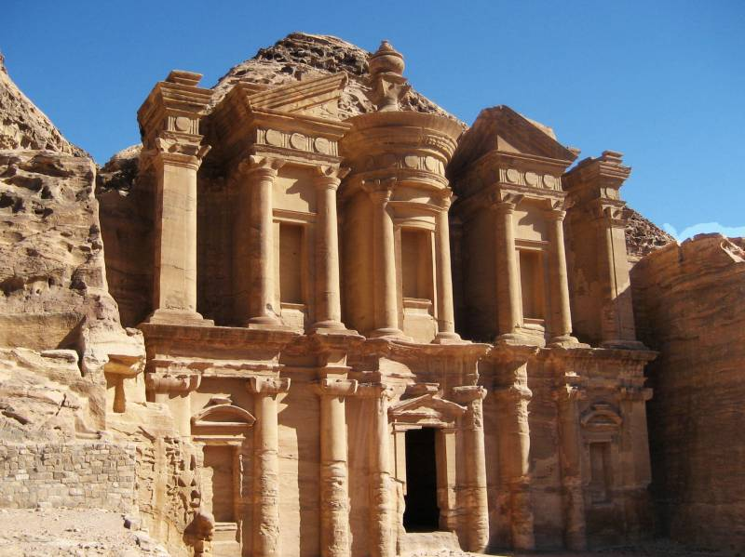
1 2 . 1 – 1 1

Slide 16
1 2 . 1 – 1 1
¹ Send the lamb to the ruler of the land, From Sela to the wilderness, To the mount of the daughter of Zion. ² For it shall be as a wandering bird thrown out of the nest; So shall be the daughters of Moab at the fords of the Arnon. ³ Take counsel, execute judgment; Make your shadow like the night in the middle of the day; Hide the outcasts, Do not betray him who escapes. ⁴ Let My outcasts dwell with
you, O Moab; Be a shelter to them from the face of the spoiler. For the extortioner is at an end, Devastation ceases, The oppressors are consumed out of the land.

Slide 17
1 2 . 1 – 1 1
Is. 40:31 ~ But those who wait on the Lord shall renew their strength; they shall mount up with wings like eagles, they shall run and not be weary, they shall walk and not faint.

Slide 18
1 2 . 1 – 1 1

Slide 19
1 2 . 1 – 1 1
Accused ~ katēgoreō – against the marketplace
Present participle

Slide 20
1 2 . 1 – 1 1

Slide 21
1 2 . 1 – 1 1
How can I get that victory?
1) Appropriate the blood
2) Make public confession
3) Live life of self-sacrifice

Slide 22
1 2 . 1 – 1 1

