Slide 1
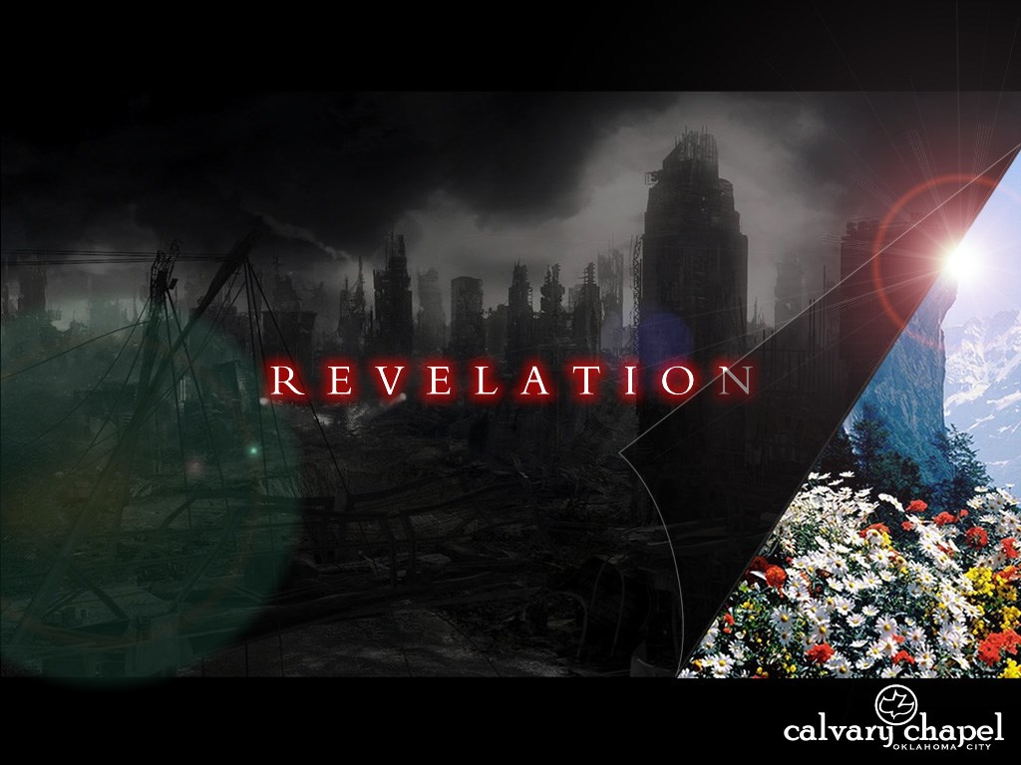
A free CD of this message will be available following the service
1 1 . 1 – 1 9
This message will also be available for podcast later in the week a calvaryokc.com

Slide 2
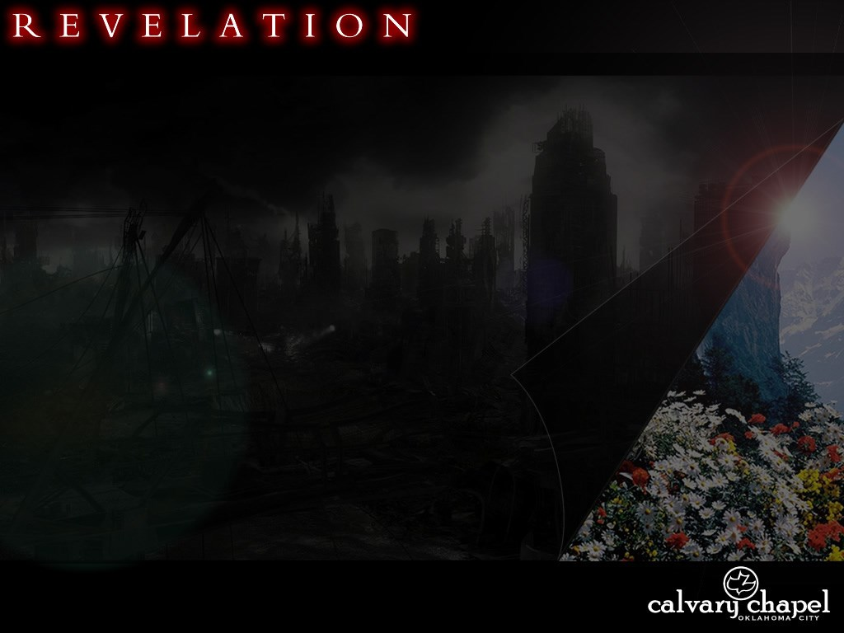
1 1 . 1 – 1 9
Measure ~ metreō

Slide 3
1 1 . 1 – 1 9
Dan. 9:27 ~ Then he shall confirm a covenant with many for one week; But in the middle of the week He shall bring an end to sacrifice and offering. And on the wing of abominations shall be one who makes desolate, Even until the consummation, which is determined, Is poured out on the desolate.

Slide 4
1 1 . 1 – 1 9
Matt. 24:15a ~ Therefore when you see the "abomination of desolation," spoken of by Daniel the prophet, standing in the holy place …
2 Thess. 2:3-4 ~ ³ Let no one deceive you by ny means; for that Day will not come unless the falling away comes first, and the man of sin is revealed, the son of perdition, ⁴ who opposes and exalts himself above all that is called God or that is worshiped, so that he sits as God in the temple of God, showing himself that he is God.

Slide 5
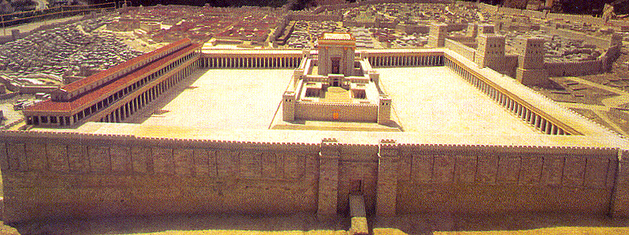
1 1 . 1 – 1 9
Two words for "Temple"
heiron – Temple Complex
naos – only the Holy of Holies

Slide 6
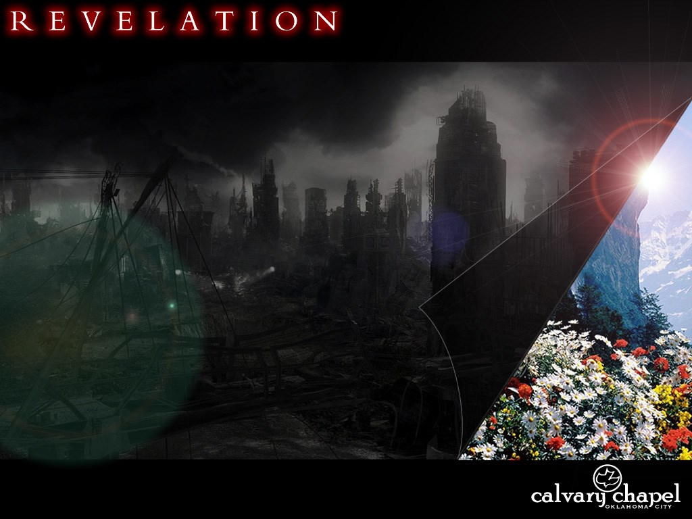
1 1 . 1 – 1 9

Slide 7
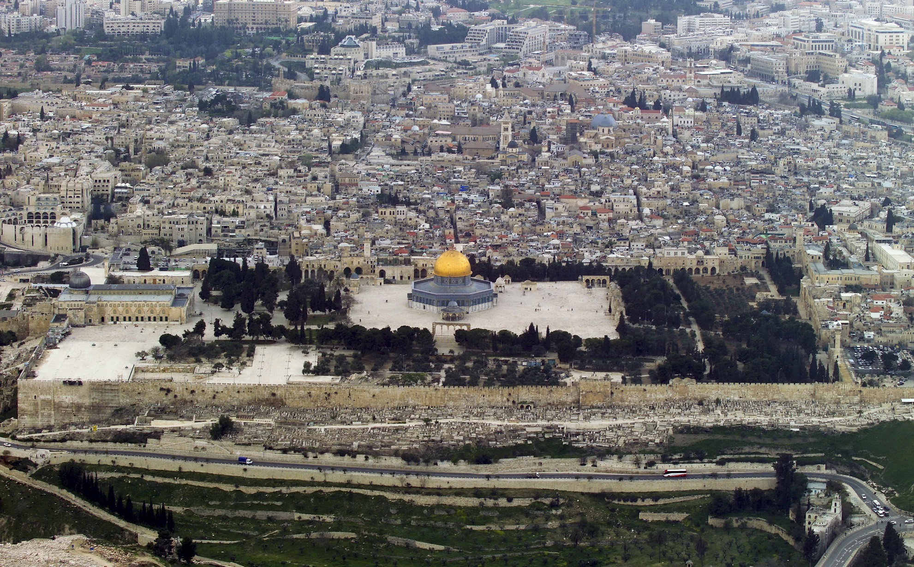
1 1 . 1 – 1 9
Dome of the Rock
Dome of the Spirits
Eastern Gate
Leave out ~ exballō + exō

Slide 8
1 1 . 1 – 1 9
Eastern Gate

Slide 9
1 1 . 1 – 1 9

Slide 10
1 1 . 1 – 1 9
1,260 days = 42 months = 3 ½ years

Slide 11
1 1 . 1 – 1 9

Slide 12
1 1 . 1 – 1 9
Zech. 4: 13 ~ So he said, "These are the two anointed ones, who stand beside the Lord of the whole earth."
Anointed ones ~ ben yitshar – sons of oil

Slide 13
1 1 . 1 – 1 9
Zerubabbel and Joshua
Enoch and Elijah
Moses and Elijah
Elijah stopped the rain 3 ½ years
Elijah called down firen from heaven ~ 2 Kings 1
Elijah will come again ~ Mal. 4:5
Moses turned water to blood
Transfiguration ~ Matt. 17

Slide 14
1 1 . 1 – 1 9

Slide 15
1 1 . 1 – 1 9
Dwell on the earth
katoikountas epi tēs gēs
3 of 8x in Revelation
Always refers to those in rebellion to God

Slide 16
1 1 . 1 – 1 9

Slide 17
1 1 . 1 – 1 9
1 Cor. 15:52 ~ in a moment, in the twinkling of an eye, at the last trumpet. For the trumpet will sound, and the dead will be raised incorruptible, and we shall be changed.

Slide 18
1 1 . 1 – 1 9
Matt. 24:29-31 ~ ²⁹ Immediately after the tribulation of those days the sun will be darkened, and the moon will not give its light; the stars will fall from heaven, and the powers of the heavens will be shaken. ³⁰ Then the sign of the Son of Man will appear in heaven, and then all the tribes of the earth will mourn, and they will see the Son of Man coming on the clouds of heaven with power and great glory. ³¹ And He will send His angels with a great sound of a trumpet, and they will gather together His elect from the four winds, from one end of heaven to the other.

Slide 19
1 1 . 1 – 1 9
1 Cor. 15:45 ~ And so it is written, "The first man Adam became a living being," The last Adam became a life-giving spirit.
1) Last in a series
2) Last in a point in time
Zech. 14:16 ~ And it shall come to pass that everyone who is left of all the nations which came against Jerusalem shall go up from year to year to worship the King, the Lord of hosts, and tokeep the Feast of Tabernacles.

Slide 20
1 1 . 1 – 1 9
Num. 10:10 ~ Also in the day of your gladness, in your appointed feasts, and at the beginning of your months, you shall blow the trumpets over your burnt offerings.

Slide 21
1 1 . 1 – 1 9

