Slide 1
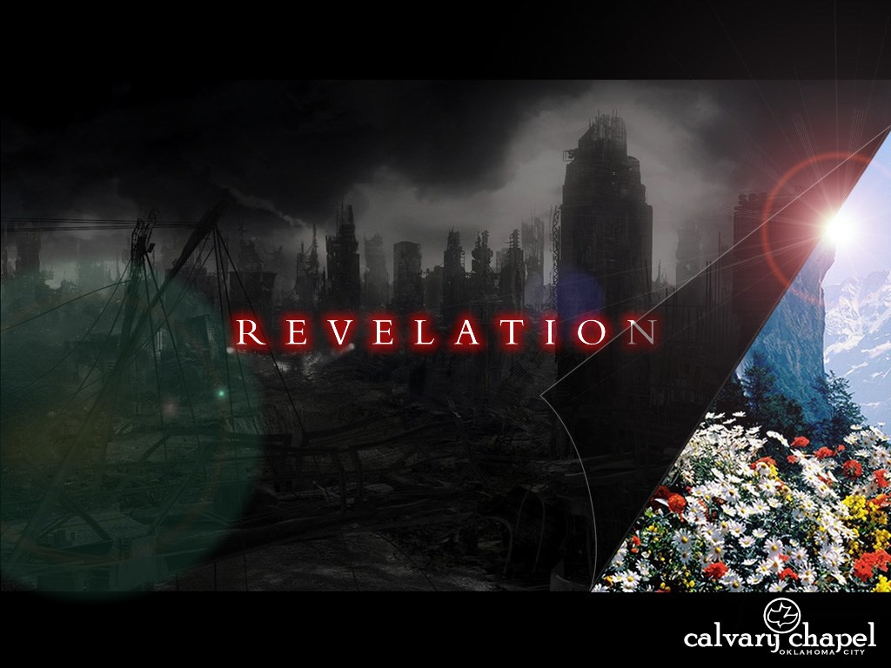
A free CD of this message will be available following the service
1 0 . 1 – 1 0
This message will also be available for podcast later in the week a calvaryokc.com

Slide 2
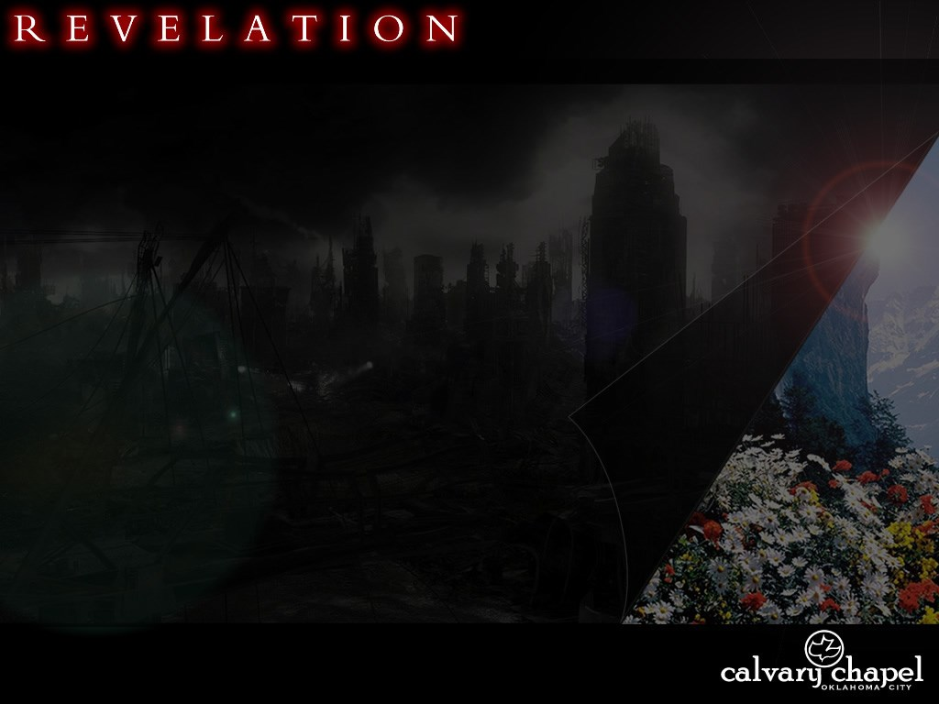
1 0 . 1 – 1 0
The Rapture had taken place
The Antichrist has been revealed
WWIII has broken out
Worldwide famine
Vegetation and water supplies destroyed
Billions of people have died
Unthinkable demonic activities and manifestation
Sun has been diminished by 1/3

Slide 3
1 0 . 1 – 1 0
7 YR
RAPTURE
2ND COMING
7TH TRUMPET
7TH BOWL
7TH SEAL
RISE OF ANTICHRIST
TRUMPETS 1-6
BOWLS 1-6
SEALS 1-6
SEALS, TRUMPETS, BOWLS

Slide 4
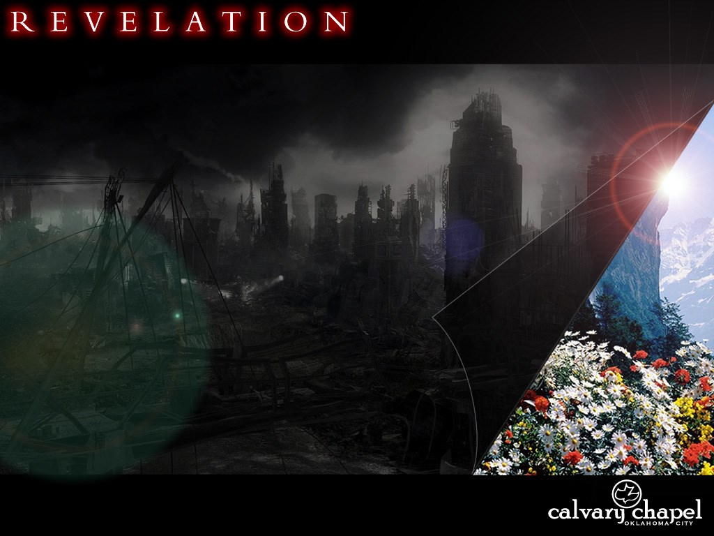
1 0 . 1 – 1 0

Slide 5
1 0 . 1 – 1 0
Other "lone" angels:
8.5 ~ Then the angel took the censer, filled it with fire from the altar, and threw it to the earth. And there were noises, thunderings, lightnings, and an earthquake.
10.1 ~ I saw still another mighty angel coming down from heaven, clothed with a cloud. And a rainbow was on his head, his face was like the sun, and his feet like pillars of fire.
7.2 ~ Then I saw another angel ascending from the east, having the seal of the living God. And he cried with a loud voice to the four angels to whom it was granted to harm the earth and the sea,
PROPHET
PRIEST
KING

Slide 6
1 0 . 1 – 1 0

Slide 7
1 0 . 1 – 1 0
Same book as chapter 5?
Rev. 5:1 ~ And I saw in the right hand of Him who sat on the throne a scroll written inside and on the back, sealed with seven seals.
Scroll (5:1) ~ biblion
Little book (10:2) ~ biblaridion

Slide 8
1 0 . 1 – 1 0
Same book as chapter 5?
Dan. 12:4 ~ But you, Daniel, shut up the words, and seal the book until the time of the end; many shall run to and fro, and knowledge shall increase.
Sea = Gentiles,
Land = Israel

Slide 9
1 0 . 1 – 1 0

Slide 10
1 0 . 1 – 1 0
Delay ~ chronos
KJV, time – weak
Message ~ ⁵ Then the Angel I saw astride sea and land lifted his right hand to Heaven ⁶ and swore by the One Living Forever and Ever, who created Heaven and everything in it, earth and everything in it, sea and everything in it, that time was up—

Slide 11
1 0 . 1 – 1 0

Slide 12
1 0 . 1 – 1 0
Rom. 11:25-27 ~ ²⁵ For I do not desire, brethren, that you should be ignorant of this mystery, lest you should be wise in your own opinion, that blindness in part has happened to Israel until the fullness of the Gentiles has come in. ²⁶ And so all Israel will be saved, as it is written: "The Deliverer will come out of Zion, And He will turn away ungodliness from Jacob; ²⁷ For this is My covenant with them, When I take away their sins."

Slide 13
1 0 . 1 – 1 0

Slide 14
1 0 . 1 – 1 0
Rev. 6:10 ~ … "How long, O Lord, holy and true, until You judge and avenge our blood on those who dwell on the earth?"

Slide 15
1 0 . 1 – 1 0

Slide 16
1 0 . 1 – 1 0
Rom. 2:2-4 ~ ² But we know that the judgment of God is according to truth against those who practice (evil) things. ³ And do you think this, O man, you who judge those practicing (evil) things, and doing the same, that you will escape the judgment of God? ⁴ Or do you despise the riches of His goodness, forbearance, and longsuffering, not knowing that the goodness of God leads you to repentance?

Slide 17
1 0 . 1 – 1 0

Slide 18
1 0 . 1 – 1 0
Is.63:1-4 ~ ¹ Who is this who comes from Edom, With dyed garments from Bozrah, This One who is glorious in His apparel, Traveling in the greatness of His strength? — "I who speak in righteousness, mighty to save." ² Why is Your apparel red, And Your garments like one who treads in the winepress? ³ "I have trodden the winepress alone, And from the peoples no one was with Me. For I have trodden them in My anger, And trampled them in My fury; Their blood is sprinkled upon My garments, And I have stained all My robes. ⁴ For the day of vengeance is in My heart, And the year of My redeemed has come.

Slide 19
1 0 . 1 – 1 0

