Slide 1

A free CD of this message will be available following the service
9 . 1 3 – 2 1
This message will also be available for podcast later in the week a calvaryokc.com

Slide 2
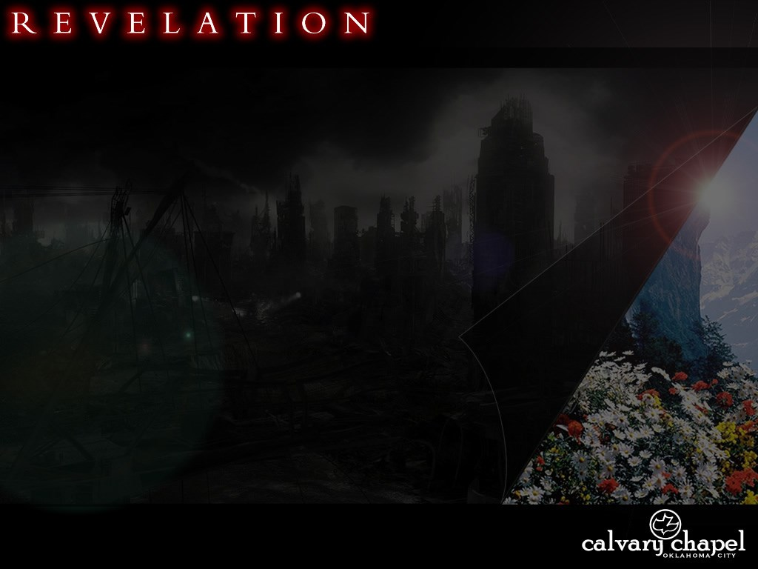
9 . 1 3 – 2 1
Moderate
Mild
Extreme
Woe-age-o-meter

Slide 3
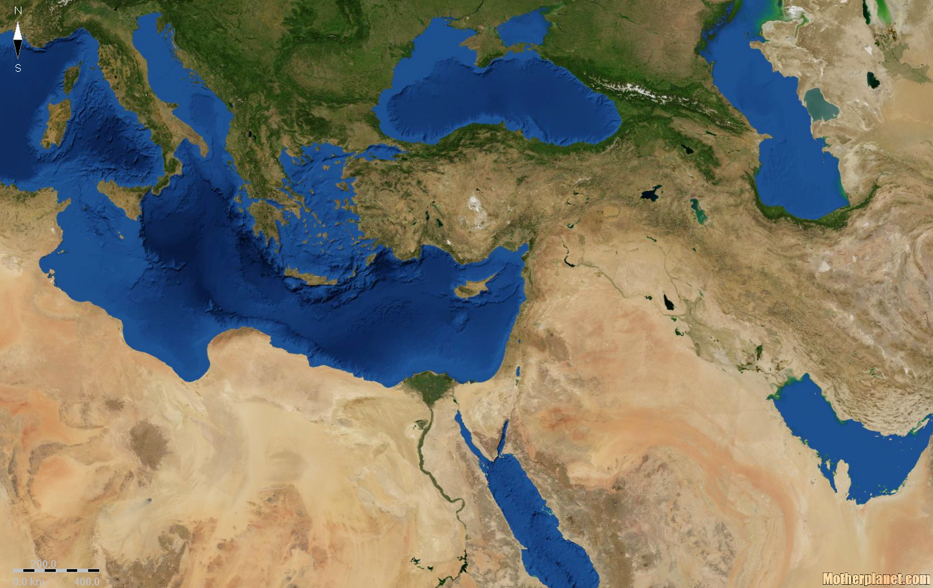
9 . 1 3 – 2 1
Euphrates River ~ eastern border of the Roman Empire
Rudyard Kipling ~ "Oh, East is East and West is West, and never the twain shall meet,
Till Earth and Sky stand presently at God's great Judgment Seat;"
Napoleon Bonaparte ~ "China is a sleeping giant. God pity the generation who wakes her up."

Slide 4
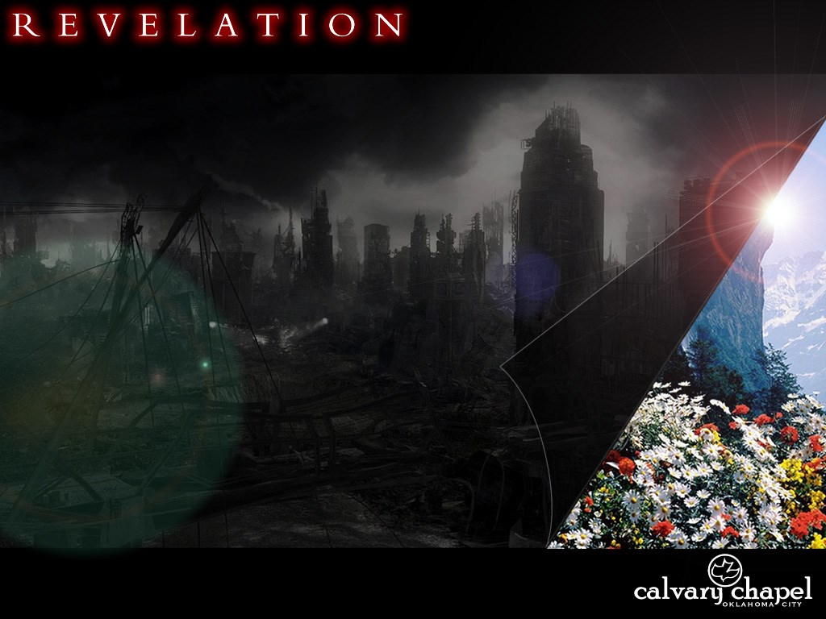
9 . 1 3 – 2 1

Slide 5
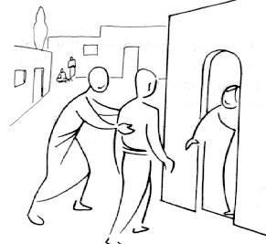
9 . 1 3 – 2 1
The hour ~ KJV, an hour
GNB ~ The four angels were released; for this very hour of this very day of this very month and year they had been kept ready.

Slide 6
9 . 1 3 – 2 1
Harry Ironside ~ "Until that hour strikes, not all the evil machinations of men, not all the ambitions of nations, can bring about the conflict here predicted. But when that hour does strike, no astute statesman’s policy, no treaties, no world-federation movements can prevent the dire catastrophe predicted."

Slide 7
9 . 1 3 – 2 1

Slide 8
9 . 1 3 – 2 1
200 million ~ literally Two ten thousands of ten thousands
Murias was the largest number they used

Slide 9
9 . 1 3 – 2 1

Slide 10
9 . 1 3 – 2 1
William Newel ~ "Believe and you scarcely need any comment."

Slide 11
9 . 1 3 – 2 1

Slide 12
9 . 1 3 – 2 1
1 Cor. 10:19–21 ~ ¹⁹ What am I saying then? That an idol is anything, or what is offered to idols is anything? ²⁰ Rather, that the things which the Gentiles sacrifice they sacrifice to demons and not to God, and I do not want you to have fellowship with demons. ²¹ You cannot drink the cup of the Lord and the cup of demons; you cannot partake of the Lord’s table and of the table of demons.

Slide 13
9 . 1 3 – 2 1

Slide 14
9 . 1 3 – 2 1
Sorceries ~ pharmakeia
Sexual immorality ~ porneia

Slide 15
9 . 1 3 – 2 1

Slide 16
9 . 1 3 – 2 1
Babylonians used a base 6 system
A B C D E F G H I
6 9 18 24 30 36 42 48 54
J K L M N O P Q R
60 66 72 78 84 90 96 102 108
S T U V W X Y Z
114 120 126 132 138 144 150 154
K I S S I N G E R
66 54 114 114 54 84 42 30 108
= 666

