Slide 1

A free CD of this message will be available following the service
9 . 1 – 1 2
This message will also be available for podcast later in the week a calvaryokc.com

Slide 2
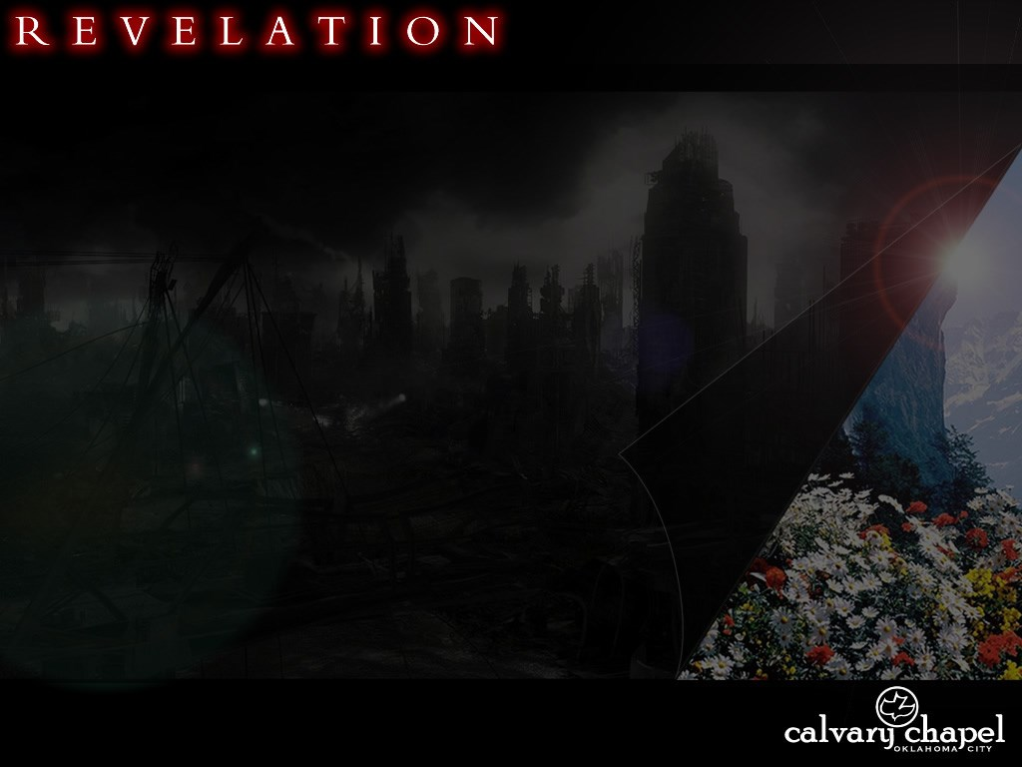
9 . 1 – 1 2
The Rapture has taken place
The Antichrist has been revealed
WWIII has broken out
Worldwide famine
1/4 earth's population killed in a single plague
1/3 of the vegetation destroyed by some cosmic disaster
1/3 of world's water supply contaminated

Slide 3
9 . 1 – 1 2
14-15,000 ships destroyed
Sun has been diminished by 1/3

Slide 4
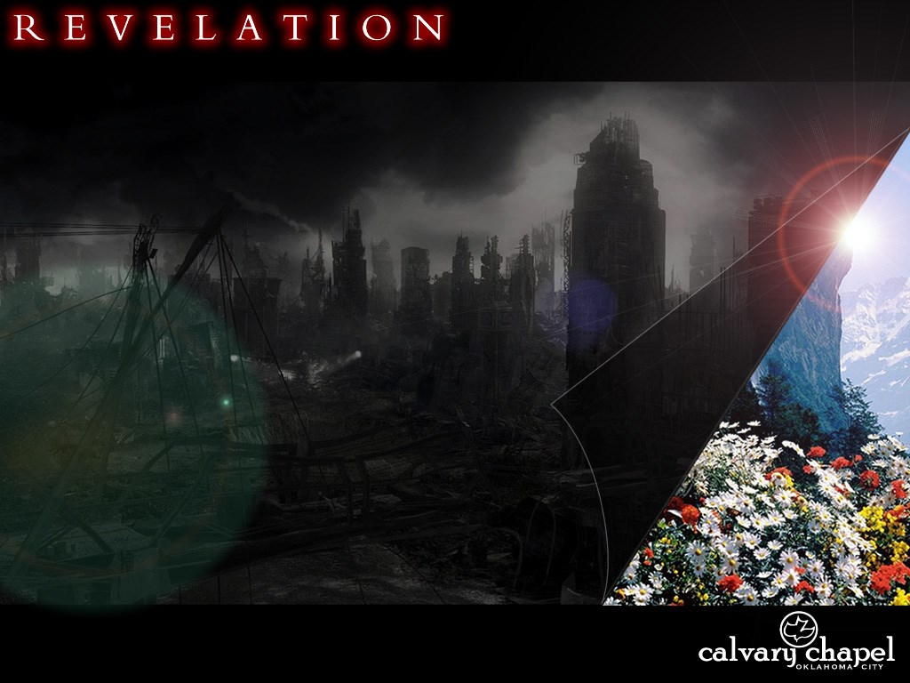
9 . 1 – 1 2

Slide 5
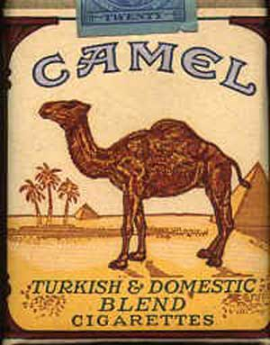



9 . 1 – 1 2
USDA Grade A Dirt

Slide 6
9 . 1 – 1 2

Slide 7
9 . 1 – 1 2
Fallen ~ (perfect, active, participle) literally, having fallen
  Had fallen (NASB, NIV)

Slide 8
9 . 1 – 1 2
Bottomless pit ~ abussos
Romans 10.7 ~ or, `Who will descend into the abyss?'" (that is, to bring Christ up from the dead).
Matt. 8 ~ Gadarenes
2 Pet. 2.4 ~ For if God did not spare the angels who sinned, but cast them down to hell (tartaroō) and delivered them into chains of darkness, to be reserved for judgment;

Slide 9
9 . 1 – 1 2
Jude 6 ~ And the angels who did not keep their proper domain, but left their own abode, He has reserved in everlasting chains under darkness for the judgment of the great day;

Slide 11
9 . 1 – 1 2
David Guzik ~ "The idea is simply that as part of the judgment of the great tribulation, God will allow demonic hordes, previously imprisoned, to descend upon the earth like a swarm of destructive locusts. They are not, as some have suggested, heretics, Muslims, Turks, Saracens, Jesuits, monks, or Protestants!"

Slide 13
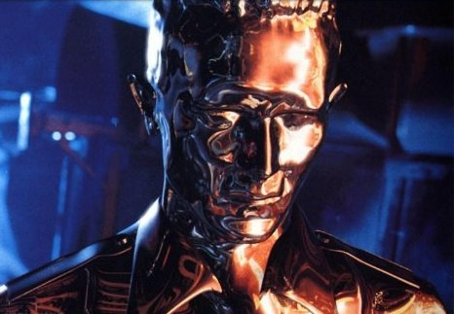
9 . 1 – 1 2

Slide 15
9 . 1 – 1 2
Joel 2.1-16

Slide 17
9 . 1 – 1 2
Prov. 30:27 ~ The locusts have no king, Yet they all advance in ranks;

Slide 18
9 . 1 – 1 2
Names of Satan (accuser)
Devil (slanderer)
Abaddon (destruction)
Apollyon (destroyer)
Belial (wicked)
Beelzebub (Lord of the dung heap)
Lucifer (light-bearer)

Slide 20
1 . 1 - 20
Babylonians used a base 6 system
A B C D E F G H I
6 9 18 24 30 36 42 48 54
J K L M N O P Q R
60 66 72 78 84 90 96 102 108
S T U V W X Y Z
114 120 126 132 138 144 150 154
K I S S I N G E R
66 54 114 114 54 84 42 30 108
= 666

