Slide 1

A free CD of this message will be available following the service
8 . 7 – 1 3
This message will also be available for podcast later in the week a calvaryokc.com

Slide 2

8 . 7 – 1 3
7 YR
Rapture (chap. 4-5)
Middle of Tribulation
(chap. 10-14)
Millennium (chap. 20)
1st ½ of Tribulation
(chap. 6-9)
2nd ½ of Tribulation
(chap. 15-19)
Church age
(chap. 2-3)
Eternal state
(chap. 21-22)
Warren Weirsbe

Slide 3
8 . 7 – 1 3
David Guzik ~ "Since John brings a report from eternity, it is difficult to assign a chronological and sequential element to these judgments. It is most important to emphasize that they are real, even if their sequence is hard to pin down with certainty."

Slide 4
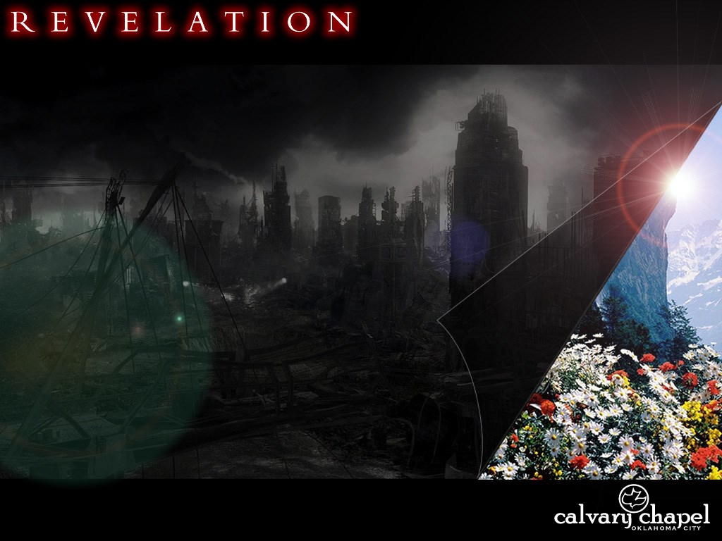
8 . 7 – 1 3

Slide 5
8 . 7 – 1 3
4 Spiritual Laws:
1) God loves you and has a wonderful plan for your life.
2) Man is sinful and separated from God. Therefore, he cannot know and experience God's love and plan for his life.
3) Jesus Christ is God's only provision for man's sin. Through Him you can know and experience God's love and plan for your life.
4) We must individually receive Jesus Christ as Savior and Lord. Then we can know and experience God's love and plan for our lives..

Slide 6
8 . 7 – 1 3

Slide 7
8 . 7 – 1 3
Trees ~ dendron, not xulon (usually signifying a fruit tree)

Slide 8
8 . 7 – 1 3

Slide 9
8 . 7 – 1 3
David Chilton ~ "If the trees and grass represent the elect remnant, this indicates that they are not exempt from physical suffering and death as God’s wrath is visited upon the wicked. Nevertheless, (1) the Church cannot be completely destroyed in any judgment, and (2) unlike the wicked, the Christian’s ultimate destiny is not wrath but life and salvation."

Slide 10
8 . 7 – 1 3

Slide 11
8 . 7 – 1 3
6th plague in Egypt ~ Nut, the sky goddess
Ex. 9:23-24 ~ ²³ And Moses stretched out his rod toward heaven; and the Lord sent thunder and hail, and fire darted to the ground. And the Lord rained hail on the land of Egypt. ²⁴ So there was hail, and fire mingled with the hail, so very heavy that there was none like it in all the land of Egypt since it became a nation.

Slide 12
8 . 7 – 1 3

Slide 13
8 . 7 – 1 3
2 Pet.3:9-10 ~ ⁹ The Lord is not slack concerning His promise, as some count slackness, but is longsuffering toward us, not willing that any should perish but that all should come to repentance. ¹⁰ But the day of the Lord will come as a thief in the night, in which the heavens will pass away with a great noise, and the elements will melt with fervent heat; both the earth and the works that are in it will be burned up.

Slide 14
8 . 7 – 1 3

Slide 15

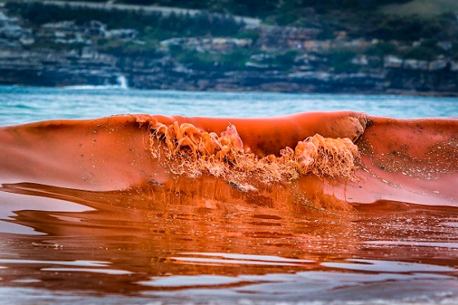
8 . 7 – 1 3
Red Tide

Slide 16
8 . 7 – 1 3

Slide 17
8 . 7 – 1 3
Angel ~ not aggelos, but aetos – eagle (as in NASB and NIV)

Slide 18
8 . 7 – 1 3

Slide 19
8 . 7 – 1 3
Gen. 15:16 ~ But in the fourth generation they shall return here, for the iniquity of the Amorites is not yet complete.

Slide 20
8 . 7 – 1 3

Slide 21
8 . 7 – 1 3
4 Spiritual Laws:
1) God loves you and has a wonderful plan for your life.
2) Man is sinful and separated from God. Therefore, he cannot know and experience God's love and plan for his life.
3) Jesus Christ is God's only provision for man's sin. Through Him you can know and experience God's love and plan for your life.
4) We must individually receive Jesus Christ as Savior and Lord. Then we can know and experience God's love and plan for our lives..

Slide 22
8 . 7 – 1 3

