Slide 1

A free CD of this message will be available following the service
7 . 9 – 8 . 6
This message will also be available for podcast later in the week at calvaryokc.com

Slide 2
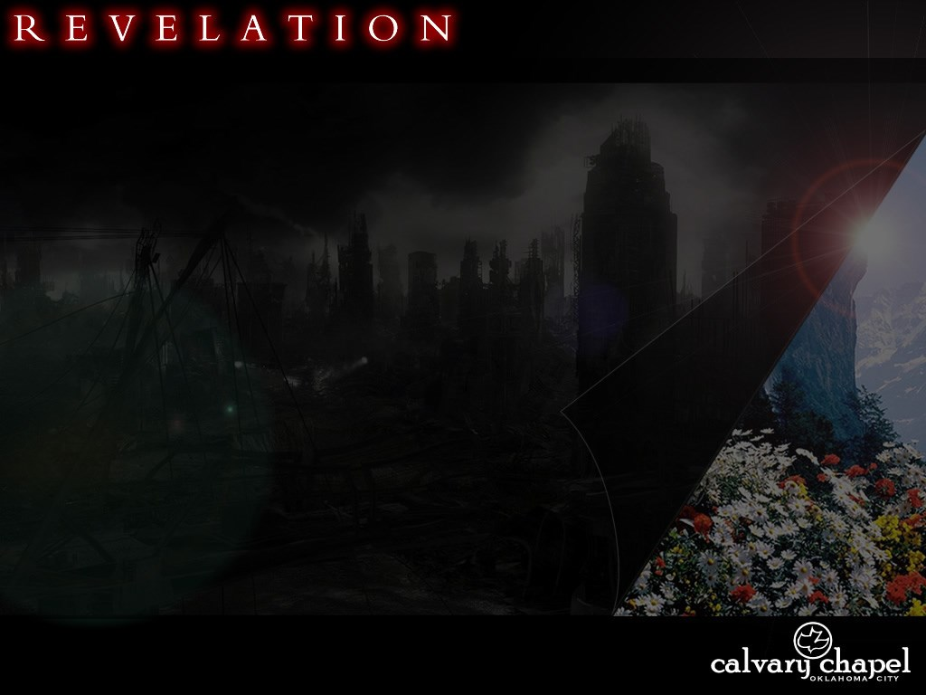
7 . 9 – 8 . 6
Jer. 30:7 ~ Alas! For that day is great,
So that none is like it;
And it is the time of Jacob’s trouble,
But he shall be saved out of it.

Slide 3
7 . 9 – 8 . 6
7 YR
RAPTURE
2ND COMING
MAGOG?
7TH TRUMPET
7TH BOWL
7TH SEAL
RISE OF ANTICHRIST
TRUMPETS 1-6
BOWLS 1-6
SEALS 1-6
SEALS, TRUMPETS, BOWLS

Slide 4
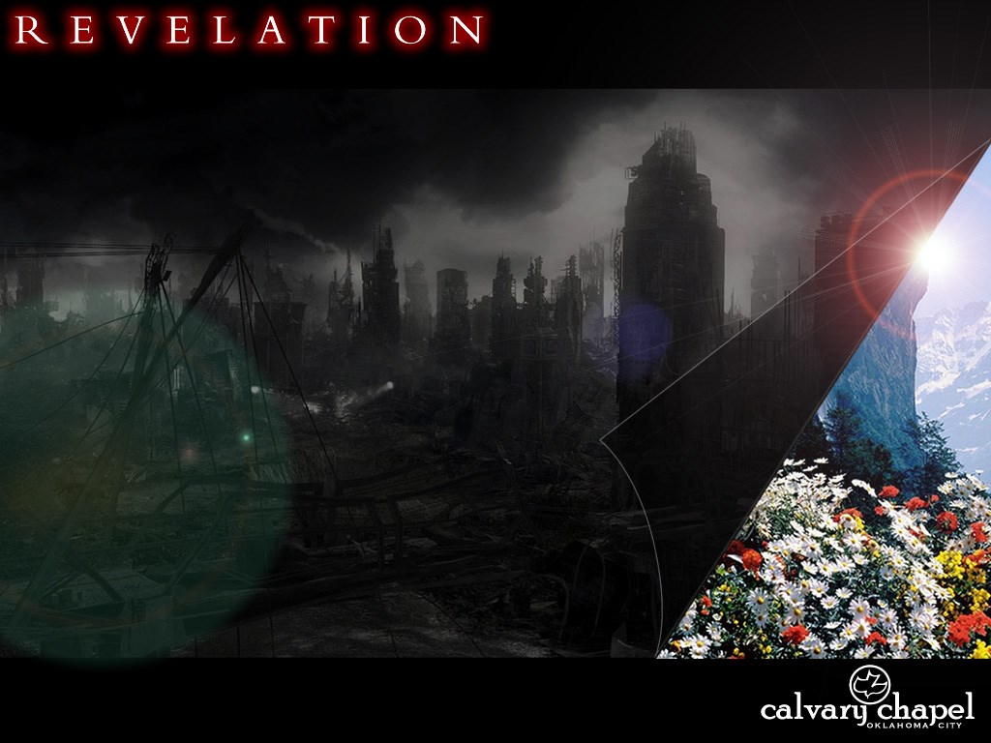
7 . 9 – 8 . 6

Slide 5
7 . 9 – 8 . 6
After these things ~ meta tauta – 4th of 10 occurrences in Revelation

Slide 6
7 . 9 – 8 . 6
7.1-8
7.9-17
Gentiles from all nations
Jews
Numbered – 144,000
Not numbered, nor could be
Standing in heaven, before God
Sealed on earth

Slide 7
7 . 9 – 8 . 6

Slide 8
7 . 9 – 8 . 6
Who come ~ literally are coming (pres. part.)
2 Thess. 2.11-12 ~ ¹¹ And for this reason God will send them strong delusion, that they should believe the lie, ¹² that they all may be condemned who did not believe the truth but had pleasure in unrighteousness.

Slide 9
7 . 9 – 8 . 6

Slide 10
7 . 9 – 8 . 6
Dwell ~ literally, Tabernacle
NIV, spread His tent

Slide 11
7 . 9 – 8 . 6

Slide 12
7 . 9 – 8 . 6
Eze. 33:11 ~ Say to them: ‘As I live,’ says the Lord God, ‘I have no pleasure in the death of the wicked, but that the wicked turn from his way and live. Turn, turn from your evil ways! For why should you die, O house of Israel?’

Slide 13
7 . 9 – 8 . 6

Slide 14
7 . 9 – 8 . 6
Altar of Sacrifice
Altar of Incense

Slide 15
7 . 9 – 8 . 6

Slide 16
7 . 9 – 8 . 6
When the ceilings are brass:
1) If I cling to sin
Ps. 66.18 ~ If I regard iniquity in my heart the Lord will not hear.
Is. 59.2 ~ But you iniquities have separated you from your God; and your sins have hidden His face fro you so that He will not hear.

Slide 17
7 . 9 – 8 . 6
When the ceilings are brass:
2) If I bring my own agenda
1 John 5.14 ~ Now this is the confidence that we have in Him, that if we ask anything according to His will, He hears us.
Ps. 37.4 ~ Delight yourself also in the Lord, and He shall give you the desires of your heart.

Slide 18
7 . 9 – 8 . 6
John 15.7 ~ If you abide in Me, and My words abide in you, you will ask what you desire, and it shall be done for you.

Slide 19
7 . 9 – 8 . 6

Slide 20
7 . 9 – 8 . 6
Num. 33.4 ~ For the Egyptians were burying all their firstborn, whom the Lord had killed among them. Also on their gods the Lord had executed judgments.
Nile ~ (1st plague) bloodstream of the Osiris
Boils ~ (6th plague) Imhotep: god of medicine
Death of the firstborn ~ (10th plague) entire Isis/Osiris worship

Slide 21
7 . 9 – 8 . 6

Slide 22
7 . 9 – 8 . 6
C. H. Spurgeon ~ "Now, how is this? If you will tell me, I shall be glad, for I cannot tell you. I do not believe that there will be one atom less tenderness, that there will be one fraction less of amiability, and love, and sympathy - I believe there will be more - but that they will be in some way so refined and purified, that while compassion for suffering is there, detestation of sin shall be there to balance it, and a state of complete equilibrium shall be attained."

Slide 23
7 . 9 – 8 . 6

