Slide 1

A free CD of this message will be available following the service
7 . 1 - 8
This message will also be available for podcast later in the week a calvaryokc.com

Slide 2

7 . 1 - 8
700 wives
refuse
Guinness’ s
liar
Apple tree
Finkelsteins
Mt. Cyanide
birthmark
300 porcupines
Mt. Montezuma
“Brother’s son?”
Canada

Slide 3
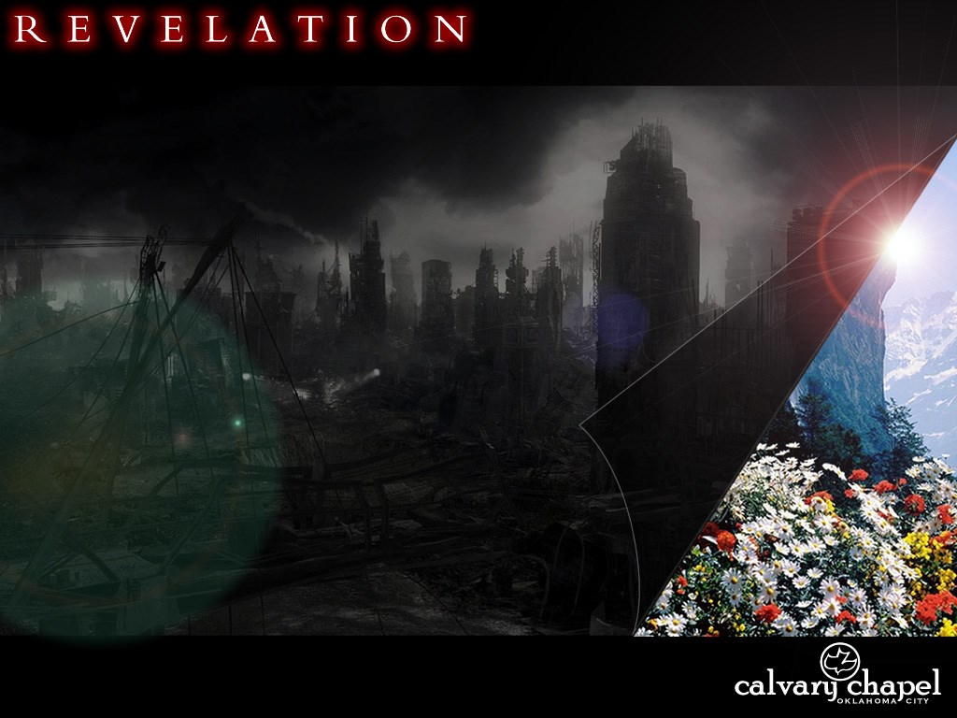
7 . 1 - 8

Slide 4
7 . 1 - 8
6:17 ~ For the day of His wrath has come, and who is able to stand?

Slide 5
7 . 1 - 8

Slide 6
7 . 1 - 8
After these things ~ Meta houtos, not meta tauta

Slide 7
7 . 1 - 8
Is 40:22a ~ It is He who sits above the circle of the earth …
chuwg – circle, compass, vault
Job 26:7b ~ He hangs the earth on nothing.

Slide 8
7 . 1 - 8

Slide 9
7 . 1 - 8
Rev. 3:10 ~ Because you have kept My command to persevere, I also will keep you from the hour of trial which shall come upon the whole world, to test those who dwell on the earth.

Slide 10
7 . 1 - 8

Slide 11
7 . 1 - 8
Matt. 24:14 ~ And this gospel of the kingdom will be preached in all the world as a witness to all the nations, and then the end will come.

Slide 12
7 . 1 - 8
The 12 Tribes of Israel
Judah
Reuben
Gad
Asher
Naphtali
Manasseh
Levi
Issachar
Simeon
Ephriam
Dan
Benjamin
Zebulun
Joseph
Levi

Slide 13
7 . 1 - 8

Slide 14
7 . 1 - 8
Anglo-Israelism
Ephraim = Great Britain
Manasseh = United States

Slide 15
7 . 1 - 8
Covenant = B'rith
, Man = ish
Hence, British
Danube, Danzig, etc.
hogwashizomai

Slide 16
7 . 1 - 8
Ezra - Neh. ~ Jews = 18x, Israel = 62x
John 1:47 ~ An Israelite indeed, in whom is no deceit!
Lu. 2:36 ~ Now there was one, Anna, a prophetess, the daughter of Phanuel, of the tribe of Asher.
James and 1 Peter to the 12 tribes
Rom. 11:1 ~ I say then, has God cast away His people? Certainly not! For I also am an Israelite, of the seed of Abraham, of the tribe of Benjamin.

Slide 17
7 . 1 - 8

Slide 18
7 . 1 - 8
Eze. 9:4 ~ and the LORD said to him, "Go through the midst of the city, through the midst of Jerusalem, and put a mark on the foreheads of the men who sigh and cry over all the abominations that are done within it."

Slide 19
7 . 1 - 8
Eph. 1:13-14 ~ ¹³ In Him you also trusted, after you heard the word of truth, the gospel of your salvation; in whom also, having believed, you were sealed with the Holy Spirit of promise, ¹⁴ who is the guarantee of our inheritance until the redemption of the purchased possession, to the praise of His glory.

Slide 20
7 . 1 - 8

Slide 21
7 . 1 - 8
2 Cor.1:20 ~ For all the promises of God in Him are Yes, and in Him Amen, to the glory of God through us.
Phil. 3:19-20 ~ ²⁰ For our citizenship is in heaven, from which we also eagerly wait for the Savior, the Lord Jesus Christ, ²¹ who will transform our lowly body that it may be conformed to His glorious body, according to the working by which He is able even to subdue all things to Himself.

Slide 22
7 . 1 - 8

Slide 23
7 . 1 - 8
Eph.4:30 ~ And do not grieve the Holy Spirit of God, by whom you were sealed for the day of redemption.
1 Thess. 5:19 ~ Do not quench the Spirit.

Slide 24
7 . 1 - 8

