Slide 1
A free CD of this message will be available following the service
5 . 1 – 1 0
This message will also be available for podcast later in the week at calvaryokc.com

Slide 2
5 . 1 – 1 0
S
t
a
a
t
n
n
a

Slide 3
5 . 1 – 1 0

Slide 4
5 . 1 – 1 0
Who owns the land?
Ex. 9:29 ~ So Moses said to him, "As soon as I have gone out of the city, I will spread out my hands to the Lord; the thunder will cease, and there will be no more hail, that you may know that the earth is the Lord's.
Ps. 24:1 ~ The earth is the Lord's, and all its fullness,
The world and those who dwell therein.

Slide 5
5 . 1 – 1 0
Gen. 1:28 ~ Then God blessed them, and God said to them, "Be fruitful and multiply; fill the earth and subdue it; have dominion over the fish of the sea, over the birds of the air, and over every living thing that moves on the earth."

Slide 6
5 . 1 – 1 0
Matt. 4:8-9 ~ ⁸ Again, the devil took Him up on an exceedingly high mountain, and showed Him all the kingdoms of the world and their glory. ⁹ And he said to Him, "All these things I will give You if You will fall down and worship me."

Slide 7
5 . 1 – 1 0

Slide 8
5 . 1 – 1 0
Gen. 17:7 ~ And I will establish My covenant between Me and you and your descendants after you in their generations, for an everlasting covenant, to be God to you and your descendants after you.

Slide 9
5 . 1 – 1 0

Slide 10
5 . 1 – 1 0
Scroll ~ biblion – title deed to the earth

Slide 11
5 . 1 – 1 0

Slide 12
5 . 1 – 1 0
Worthy ~ axios
– idea of equality or equal weight
"Who is equal to the task?"

Slide 13
5 . 1 – 1 0

Slide 14
5 . 1 – 1 0
Wept much ~ i.e. "an in consolable weeping"

Slide 15
5 . 1 – 1 0

Slide 16
5 . 1 – 1 0
Mark 12.35-37 ~ ³⁵ …"How is it that the scribes say that the Christ is the Son of David? ³⁶ For David himself said by the Holy Spirit:
'The LORD said to my Lord,
Sit at My right hand,
Till I make Your enemies Your footstool.'
³⁷ Therefore David himself calls Him, 'Lord'; how is He then his Son?"

Slide 17
5 . 1 – 1 0

Slide 18
5 . 1 – 1 0
Lamb ~ not arnēn, but arnion (diminutive)
28x in Revelation
Seven horns ~ Omnipotence
Seven eyes ~ Omniscience
Had been slain ~ perfect tense

Slide 19
5 . 1 – 1 0
Perfect tense ~ "The basic thought of the perfect tense is that the progress of an action has been completed and the results of the action are continuing on, in full effect. In other words, the progress of the action has reached its culmination and the finished results are now in existence. Unlike the English perfect, which indicates a completed past action, the Greek perfect tense indicates the continuation and present state of a completed past action."

Slide 20
5 . 1 – 1 0
John Trapp ~ “This form of speech is put to show the continual recent virtue of Christ’s death eternally effectual before God, as whereby once for all he hath purchased eternal redemption.”

Slide 21
5 . 1 – 1 0

Slide 22
5 . 1 – 1 0
2 Cor. 5:10 ~ For He made Him who knew no sin to be sin for us, that we might become the righteousness of God in Him.

Slide 23
5 . 1 – 1 0

Slide 24
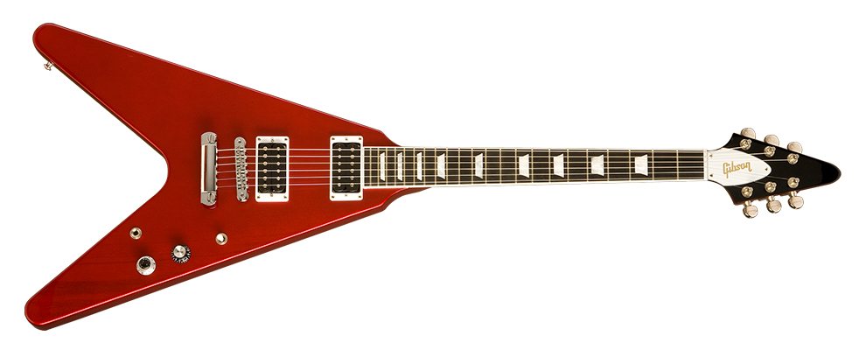
5 . 1 – 1 0
Harps ~ kithara - pre-guitars

Slide 25
5 . 1 – 1 0

Slide 26
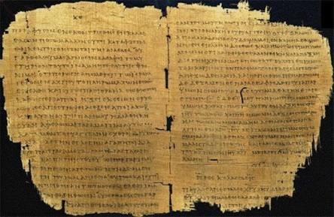
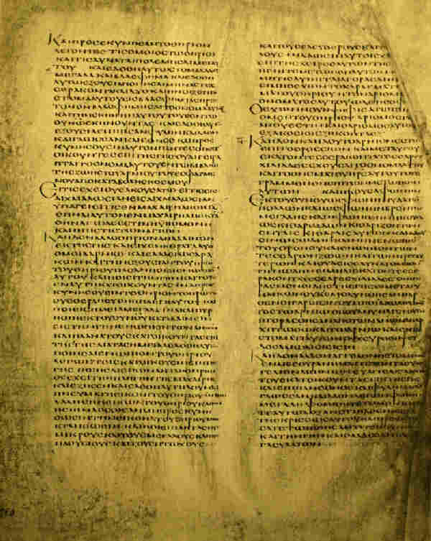
5 . 1 – 1 0
Redeemed us to God by Your blood
NIV ~ and with your blood you purchased men for God
NASB ~ and purchased for God with Your blood men
Sinaiticus reads "us"
Only Alexandrinus omits "us" (dated from the 5th century)

Slide 27
5 . 1 – 1 0
Rev. 1:6 ~ and has made us kings and priests to His God and Father, to Him be glory and dominion forever and ever. Amen.

Slide 28
5 . 1 – 1 0

Slide 29
5 . 1 – 1 0
Rom. 14:7 ~ for the kingdom of God is not eating and drinking, but righteousness and peace and joy in the Holy Spirit.

Slide 30
5 . 1 – 1 0

