Slide 1

A free CD of this message will be available following the service
4 . 2 – 1 1
This message will also be available for podcast later in the week a calvaryokc.com

Slide 2
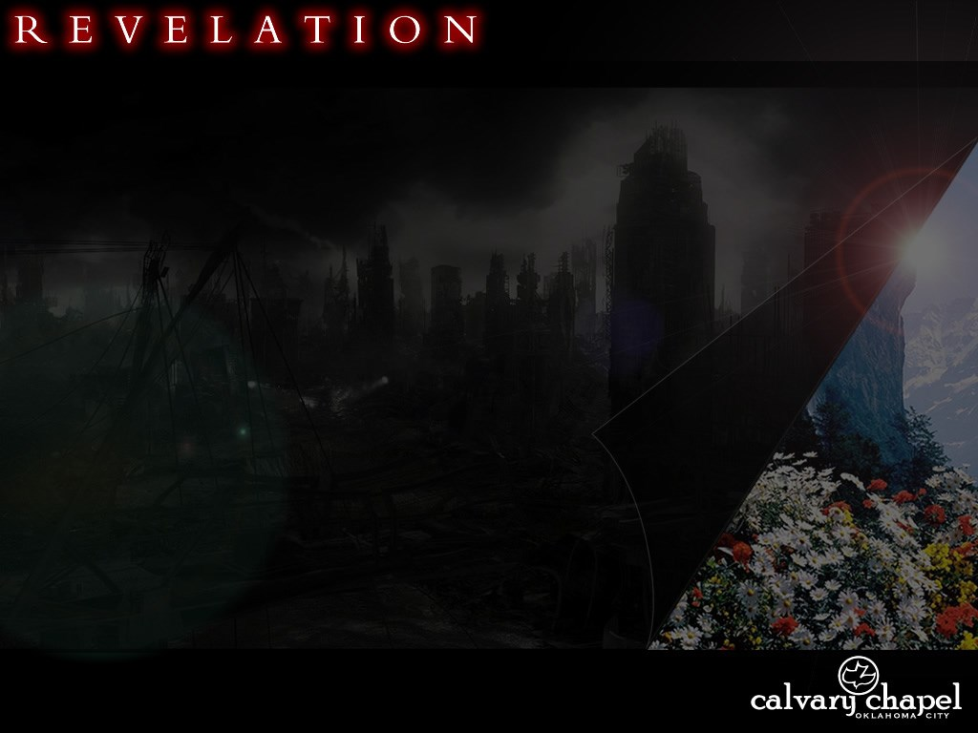
4 . 2 – 1 1
Throne ~ thronos – 14x in chapter 4 (46x in book)
G. Campbell Morgan ~ “While there may be many differing interpretations, the fundamental truths are self-evident. At the center of everything is an occupied throne.”

Slide 3
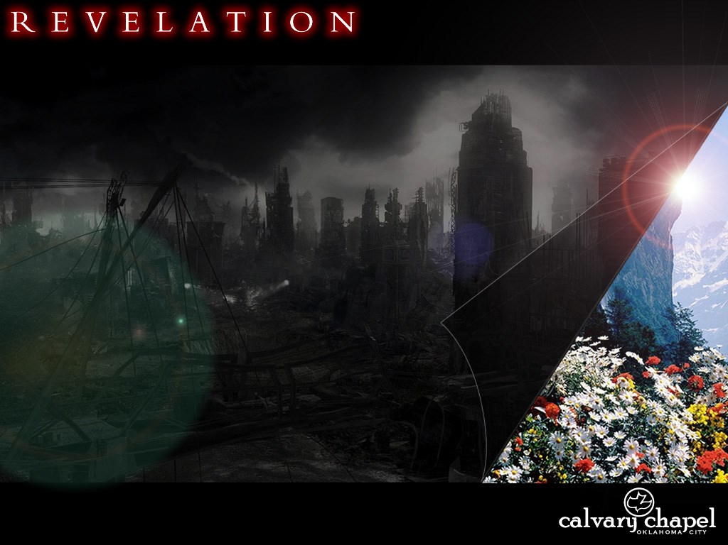
4 . 2 – 1 1

Slide 4
4 . 2 – 1 1
Elders ~ presbuteros
Crowns ~ stephanos
Jay Adams ~ "They are here to create the proper effect. Later in the book, they help carry the story forward, much as the chorus in a Greek tragedy. … Beyond this, they seem to do nothing, and represent nothing."

Slide 5
4 . 2 – 1 1

Slide 6
4 . 2 – 1 1
Heb 9:23 ~ Therefore it was necessary that the copies of the things in the heavens should be purified with these, but the heavenly things themselves with better sacrifices than these.

Slide 7
4 . 2 – 1 1
150 '
Ark
Table of Showbread
Salvation
Golden Altar
Menorah
Cleansing
75'
15 '
45 '
Bronze Laver
(Sea)
Bronze Altar

Slide 8
4 . 2 – 1 1
Four living creatures ~ zōa – literally "livings”
KJV ~ living beasts
Message ~ Four Animals

Slide 9
4 . 2 – 1 1

Slide 10
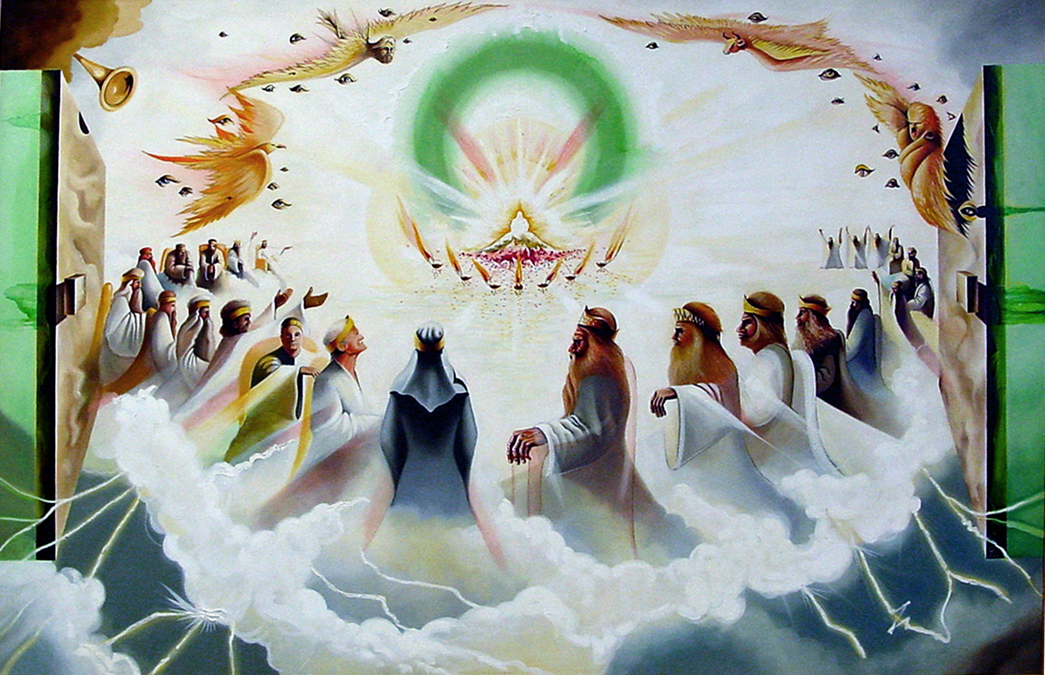
4 . 2 – 1 1

Slide 11
4 . 2 – 1 1

Slide 12
4 . 2 – 1 1
Comparison of the Beings in Eze. 1, Is. 6 and Rev. 4
Ref.
Eze. 1
Is. 6
Rev. 4
Living creatures
Identity
Cherubim
Seraphim
4 different faces
Faces
4 faces each
N/A
Wings
4 wings
6 wings
6 wings
Speech
N/A
Holy 3x
Holy 3x
Covering the creatures
Eyes
W/I the rims
N/A

Slide 13
4 . 2 – 1 1
108100
Dan
67200
Naphtali
53400
Ephraim - calf
Benjamin
35400
Mark
Manasseh
32200
Asher
41500
Ephraim
40500
Dan - eagle
John
151450
Levites
157600
Tabernacle
Reuben - man
Luke
Judah
74600
Simeon
59300
Judah - lion
Issachar
54400
Matt
Gad
45650
Reuben
46500
Zebulun
57400
N
186400

Slide 14
4 . 2 – 1 1

Slide 15
4 . 2 – 1 1
1 Jn. 3:2 ~ Beloved, now we are children of God; and it has not yet been revealed what we shall be, but we know that when He is revealed, we shall be like Him, for we shall see Him as He is.
Phil. 3:20-21 ~ ²⁰ For our citizenship is in heaven, from which we also eagerly wait for the Savior, the Lord Jesus Christ, ²¹ who will transform our lowly body that it may be conformed to His glorious body, according to the working by which He is able even to subdue all things to Himself.

Slide 16
4 . 2 – 1 1

