Slide 1
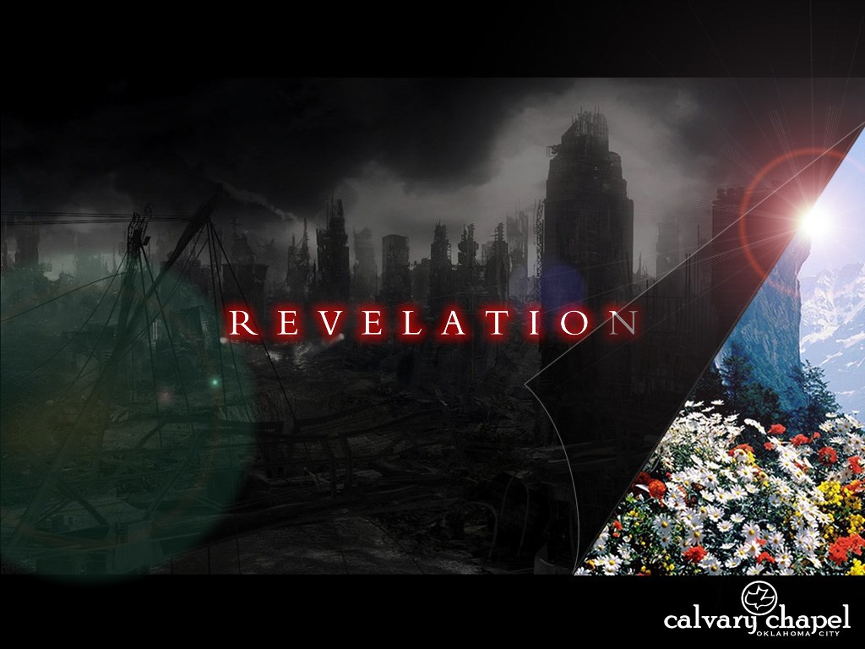
A free CD of this message will be available following the service
4 . 1
This message will also be available for podcast later in the week a calvaryokc.com

Slide 2
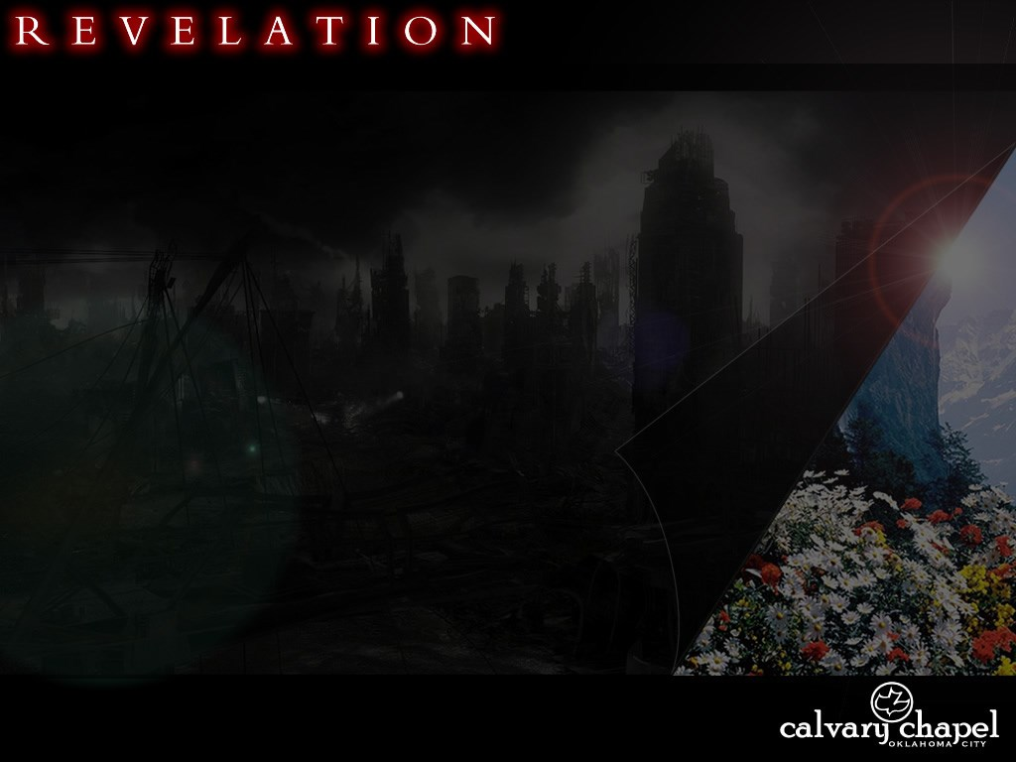
4 . 1
Lu. 17.26 ~ And as it was in the days of Noah, so it will be also in the days of the Son of Man…
Gen. 6.5-6 ~ ⁵ Then the Lord saw that the wickedness of man was great in the earth, and that every intent of the thoughts of his heart was only evil continually. ⁶ And the Lord was sorry that He had made man on the earth, and He was grieved in His heart.

Slide 3
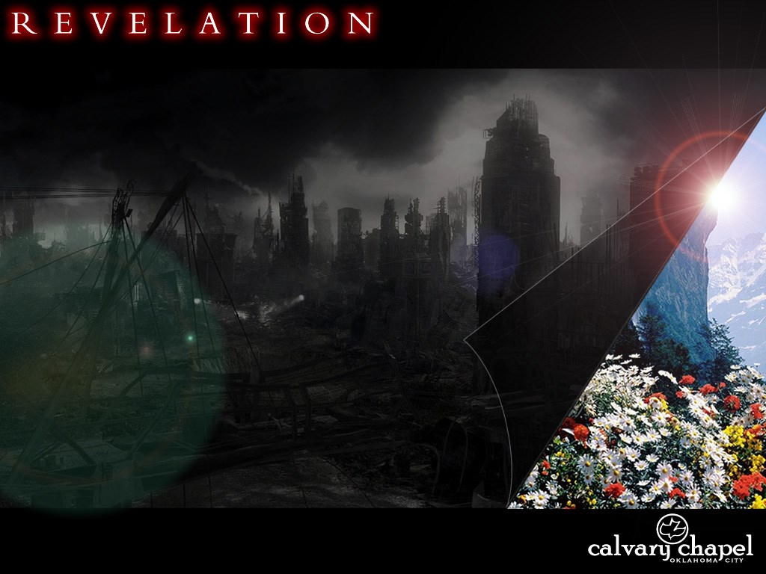
4 . 1

Slide 4



4 . 1
And a Happy New Year
Buy your
own gift.
Love,
Annabelle

Slide 5
4 . 1

Slide 6
4 . 1
Revelation 1.19 ~
Things which you have seen ~ chapter 1
Things which are ~ chapters 2-3
Things which will take place after this ~ chapters 4-22

Slide 7
4 . 1

Slide 8
4 . 1
After these things ~ meta tauta
After this ~ meta tauta

Slide 9
4 . 1

Slide 10
4 . 1
Rapture Primer
Webster's ~ 1. An elementary textbook. 2. A book covering the basic elements of a subject.
“The word Rapture doesn’t occur in the Bible”
Neither does the word Trinity
Or even the word Bible
Neither does the word Bible

Slide 11
4 . 1
1 Thess. 4.17 ~ Then we who are alive and remain shall be caught up together with them in the clouds to meet the Lord in the air. And thus we shall always be with the Lord.
Caught up – harpazō, to take away by force, to snatch
rapio, M. L. ~ raptura
Neither does the word Bible

Slide 12
4 . 1

Slide 13
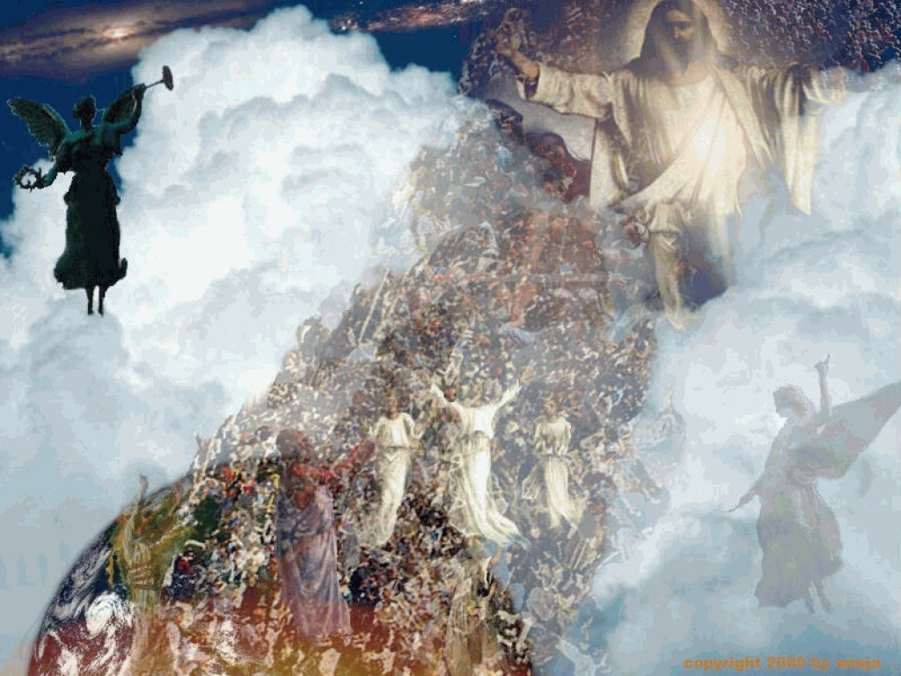
4 . 1
Merriam-Webster ~ “the final assumption of Christians into heaven during the end-time according to Christian theology.”

Slide 14
4 . 1

Slide 15
4 . 1
“The rapture is an event that will take place very soon and very suddenly. It will be the most astonishing event in the history of the world which will turn the entire planet on its head. The Bible teaches this very clearly and it is the hope of every believer in the Lordship of Jesus Christ to be among those who experience the rapture."
"Let me make a very clear statement. The idea of the rapture, as described in the Left Behind books and described by certain fundamentalist churches especially in the United States, is completely fictional. It has absolutely no basis in reality."

Slide 16
4 . 1

Slide 17
4 . 1
1) 2 Thess. 5:2-3 ~ For you yourselves know perfectly that the day of the Lord so comes as a thief in the night. For when they say, “Peace and safety!” then sudden destruction comes upon them, as labor pains upon a pregnant woman. And they shall not escape.
They ~ not we … them, not us

Slide 18
4 . 1
2) Imminent Return
Matt. 24.44 ~ Therefore you also be ready, for the Son of Man is coming at an hour you do not expect.

Slide 19
4 . 1
3) Prepare for Christ's appearing, not Antichrist's
Titus 2:11-13 ~ ¹¹ For the grace of God that brings salvation has appeared to all men, ¹² teaching us that, denying ungodliness and worldly lusts, we should live soberly, righteously, and godly in the present age, ¹³ looking for the blessed hope and glorious appearing of our great God and Savior Jesus Christ,

Slide 20
4 . 1
4) Lot (Gen. 19)
2 Pet. 2.9 ~ then the Lord knows how to deliver the godly out of temptations and to reserve the unjust under punishment for the day of judgment,

Slide 21
4 . 1
5) Rahab was saved from the destruction at Jericho
Josh. 6.17 ~ Now the city shall be doomed by the LORD to destruction, it and all who are in it. Only Rahab the harlot shall live, she and all who are with her in the house, because she hid the messengers that we sent.

Slide 22
4 . 1
6) Is. 57.1 ~ The righteous perishes,
And no man takes it to heart;
Merciful men are taken away, While no one considers
That the righteous is taken away from evil.
7) Daniel's "absence" in Daniel 3

Slide 23
4 . 1
8) Daniel's "70th week"
Dan. 9.24 ~ Seventy weeks are determined For your people and for your holy city, To finish the transgression, To make an end of sins, To make reconciliation for iniquity, To bring in everlasting righteousness, To seal up vision and prophecy, And to anoint the Most Holy.

Slide 24
4 . 1
9) Col. 3.4 ~ When Christ who is our life appears, then you also will appear with Him in glory.
10) 1 Thess. 4.14-17 ~ ¹⁴ For if we believe that Jesus died and rose again, even so God will bring with Him those who sleep in Jesus.¹⁵ For this we say to you by the word of the Lord, that we who are alive and remain until the coming of the Lord will by no means precede those who are asleep. ¹⁶ For the Lord Himself will descend from
1 Thess. 4.14-17 ~ heaven with a shout, with the voice of an archangel, and with the trumpet of God. And the dead in Christ will rise first. ¹⁷ Then we who are alive and remain shall be caught up together with them in the clouds to meet the Lord in the air. And thus we shall always be with the Lord.

Slide 25
4 . 1
11) Not appointed unto wrath
1 Thess. 5.9-11 ~ ⁹ For God did not appoint us to wrath, but to obtain salvation through our Lord Jesus Christ, ¹⁰ who died for us, that whether we wake or sleep, we should live together with Him. ¹¹ Therefore comfort each other and edify one another, just as you also are doing.

Slide 26
4 . 1
12) The Holy Spirit indwelling the Church
2 Thess. 2.7 ~ For the mystery of lawlessness is already at work; only He who now restrains will do so until He is taken out of the way.

Slide 27
4 . 1
13) Church in Philadelphia
Rev. 3.10 ~ Because you have kept My command to persevere, I also will keep you from the hour of trial which shall come upon the whole world, to test those who dwell on the earth.
Keep ~ tēreō
From ~ ek – out of
Hour ~ hora – period of time

Slide 28
4 . 1
14) Absence of the Church
Mentioned 19x in 1-3; not once in 6-19
Church is a mystery (hidden) in the Old Testament
15) Rev. 4.1 ~ after these things – meta tauta (2x)
16) 24 elders
Rev. 4.10 ~ crowns – stephanos
Rev. 5.9-10 – song of redemption ("You have redeemed us")

Slide 29
4 . 1
17)1 Cor. 12.27 ~ Now you are the body of Christ, and members individually
18) Rev. 13.9 ~ If anyone has an ear, let him hear.

Slide 30
4 . 1

Slide 31
4 . 1
Epistle of Barnabas (ca. AD 100) 15:3-6, 9 ~ ³ Of the Sabbath He speaketh in the beginning of the creation; And God made the works of His hands in six days, and He ended on the seventh day, and rested on it, and He hallowed it. ⁴ Give heed, children, what this meaneth; He ended in six days. He meaneth this, that in six thousand years the Lord shall bring all things to an end; for the day with Him
signifyeth a thousand years; and this He

Slide 32
4 . 1
He himself beareth me witness, saying; Behold, the day of the Lord shall be as a thousand years. Therefore, children, in six days, that is in six thousand years, everything shall come to an end. ⁵ And He rested on the seventh day. this He meaneth; when His Son shall come, and shall abolish the time of the Lawless One, and shall judge the ungodly, and shall
change the sun and the moon and the stars, then shall he truly rest on the

Slide 33
4 . 1
seventh day. ⁶ Yea and furthermore He
saith; Thou shalt hallow it with pure hands and with a pure heart. If therefore a man is able now to hallow the day which God hallowed, though he be pure in heart, we have gone utterly astray …
⁹ Wherefore also we keep the eighth day for rejoicing, in the which also Jesus rose from the dead, and having been manifested ascended into the heavens.

Slide 34
4 . 1

Slide 35
4 . 1
Shepherd of Hermas (ca. AD 100), Vision 4, chapter 2 ~
"Go, therefore, and tell the elect of the Lord His mighty deeds, and say to them that this beast is a type of the great tribulation that is coming. If then ye prepare yourselves, and repent with all your heart, and turn to the Lord, it will be possible for you to escape it, if your heart be pure and spotless, and ye spend the rest of the days of your life in serving the

Slide 36
4 . 1
Lord blamelessly. Cast your cares upon the Lord, and He will direct them. Trust the Lord, ye who doubt, for He is all-powerful, and can turn His anger away from you, and send scourges on the doubters. Woe to those who hear these words, and despise them: better were it for them not to have been born.”

Slide 37
4 . 1

Slide 38
4 . 1
Irenaeus, Against Heresies, (ca. AD 175) book 5, chapter 29 ~ And therefore, when in the end the Church shall be suddenly caught up from this, it is said, “There shall be tribulation such as has not been since the beginning, neither shall be …”

Slide 39
4 . 1

Slide 40
4 . 1
Morgan Edwards (1722-1795) "... the dead saints will be raised, and the living changed at Christ's 'appearing in the air' (I Thess. iv. 17); and this will be about three years and a half before the millennium, as we shall see hereafter: but will he and they abide in the air all that time? No: they will ascend to paradise, or to some one of those many 'mansions in the father's house' (John xiv. 2), and so

Slide 41
4 . 1
disappear during the foresaid period of
time. The design of this retreat and disappearing will be to judge the risen and changed saints; for 'now the time is come that judgment must begin,' and that will be 'at the house of God' (I Pet. iv. 17)..." (source: Dr. Thomas Ice)

Slide 42
4 . 1

Slide 43
4 . 1
Dan. 12.4 ~ But you, Daniel, shut up the words, and seal the book until the time of the end; many shall run to and fro, and knowledge shall increase.
Dan. 12.9 ~ And he said, "Go your way, Daniel, for the words are closed up and sealed till the time of the end."

Slide 44
4 . 1

Slide 45
4 . 1
"Oh no, it's the Rapture! Quick, Marge, get Bart out of the house before God comes!" – Homer Simpson

Slide 46
4 . 1

Slide 47

4 . 1
www.aftertherapturepetcare.com

Slide 48
4 . 1

Slide 49
4 . 1
1 Cor. 15.52 ~ in a moment, in the twinkling of an eye, at the last trumpet. For the trumpet will sound, and the dead will be raised incorruptible, and we shall be changed.
Moment ~ atomos – that which cannot be cut in two, indivisible

Slide 50
4 . 1

