Slide 1
A free CD of this message will be available following the service
3 . 7 – 1 3
This message will also be available for podcast later in the week at calvaryokc.com

Slide 2
3 . 7 – 1 3
Revelation 1:19 ~
Things which you have seen ~ chapter 1
Things which are ~ chapters 2-3
Things which will take place after this ~ chapters 4-22

Slide 3
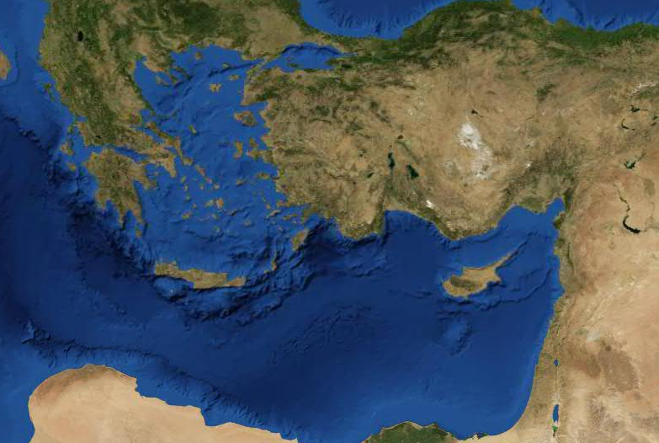
3 . 7 – 1 3
Pergamos
Thyatira
Sardis
Asia
Smyrna
Philadelphia
Patmos
Laodicea
Ephesus

Slide 4
3 . 7 – 1 3
Laodicea 1800 – Present
Philadelphia 1800 - Present
Sardis 1517 - Present
Thyatira 590 - Present
Pergamos 314 - 590
Smyrna 100 - 314
Ephesus 32 - 100
200
400
600
800
1000
1200
1400
1600
1800
2000

Slide 5
3 . 7 – 1 3

Slide 6
3 . 7 – 1 3
Philadelphia ~ philos (strong affection) + adelphos (brother)

Slide 7
3 . 7 – 1 3

Slide 8
3 . 7 – 1 3
Two words for true:
alēthēs
~ true as opposed to false
alethēnos
~ true as opposed to fake

Slide 9
3 . 7 – 1 3

Slide 10
3 . 7 – 1 3
Matt. 5:3 ~Blessed are the poor in spirit, For theirs is the kingdom of heaven.

Slide 11
3 . 7 – 1 3

Slide 12
3 . 7 – 1 3
Barna research on beliefs of "born-again Christians"
52% do not believe Holy Spirit is a living entity
27% have been divorced
25 % believe in Universalism
45% do not believe the devil exists
26 % believe all religions teach the same essential beliefs
10% believe in reincarnation
40 % believe Christians and Muslims worship the same God
29% believe in communicating with the dead
33% believe in same sex unions
39% believe cohabitation is morally acceptable

Slide 13
3 . 7 – 1 3

Slide 14
3 . 7 – 1 3
Oswald Chambers ~ Faith is not a pathetic sentiment, but a robust, vigorous confidence built on the fact that God is holy love. You cannot see Him just now, you cannot understand what He is doing, but you can know Him. Shipwreck occurs where there is not that mental poise which comes from being established on the eternal truth that God is holy love. Faith is the heroic effort of your life; you fling yourself in reckless confidence on God.

Slide 15
3 . 7 – 1 3

Slide 16
3 . 7 – 1 3
Keep ~ tēreō – to keep or watch
From ~ ek – out of
Hour ~ hōra – period of time
Dwell on the earth ~ katoikountas epi tēs gēs
Occurs 10x in Revelation
Always refers to those in rebellion to God

Slide 17
3 . 7 – 1 3

Slide 18
3 . 7 – 1 3
When God wants to drill a man,
And thrill a man,
And skill a man
When God wants to mold a man
To play the noblest part;
When He yearns with all His heart
To create so great and bold a man
That all the world shall be amazed,
Watch His methods, watch His ways!

Slide 19
3 . 7 – 1 3
How He ruthlessly perfects
Whom He royally elects!
How He hammers him and hurts him,
And with mighty blows converts him
Into trial shapes of clay which
Only God understands;
While his tortured heart is crying
And he lifts beseeching hands!

Slide 20
3 . 7 – 1 3
How He bends but never breaks
When his good He undertakes;
How He uses whom He chooses,
And which every purpose fuses him;
By every act induces him
To try His splendor out-
God knows what He's about
– Author Unknown

Slide 21
3 . 7 – 1 3

Slide 22
3 . 7 – 1 3
Warren Weirsbe ~ "There were both opportunities and obstacles! Unbelief sees the obstacles, but faith sees the opportunities! And since the Lord holds the keys, He is in control of the outcome! So what do we have to fear? Nobody can close the doors as long as He keeps them open. Fear, unbelief, and delay have caused the church to miss many God-given opportunities."

Slide 23
3 . 7 – 1 3

Slide 24
3 . 7 – 1 3
David Guzik ~ "This is not a crown of royalty, given because of royal birth. This is a crown of victory. Jesus encourages His saints to finish their course with victory, to 'play the second half' just as strongly as they 'played the first half.'"
Vance Havener ~ “Never forget that the man most likely to steal your crown is yourself. ‘Keep thy heart with all diligence, for out of it are the issues of life’ (Proverbs 4:23). You are in no greater danger from anyone or anything than from yourself.”

Slide 25
3 . 7 – 1 3

