Slide 1

A free CD of this message will be available following the service
3 . 1 - 6
This message will also be available for podcast later in the week a calvaryokc.com

Slide 2
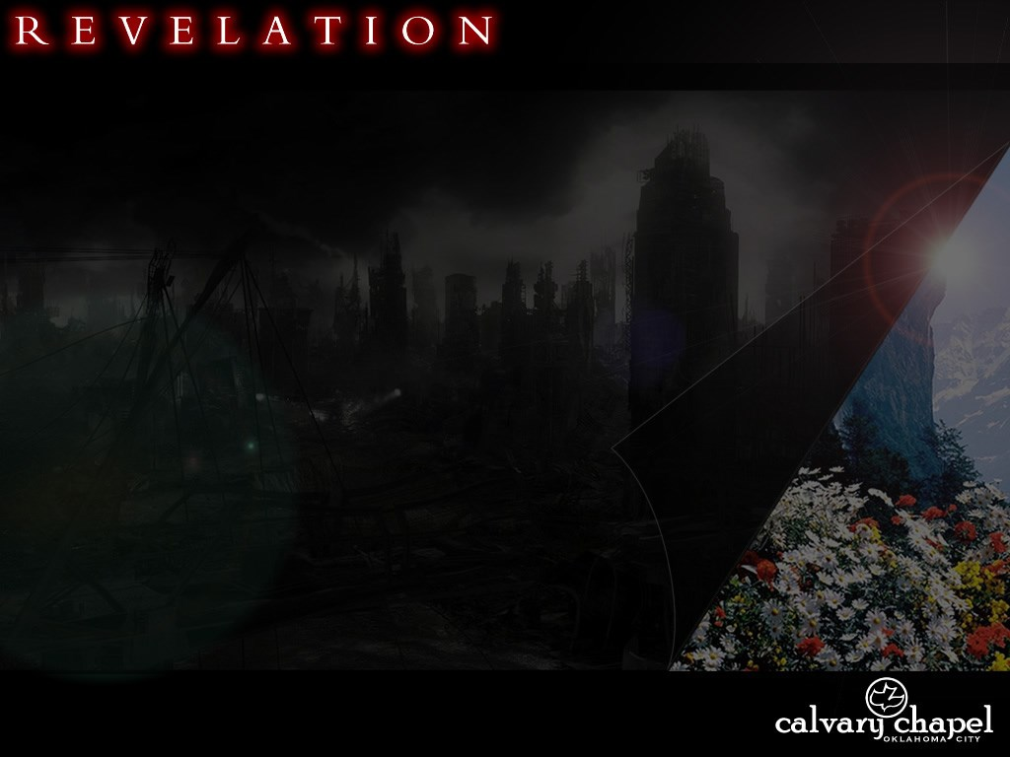
3 . 1 - 6
Revelation 1:19 ~
Things which you have seen ~ chapter 1
Things which are ~ chapters 2-3
Things which will take place after this ~ chapters 4-22

Slide 3
3 . 1 - 6
Laodicea 1800 – Present
Philadelphia 1800 - Present
Sardis 1517 - Present
Thyatira 590 - Present
Pergamos 314 - 590
Smyrna 100 - 314
Ephesus 32 - 100
200
400
600
800
1000
1200
1400
1600
1800
2000

Slide 4
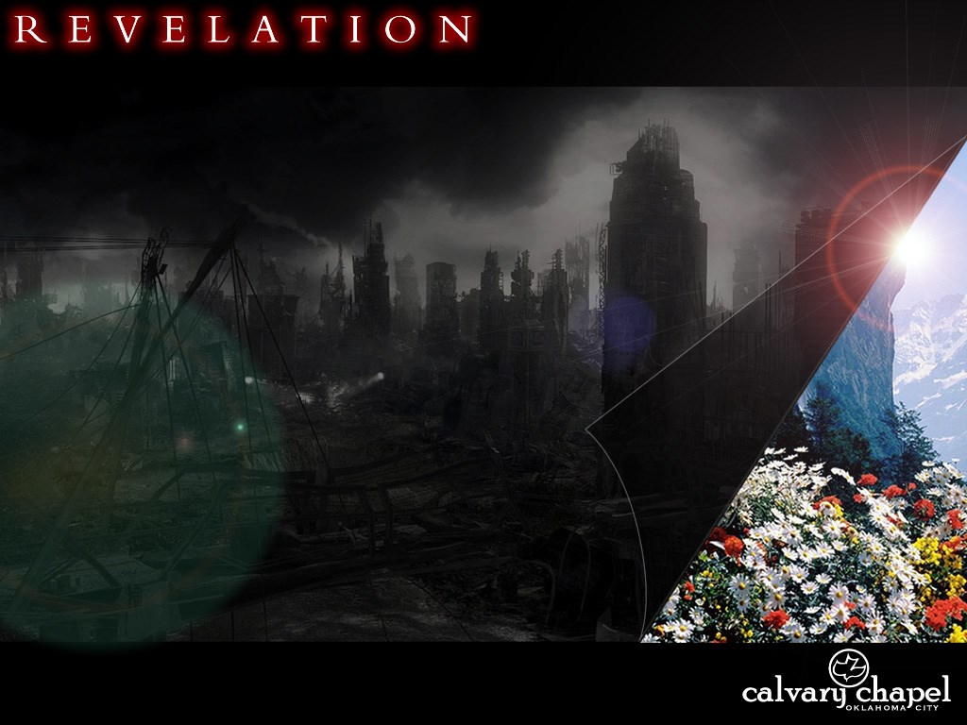
3 . 1 - 6

Slide 5
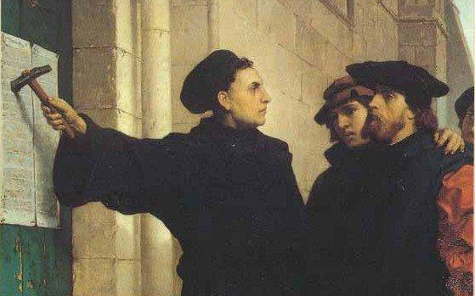
3 . 1 - 6
October 31, 1517

Slide 6
3 . 1 - 6

Slide 7
3 . 1 - 6
Seven Spirits ~ i.e. the seven-fold Spirit (Is. 11:2-3)
¹ There shall come forth a Rod from the stem of Jesse, And a Branch shall grow out of his roots. ² The Spirit of the LORD shall rest upon Him, The Spirit of wisdom and understanding, The Spirit of counsel and might, The Spirit of knowledge and of the fear of the LORD. ³ His delight is in the fear of the LORD, And He shall not judge by the sight of His eyes, Nor decide by the hearing of His ears;

Slide 8
3 . 1 - 6

Slide 9
3 . 1 - 6
Ray Stedman ~ "Mild-mannered people, meeting in mild-mannered ways, striving to be more mild-mannered."

Slide 10
3 . 1 - 6

Slide 11

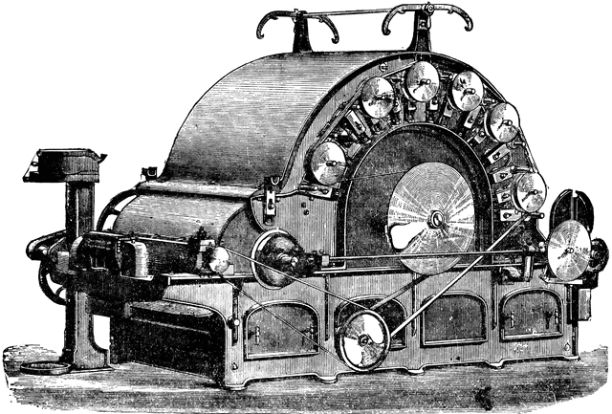
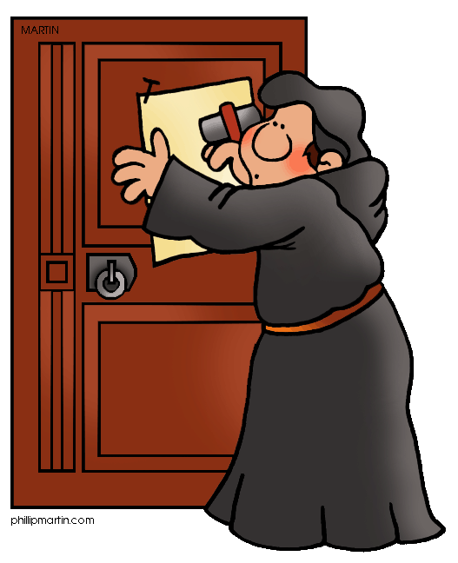

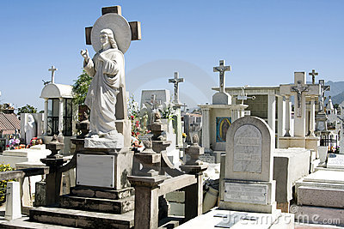
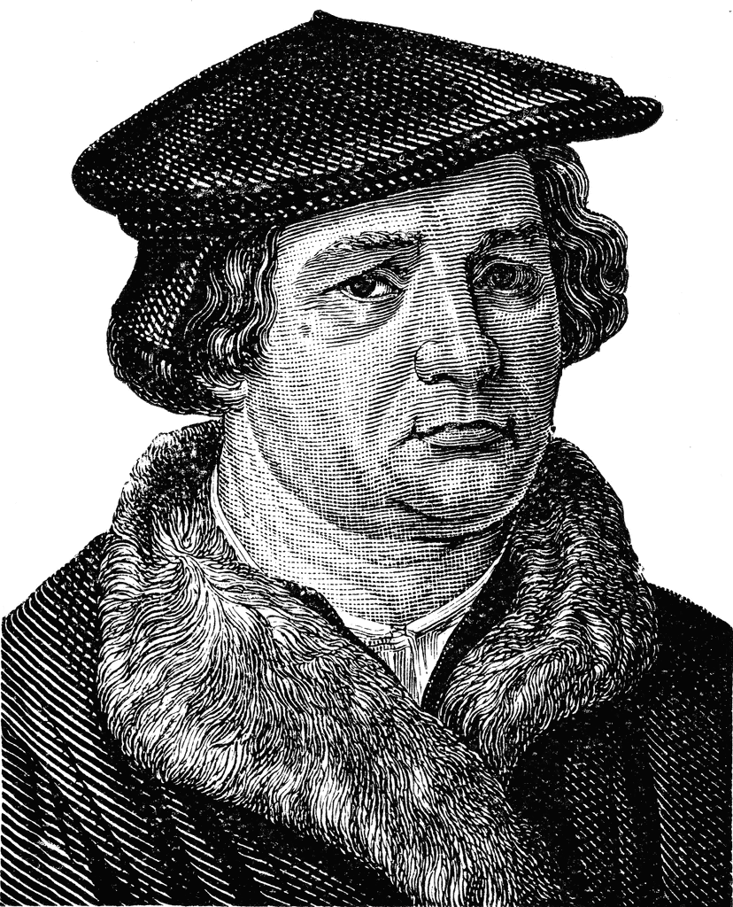
3 . 1 - 6
Movement
Machine
Monument
Ministry
Mausoleum
Man

Slide 12
3 . 1 - 6

Slide 13
3 . 1 - 6
Sola scriptura
Sola fide
Sola gratia
Scripture alone
Faith alone
Grace alone

Slide 14
3 . 1 - 6

Slide 15
3 . 1 - 6
William Barclay ~ "A church is in danger of death when it begins to worship its own past; when it is more concerned with forms than with life; when it loves systems more than it loves Jesus; when it is more concerned with material than it is with spiritual things."

Slide 16
3 . 1 - 6
Remember ~ present tense
Be remembering (Wuest)
How ~ NASB, NIV, ESV; what (weak)
RSV ~ in what way

Slide 17
3 . 1 - 6

Slide 18
3 . 1 - 6
Not ~ ou + mē – literally no, no

Slide 19
3 . 1 - 6

Slide 20
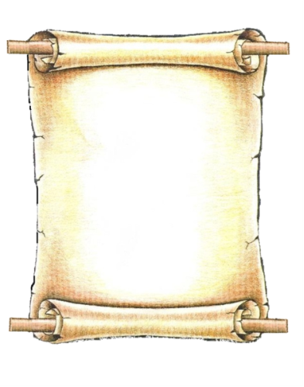

3 . 1 - 6
Book of Life
Bill
Suzy
Poindexter
Mabel
John

Slide 21
3 . 1 - 6

